Slide 1
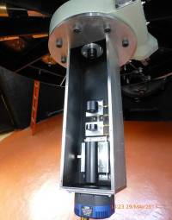
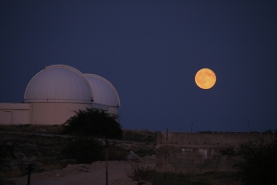
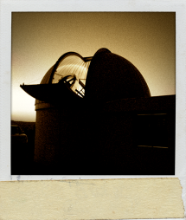
CAPS @ C2PU
Calern Asteroids Polarimetric Survey @
Center for Pedagogy in Planetary and Universe sciences
J.-P. Rivet, Ph. Bendjoya, L. Abe, O. Suarez
Observatoire de la Côte d’Azur, CNRS, Université de Nice-Sophia Antipolis
In collaboration with:
A. Cellino, C. Pernechele, G. Massone
INAF, Osservatorio Astrofisico di Torino

Slide 2
Outline
What is C2PU ?
What is CAPS ?
Current status of CAPS
http://c2pu.oca.eu

Slide 3
C2PU in a nut shell...
An infrastructure both for research and for educational outreach in experimental astrophysics and geophysics
Several astrophysical research programs
Immersion of students groups in real research programs
Complete refurbishing of two «1 meter-class» telescopes ➔ Astrophysics
Specific characteristics of the Plateau de Calern region ➔ Geophysics
Partial Remote Access

Slide 4
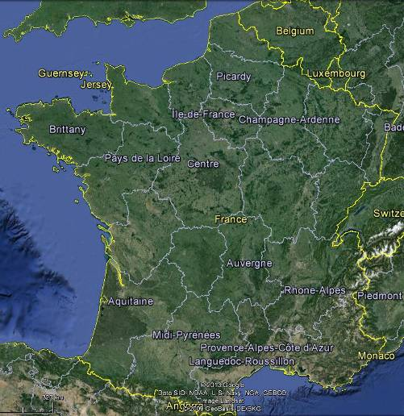
Where is it ?
Alpes Maritimes (06)
France
60 km from Nice (France)
Altitude: 1260m
Latitude: 43° 45′ 13.60″ N
Longitude : 06° 55′ 22.07″ E
Nb. of observable nights (more
than 2hrs clear) per year: ~180,
70% of which are totally clear. *
From June to October:
50% nights with seeing < 1.25’’
20% nights with seeing < 1’’
* Average over 10 years (1985 to 1995)
D. Bonneau, J.A.F. 52, p. 35, 1996

Slide 5
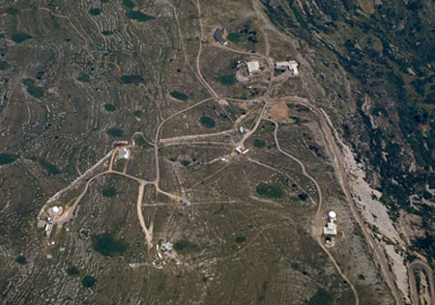
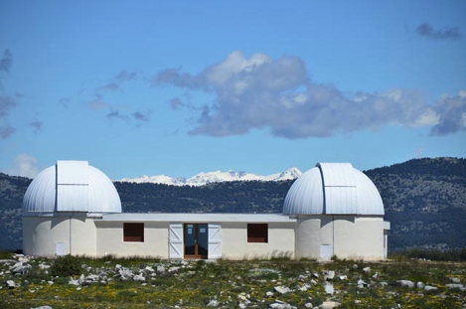
Where is it ?
Plateau de Calern Observatory
Epsilon@C2PU
C2PU
West
East
Omicron@C2PU

Slide 6
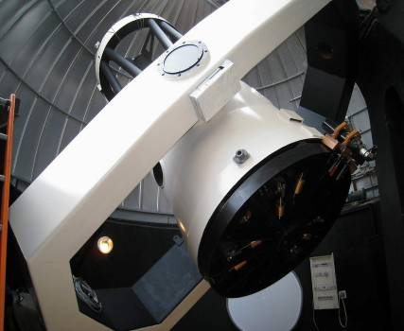
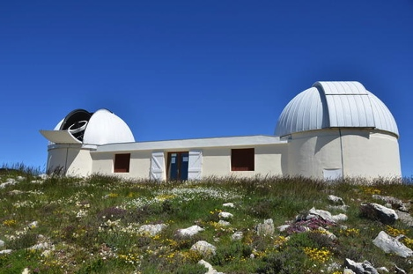
What is it ?
Two 104 cm telescopes with yoke equatorial mounts:
East “Epsilon” Telescope:
Cassegrain F/12.5 + “Coudé” F/30 (refurbishing in progress)
West “Omicron” Telescope:
Primary F/3.2 + Cassegrain F/12.5 (in operation now)
Also known as:
“ V.S.T ” ;-)

Slide 7
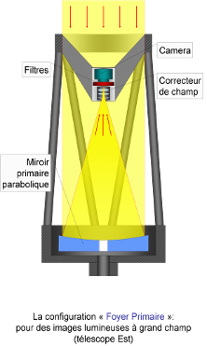
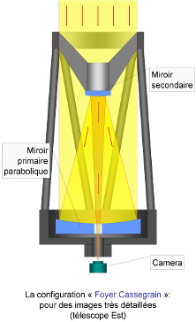
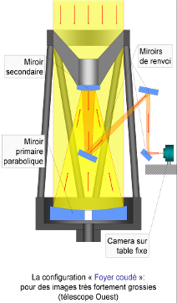
What is it ?
A “Swiss Knife” for Astronomy
Omicron telescope
Epsilon telescope
Primary F/3.2 focus
with 3-lens Wynne corrector
Secondary F/12.5 focus
(Cassegrain)
Coudé F/30 focus

Slide 8
How we did it ?
We had :
Two telescopes (mounts + domes) without optics
Originally for interferometry: very stable yoke mounts (but pointing limitations)
Two Zerodur® blanks (108cm)
David Vernet (Collège de France): polished several
high quality mirrors for A. Labeyrie…
Two workshops for mechanical design and construction
One “Hotel” with about 24 beds + Catering service
Collaboration with A. Cellino et al.
We have :
One telescope (West, Omicron) completely refurbished
Semi-remote controlled through internet
CAPS polarimeter on it
We plan :
Full-remote control of the West Telescope
Second telescope (East, Epsilon) fully featured
PISCO speckle camera on it

Slide 9
Who participated ?
Observatoire de la Côte d’Azur
Université de Nice – Sophie Antipolis
Collège de France
Région P.A.C.A.
Département des Alpes Maritimes

Slide 10
Equipments
Available
cameras :
1 CCD SBIG STX16803 4k × 4k (38’ FoV @ prime focus)
1 CCD QSI 632WS 2.1k × 1.5k (with filter wheel)
1 EMCCD Andor Ixon 897 512 × 512 (56fps full frame)
2 CCD SBIG ST402ME 765 × 510 (one with filter wheel)
1 CCD SBIG ST7XME 765 × 510
Equipment &
Instruments :
Meinberg GPS board (PCI bus) on a PC
2’’ Focal reducer for secondary Cassegrain focus
Filter sets
2 LHIRES III Spectrographs (2400,1200,300,150 gr/mm)
Custom Polarimeter: CAPS (design / manufacture / owner:
Osservatorio Astrofisico di Torino.)
Within 1 year: PISCO speckle camera (Collab. M. Scardia
Osservatorio Brera di Merate)
More detailed Information :
downloadable EXCEL spreadsheet from
https://c2pu.oca.eu/spip.php?article53

Slide 11
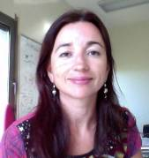
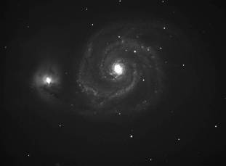
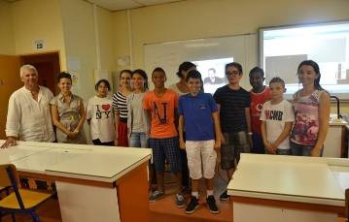
EDUCOSMOS
An extension of the C2PU concept to pre-university students
Leader: Olga SUAREZ
Secondary-school classes participate in a real research project
Teacher training provided by OCA
Preparation of teachers-students with the help of the EduCosmos team
Telescope remote access
First observations: 25 June 2013: remote control of Omicron@C2PU telescope by 13-year-old students from “Collège Vernier” (Nice, France)
Scope: asteroid photometry + data reduction; M51 imaging + data reduction
Sample image of M51
done by students
Ph. Bendjoya, the students
and Olga Suarez

Slide 12
Main science topics:
Asteroids / TNO occultations
Asteroids polarimetry (CAPS)
Asteroids photometry (rotators)
Transiting exoplanets discovery / survey
GAIA-FUN (astrometry, photometry)
Want some more details ?

Slide 13
C2PU status report
West “Omicron” Telescope:
Mechanics, Optics and Software: OK (June 2013)
F/12.5 focus: Fully operational
F/3.2 focus: Operational w/o filter wheel
CAPS polarimeter: Installed; calibration in progress
Remote access: Successfully tested (June 2013)
East “Epsilon” Telescope:
Primary mirror: Parabolization in progress (exp. Q1.2014)
Mechanics: Design of barrel in progress (exp. Q1.2014)
First light on F/12.5: Expected by the end of 2014
PISCO speckle camera: Installation expected mid 2014

Slide 14
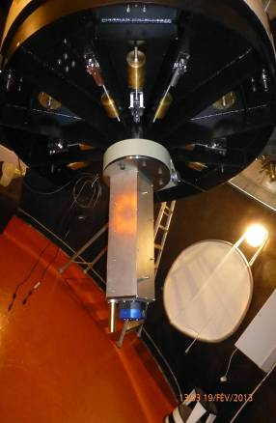
CAPS :
a Torinese polarimeter @ C2PU
(A. Cellino / C. Pernechele / G. Massone)
CAPS : Calern Asteroids Polarimetric Survey
a “simultaneous” polarimeter for asteroids
In collaboration with M. Devogele
Pernechele et al., “Device for optical linear polarization
measurements with a single exposure”, Proc. SPIE, 4843 (2003).
doi: 10.1117/12.466129
Pernechele et al., “A single-shot optical linear polarimeter for
asteroid studies”,, Proc. SPIE 8446, 84462H (2012)
doi: 10.1117/12.925933
Omicron@C2PUtelescope
(F/12.5 Cassegrain)
CAPS polarimeter

Slide 15
Optical design
(A. Cellino / C. Pernechele / G. Massone)
From the F/12.5
Cassegrain focus
Double Wollaston
Camera optics
Filter wheel
CCD camera
Collimated beam
Field stop
Collimator lens
Field lens
Gives I, Q, U
in a single shot
(not V)
Field stop
Double Wollaston’s face
with telescope’s pupil image
CCD sensor
QSI 632

Slide 16
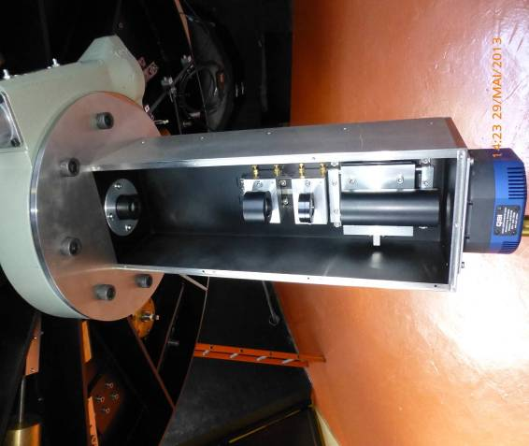
Layout
(A. Cellino / C. Pernechele / G. Massone)
Rotating stage
Camera optics
Double Wollaston
Field lens
Collimator lens
CCD camera
+ filter w.

Slide 17
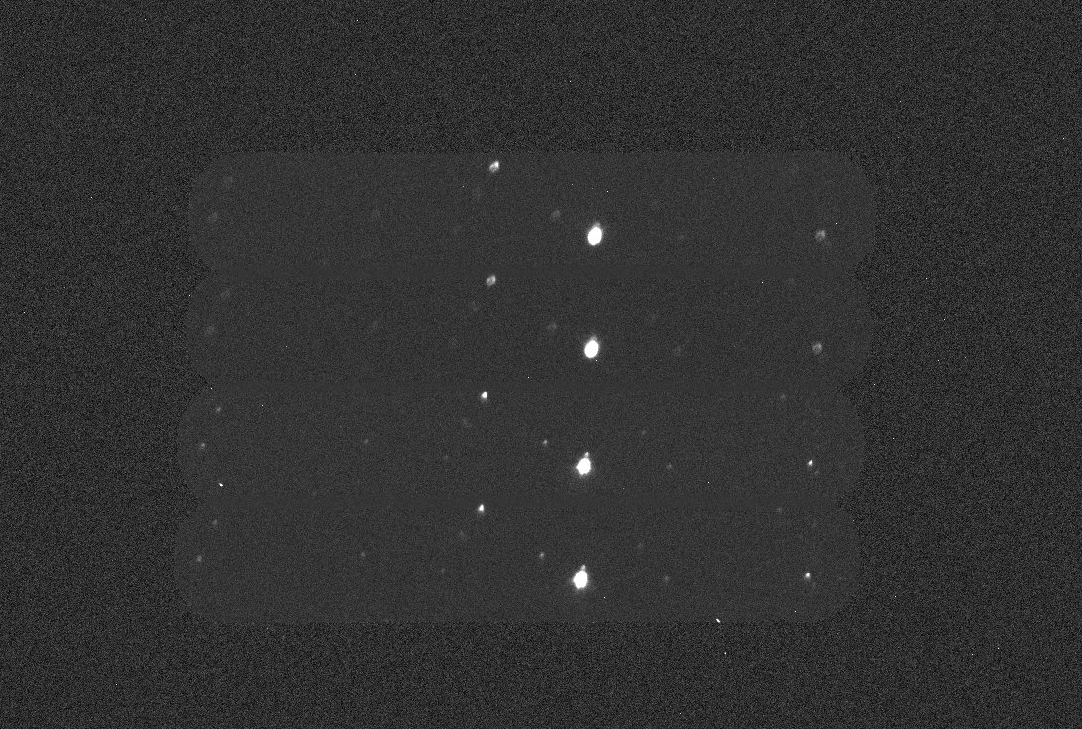
Sample science image
Focal length = 13000 mm x 0.5 = 6500 mm; 0.21’’ / pix
51 ‘’
5 ’
Mv = 12
Exp. = 60s
Binning 1x1
V filter →
Half dynamics
(30000 ADUs)
1472 pixels of 6.87 μm = 10.1 mm
2148 pixels of 6.87 μm = 14.7 mm

Slide 18
CAPS present status report
Entrance slit orientation adjusted
Collimator position adjusted at best (using auto-collimation)
Position of the camera optics adjusted accordingly
First “fully featured” on-sky tests: mid June 2013.
Light source
Diffusing mask
Slightly tilted mirror
BUT: the telescope’s entrance pupil image does not form exactly on the
double Wollaston prism, thus, polarimetric response may vary slightly
across the field of view.
AND the telescope’s entrance pupil image is not cut exactly 50/50 by the
double Wollaston prism’s edge, thus, the 0º-90º and 45º-135º channels
will have slightly different photometric throughputs.

Slide 19
CAPS present status report
Should be this way...
... but is this way:
offset
Telescope’s pupil image
sharp and centered
Pupil slightly off-axis
Pupil image forms too far (fuzzy
pupil image on Wollaston’s entrance)
Double Wollaston
entrance face

Slide 20
CAPS present status report
Image of Star #1
Image of Star #2
Beam of Star #1
(0º-90º enhanced)
Beam of Star #2
(45º-135º enhanced)
Different stars in the field make different beam footprints
on the double Wollaston → inhomogeneous and un-even
polarimetric throughputs
THUS:
GOOD FLAT FIELDING / CALIBRATION IS REQUIRED !

Slide 21
Flat-fielding strategies
Dome flats: hardly possible (dome too small).
Sky flats at fixed position w.r.t the Sun + polarimeter
rotation around its axis: possible, but entrance pupil
may not be perfectly symmetrical w.r.t the polarimeter’s
mechanical rotation axis → poor performances.
Sky flats at different positions w.r.t the Sun (same
angular distance, but different orientations) so that
sky polarization averages out: maybe OK, to be tested
(currently in progress)...
Flats on external panel: probably the best solution;
requires extra hardware → TBD !

Slide 22
Pure dome flats
In-dome diffusive screen
(difficult to light
with sufficient homogeneity
and low incidence angles).
CAPS
25-09-2013
COST meeting "PPSW", Firenze; Sept. 23-26, 2013
Slide 22

Slide 23
Sky flats + rotation
DAWN / DUSK
Fixed relative
position
Rotation of CAPS
w.r.t. the telescope
(0º, 45º, 90º, 135º)
horizon
CAPS
SUN
25-09-2013
COST meeting "PPSW", Firenze; Sept. 23-26, 2013
Slide 23

Slide 24
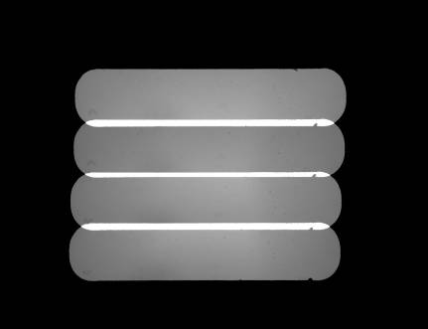
Sky flats + rotation
CONDITIONS:
during dusk (-18º < H_{sun} < 0º);
telescope at fixed position w.r.t. the Sun),
10 frames with CAPS’ ordinary axis at angle
0º w.r.t. the celestial North direction
10 frames with CAPS’ ordinary axis at angle
90º w.r.t. the celestial North direction
composition with level balancing
normalization to 1
thresholding
B, V and R filters.
Flat-fielding failed !
(too high Q and U on the “unpolarized” standard HD210027)
25-09-2013
25-09-2013
Slide 24
Slide 24

Slide 25
Why it failed...
Less light in
the 0º-90º channels
More light in
the 0º-90º channels
offset
0º position
90º position
→ sky polarization will not average-out exactly !
25-09-2013
COST meeting "PPSW", Firenze; Sept. 23-26, 2013
Slide 25

Slide 26
Sky flats at ≠ positions
DAWN / DUSK
TO BE TESTED…
Fixed angular
distance
horizon
CAPS
SUN
25-09-2013
COST meeting "PPSW", Firenze; Sept. 23-26, 2013
Slide 26

Slide 27
Flats on external panel
Diffusive screen
held outside the dome
TO BE TESTED…
LED spot on
the M2 support
CAPS
25-09-2013
COST meeting "PPSW", Firenze; Sept. 23-26, 2013
Slide 27

Slide 28
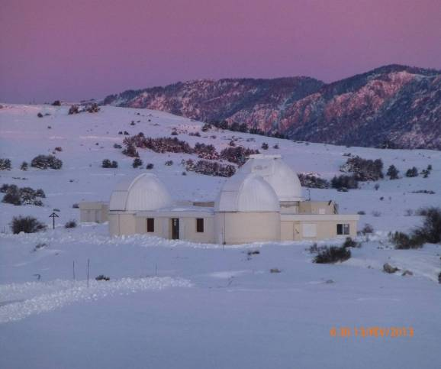
Thank you !
WEB site: c2pu.oca.eu
Email: c2pu@oca.eu

Slide 29
ADDITIONAL MATERIALS

Slide 30
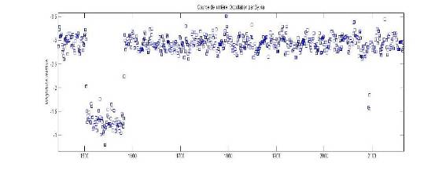
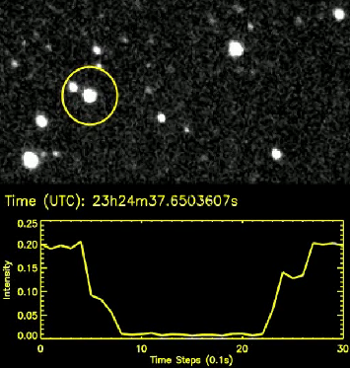
C2PU: Some results (I)
Occultation of TYC 1856-00745-1 (Mv=10.8)
by (87) Sylvia and its satellite (6 Jan. 2013)
Occultation of TYC 6255-00419-1 (Mv=11.1)
by (1271) Isergina (24 Jul. 2013)

Slide 31
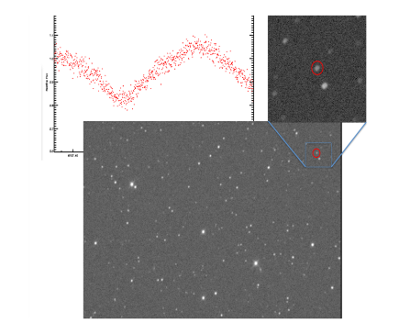
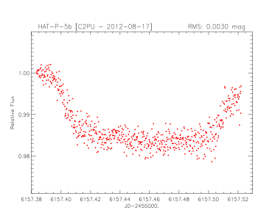
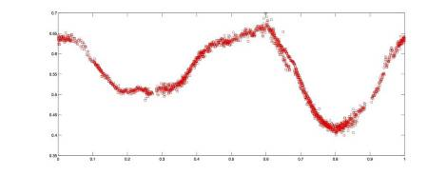
C2PU: Some results (II)
HAT-P-5b exoplanet transit
(2012/08 preliminary test observation)
New variable star discovered @C2PU
(729) Watsonia light curve ➔ T=25.1713 h
M. Devogèle, PhD student @ Liège/C2PU

Slide 32
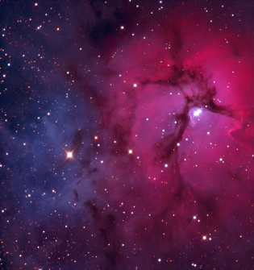
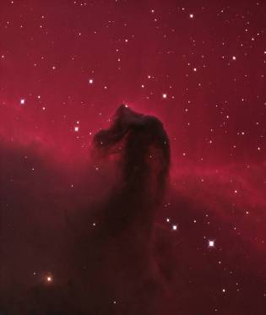
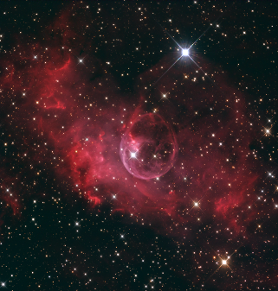
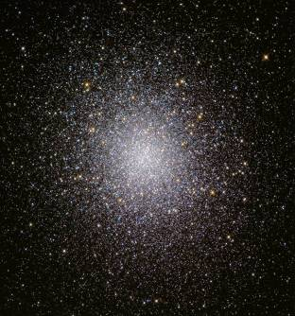
C2PU: Picture gallery (sample)
Some “first-light” pictures
from telescope Omicron@C2PU
F/3.2 primary focus
M20 “Trifid” nebula
“Horse head” nebula
NGC 7635 “Bubble” nebula
M13 “Herculis” globular cluster

Slide 33
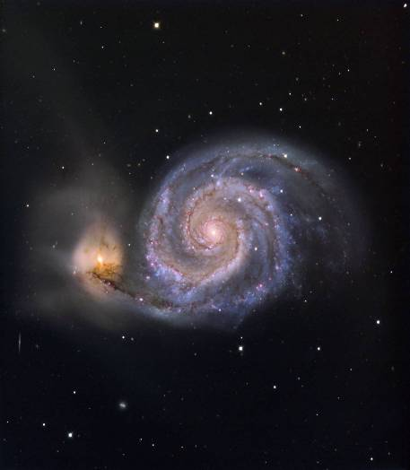
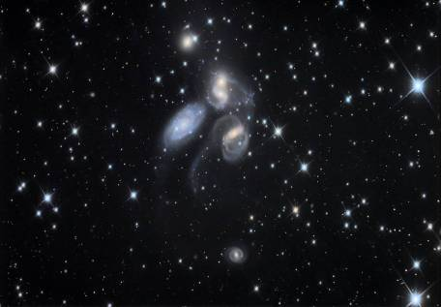
C2PU: Picture gallery (sample)
Some “first-light” pictures
from telescope Omicron@C2PU
F/3.2 primary focus
M51 galaxy
Stefan’s quintet

Slide 34
C2PU: Picture gallery (sample)
More at: c2pu.oca.eu/spip.php?rubrique24

