Slide 1
Linear and circular radio and optical polarization studies as a probe of AGN physics
I. Myserlis E. Angelakis (PhD advisor), L. Fuhrmann, V. Pavlidou, A. Kraus, I. Nestoras, V. Karamanavis,
J.A. Zensus, T. P. Krichbaum From the RoboPol team: O.G. King, A.N. Ramaprakash, I. Papadakis, A. Kus
Max-Planck-Institute for Radioastronomy
F-GAMMA program IMPRS for Astronomy & Astrophysics

Slide 2
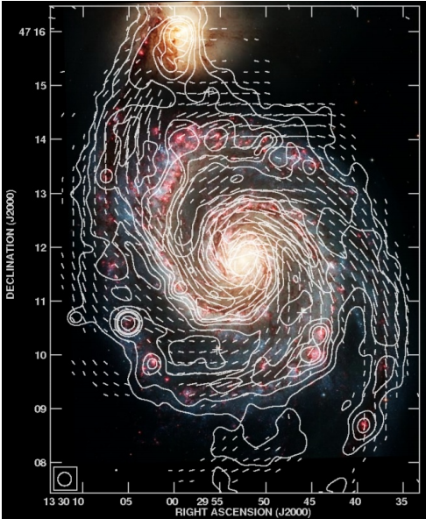
Outline
The F-GAMMA Program
Idea
Facts
Radio polarization and AGN
Theory
Practice
The RoboPol Program
Introduction
Current work
Fletcher et al., 2011, MNRAS, 412, 2396

Slide 3
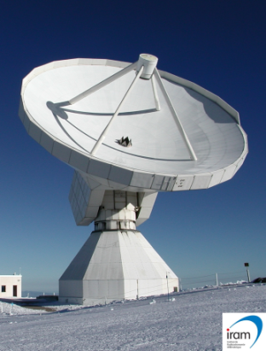
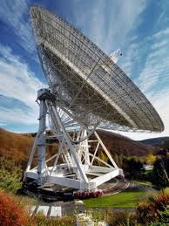
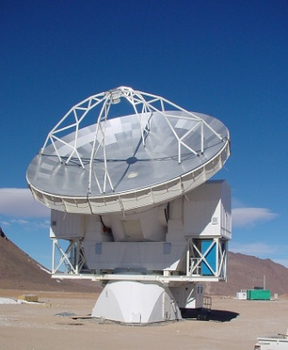
The F-GAMMA Collaboration
Multi-frequency monthly monitoring of 60 γ-ray blazars
Flux density variability
Spectral evolution
Polarization variability
Main facilities
100-m Effelsberg telescope (Germany): 2.64, 4.85, 8.35, 10.45, 14.60, 23.05, 32.00, 42.90 GHz
30-m Pico Veleta IRAM (Spain): 86.24, 142.33, 228.39 GHz
12-m APEX (Chile): 345 GHz
fermi.gsfc.nasa.gov
MPIfR
MPIfR

Slide 4
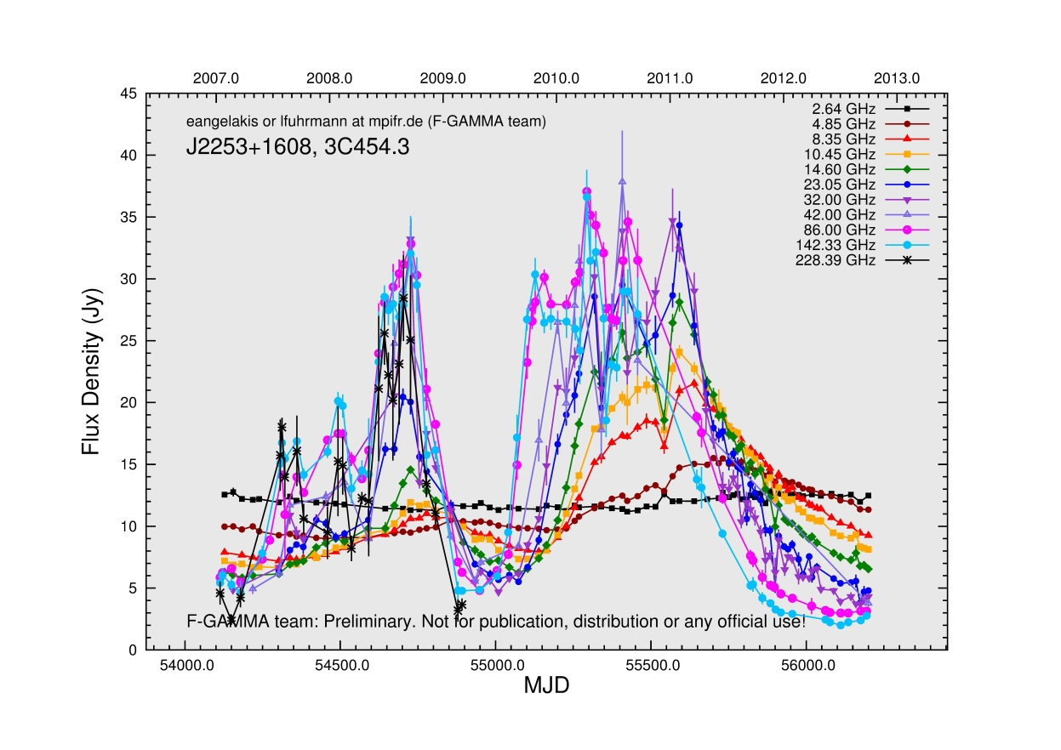
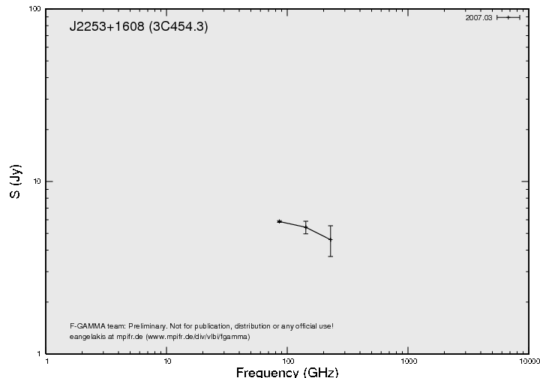
Data products
Blazar 3C454.3
Light curves
Spectra
Data: F-GAMMA Program

Slide 5
Scientific objectives
Stand-alone radio studies:
Radio variability mechanism (e.g. unification of variability patterns, Angelakis et al., in prep.)
Spectral evolution of flaring events (Angelakis et al., in prep.)
Variability and time series analysis of radio datasets (Nestoras et al., in prep.; Angelakis et al., in prep.)
Test shock models (e.g. cross-frequency time lags)
…
Multi-band studies:
Radio vs γ-ray flux correlation (biases-free methodology Pavlidou et al., 2012; Fuhrmann et al, in prep.)
Cross-band correlation analysis (Fuhrmann et al., in prep.)
Location of the γ-ray emitting region (Fuhrmann et al., in prep.)
γ-ray loudness and radio variability (Fuhrmann et al., in prep.; Richards et al., 2012)
Optical polarization angle swings during high energy events (see part 3)
…

Slide 6
Radio polarization and AGN
Incoherent synchrotron emission → polarized emission
Polarization measurements
Linear polarization
Polarization angle → Magnetic field orientation
Polarization angle + Faraday rotation → Integrated magnetic field magnitude
Circular polarization
Faraday conversion → Jet composition (e.g. Beckert & Falcke, 2002)
Polarization monitoring
Dynamics of the physical properties
Test of variability models
Correlation with: Total flux density, spectral index, spectral evolution, structural evolution, optical polarization
Investigate polarization angle swings during high-energy flares

Slide 7
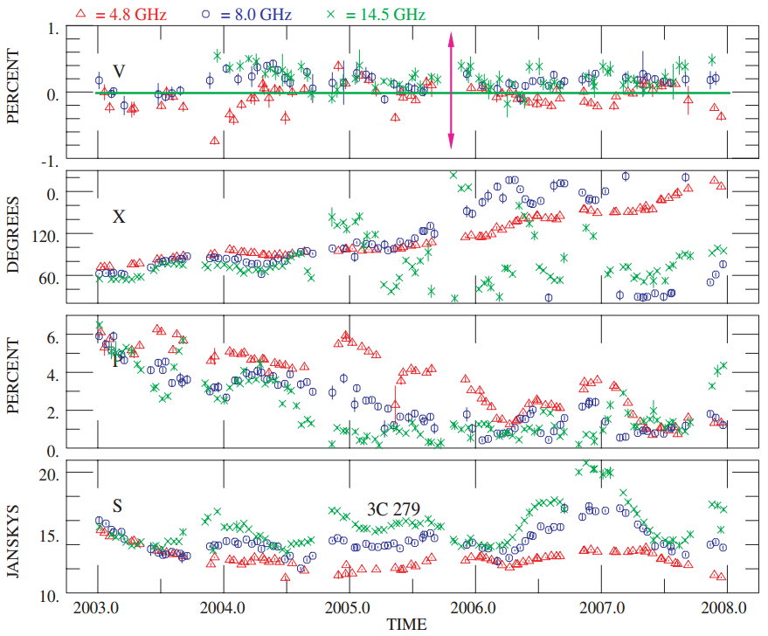
Radio polarization data reduction
AGN have low levels of polarization
Instrumental polarization (e.g. ~1% at 5 GHz)
Müller matrix: Transfer function between the real and observed Stokes parameters
Method
Observe sources with known polarization characteristics
Solve the system of equations [1] by fitting our measurements
Apply the instrumental polarization correction to our target sources
$$S_{obs}=M∙S_{real} →{ S}_{real}=M^{−1}∙S_{obs}$$
$$\left(\begin{aligned}I_{obs} \\ Q_{obs} \\ U_{obs} \\ V_{obs}\end{aligned}\right)=\left(\begin{matrix}m_{11} & m_{12} & \begin{matrix}m_{13} & m_{14}\end{matrix} \\ m_{21} & m_{22} & \begin{matrix}m_{23} & m_{24}\end{matrix} \\ \begin{matrix}m_{31} \\ m_{41}\end{matrix} & \begin{matrix}m_{32} \\ m_{42}\end{matrix} & \begin{matrix}\begin{matrix}m_{33} & m_{34}\end{matrix} \\ \begin{matrix}m_{43} & m_{44}\end{matrix}\end{matrix}\end{matrix}\right)∙\left(\begin{matrix}I_{real} \\ Q_{real} \\ \begin{matrix}U_{real} \\ V_{real}\end{matrix}\end{matrix}\right)$$
[1]
Homan et al., 2009, ApJ, 696, 328

Slide 8
Radio polarization data reduction
An example at 4.85 GHz:
Stable calibrators
High CP degrees for some sources, cross-checked with other stations (UMRAO)
Current work:
Stabilize data reduction pipeline
Extend to other frequencies
Produce radio polarization light curves
Source | Note | LP (%) |  |  | CP (%)
 |  | Before | After | Archival | Before | After | Archival
3C286 | Calibrator | 10.55 | 10.81 | 11.00 | -0.33 | 0.01 | 0.00
3C48 | Calibrator | 3.79 | 4.77 | 4.20 | -0.06 | 0.34 | 0.00
3C84 | Calibrator | 0.41 | 0.42 | 0.00 | -0.68 | -0.54 | -0.60
3C454.3 | Target | 2.34 | 2.75 | - | -0.92 | -0.83 | -
JUPITER | Target | 5.14 | 6.13 | - | -0.85 | -0.90 | -

Slide 9
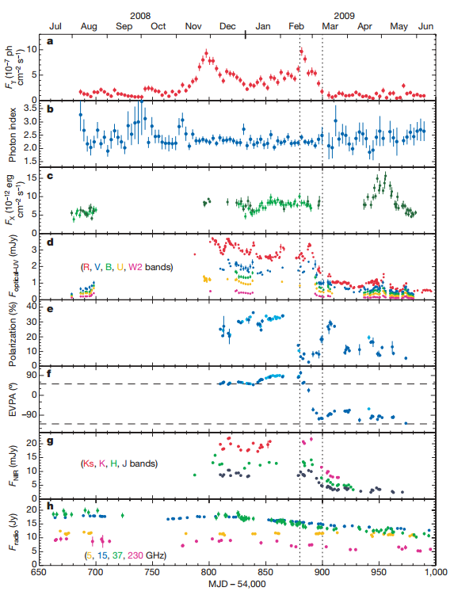
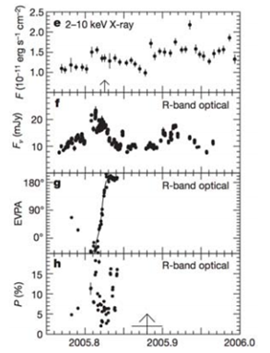
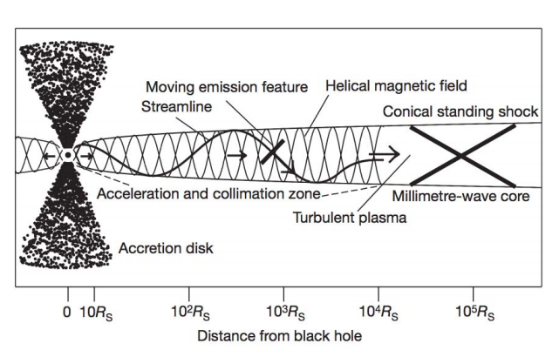
Optical polarization swing events
Rarely it has been observed during γ-ray outbursts
3C279: Abdo et al., 2010, Nature, 463, 919
PKS 1510-089: Marscher et al., 2010, ApJ, 710, 126
BL Lacertae: Marscher et al., 2008, Nature, 452, 966
Possible interpretation (Marscher et al., 2008):
Emission feature moving along a streamline in the acceleration and collimation zone
Abdo et al., 2010, Nature, 463, 919
Marscher et al., 2008, Nature, 452, 966

Slide 10
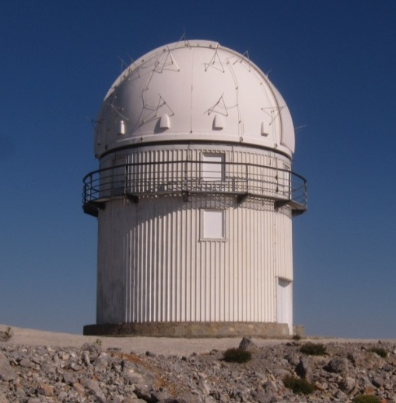
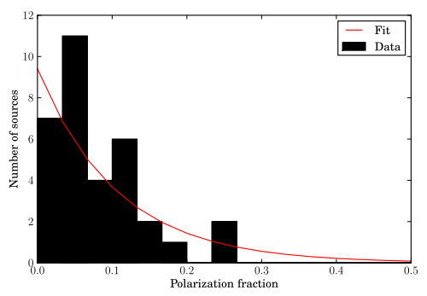
The RoboPol Program
Chasing optical polarization swing events
Optical polarimeter on Skinakas telescope (UoC)
Instrument: A. N. Ramaprakash (IUCAA), specifically for the telescope
Fully automated, on-the-spot data reduction : O. G. King (Caltech)
Observing strategy
Observe massively: 50 – 100 sources
Observe frequently: 2 to 3–night cycles
Observe dynamically: Dynamic observing schedule by real-time data reduction
Image: E. Angelakis
Smith et al., 2009

Slide 11
Candidate target sample
Fermi detectable
γ-ray variable
1% or less to be non-variable in γ-rays (variability index ≥ 41.64)
Other constrains
Archival optical magnitude ≤ 18 mag
Observable for 3 consecutive months
Airmass ≤ 2
Flux limited sub-sample of 2FGL catalogue → 557 sources
e.g. June
86 sources
Moon avoidance
Optically detectable from Skinakas

Slide 12
Current status
Sub-sample (80) observed in June 2012
Up-to-date photometry
Test data reduction pipeline
Continue photometric observations (October 2012)
Get information on optical polarization
Polarimetric observations with IUCAA Girawali Observatory (December 2012)
Control sample observations (October 2012)
Are there any differences in the optical characteristics of sources which are expected to be Fermi detectable from radio observations?
Small source sample (10) to investigate
Radio variable
Fermi non-detected

Slide 13
thank you

