Slide 1
IR & sub-mm Polarimetry
Chris Packham
University of Texas at San Antonio
7th June, 2013

Slide 2
Initial Comments
Firstly, thanks to the organizers, teachers, and especially Mathieu for an excellent school, great location, and wonderful cheese
Also of course thanks to Herve and COST
Caveats to my presentation
  I’m very heavily IR biased
    sub-mm can be seen as an extension to much of what I show
  Out of familiarity (laziness?!!), I’ll concentrate a little on some of the polarimeters and science I’ve been closed involved with
  This is necessarily broad and brief, I hope such brevity is OK

Slide 3
Outline
  IR (1-40μm) Polarimetric Science
  Mechanisms
  Science Apps
IR Polarimeters
  CanariCam-POL, MMT-POL
  Polarization gratings
Brief Personal Comments on Polarimetry
Sub-mm Polarization
The Future & Conclusions

Slide 4
IR Polarizing Mechanisms: Scattering
Scattering of radiation polarizes light perpendicular to the photon’s last direction of flight
  Can scatter from dust…
  P_{eff} α λ⁻⁴ to λ⁻¹
    Strong color – very blue and hence minimal at λ>~5μm
      But large dust grains could modify this statement
  …or electrons
    Wavelength invariant (P_{eff} α λ⁰)
Scattering pattern can be centro-symmetric
  Rotate the PA of polarization by 90 degrees to point to the TRUE source

Slide 5
Hashimoto et al 2010, AB Aurigae at 2μm

Slide 6
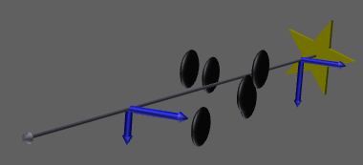
IR Polarizing Mechanisms: Dichroism
Dichroic polarization is the passage of light through aligned dust grains
  Transmitted or emitted dichroism indicates dust temperature structure
    Magnetic field parallel to PA of polarization for absorptive polarization, perpendicular for emissive
      Radiation pressure
      Barnett effect, where short grain axis aligned with magnetic field (opposite to compass ‘cartoon’)
MIR (5-40μm) polarization primarily due to emission or absorption from aligned aspheric dust grains

Slide 7
Serkowski Curve (1975)
Empirical curve describing the degree of polarization caused by dichroic transmission
  λ_{max} is the λ of the maximum polarization
  P_{max} is the max. polarization
  K is an empirical constant
    K = 0.01±0.05
    (Whittet et al. 1992)

Slide 8
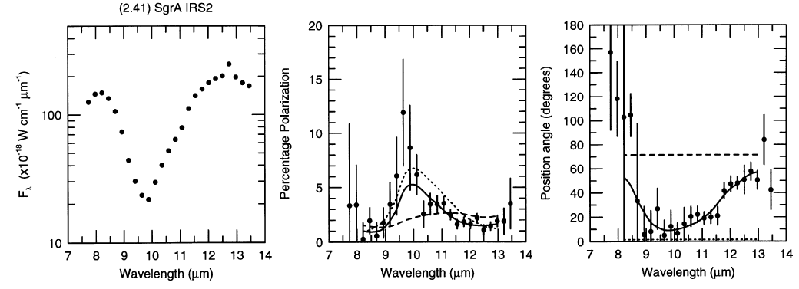
Wide λ Coverage Essential
90° PA of polarization switch in wavelength when going from dichroic transmission to emission
  Occurs at a characteristic dust temperature

Slide 9
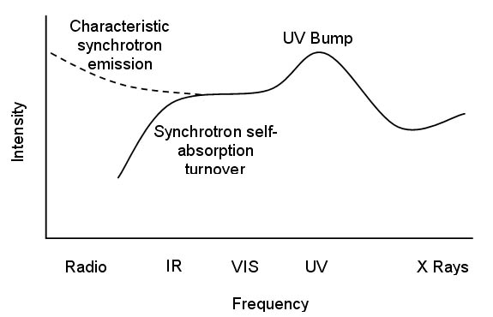
IR Polarizing Mechanisms: Synchrotron
Synchrotron radiation
  Same wavelength dependence as synchrotron
  f_{ν} ∝ ν^{−α}, with spectral index α
  Degree of polarization can be VERY high (75%)
  Seen in AGN jets at radio to optical wavelengths

Slide 10
Polarization & λ Coverage
(Illustrative only)
Dust Scattering
P ∝ λ⁻⁴ or λ⁻¹
Dichroic Emission
P ∝ ?
Efficiency
Dichroic Absorption
P ∝ exp(ln²(λ⁻¹))
Electron Scattering
Synchrotron Emission
P ∝ λ⁰
λ
0.5μm
5μm
15μm

Slide 11

3 Key IR Polarization Science Cases
Debris disks and planet formation
  Polarimetry investigates dust grain composition and distribution, and effect of magnetic field
Star formation
  Role of magnetic fields in star formation
Galaxies & the AGN torus
  Exclusion of surrounding and contaminating flux through as torus is polarized

Slide 12
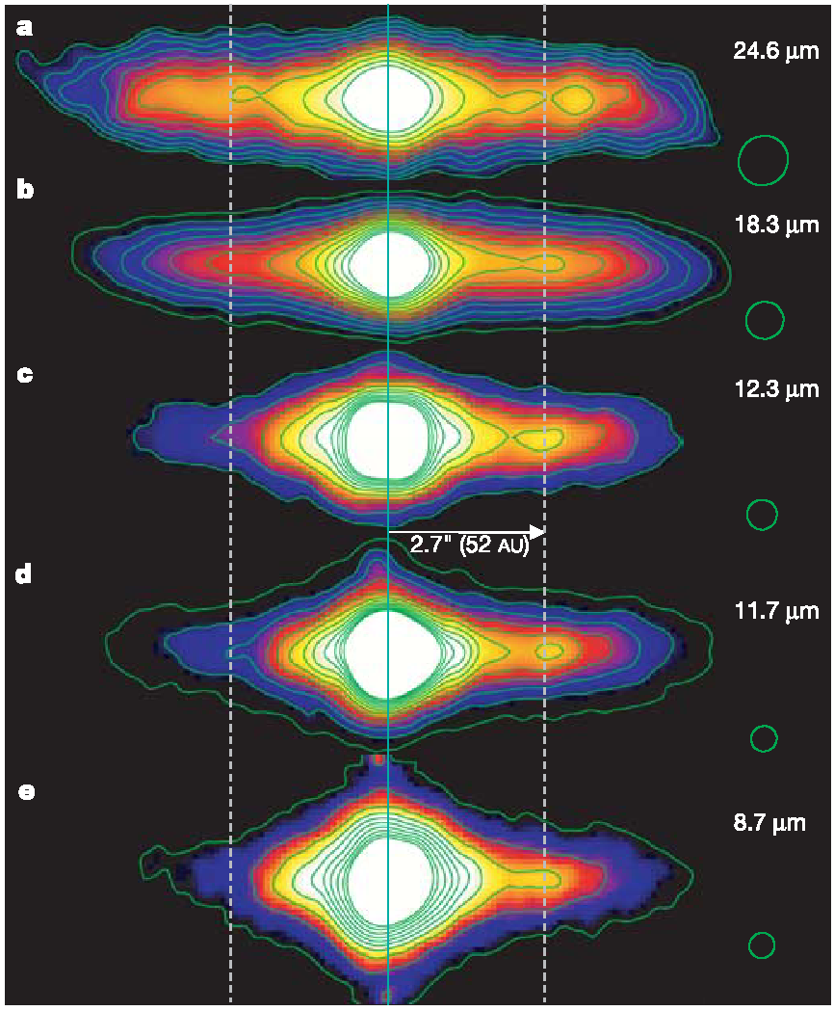
β Pictoris
Telesco et al., Nature, 2005
Observations made from 8-24μm on Gemini S
Proto-planetary dust surrounding star clearly changes in morphology through λ
Clump of dust at ~52AU shows different color properties to surrounding dust
  Possibly represents dust liberated after collision

Slide 13
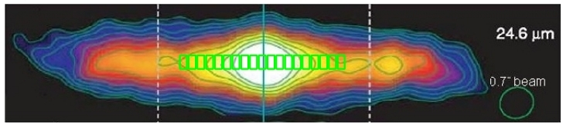
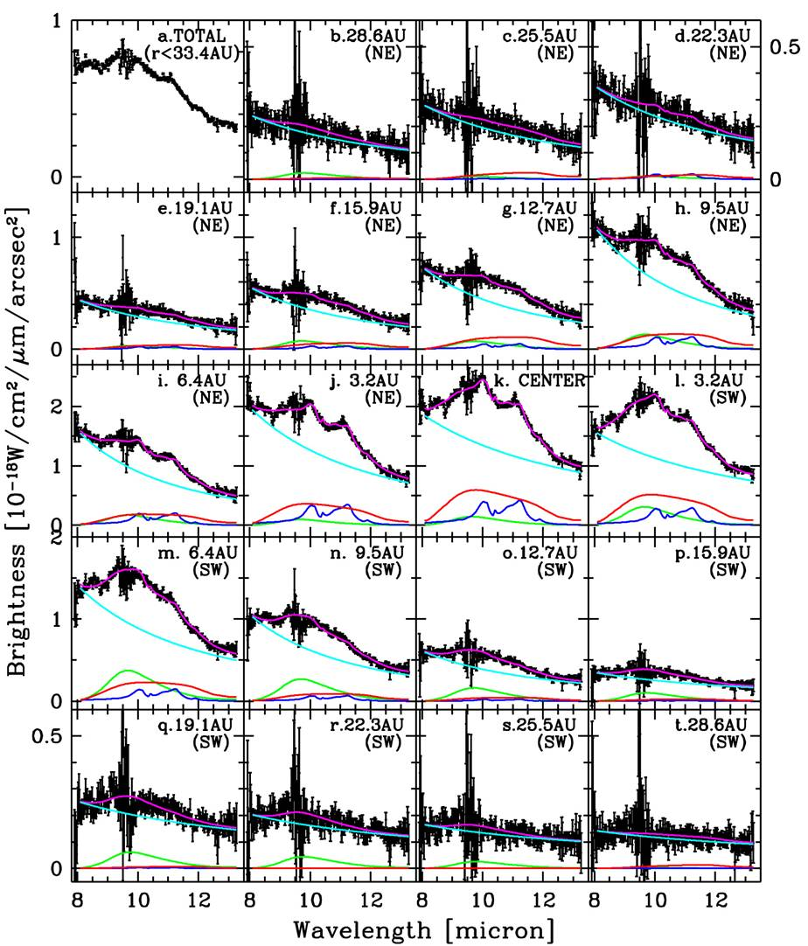
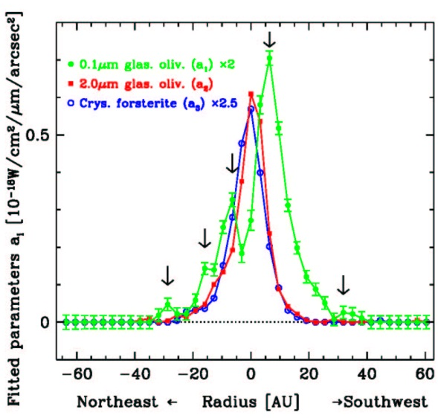
N-band low-R spectroscopy of planet forming disks
Spatially resolved N-band spectra of β Pic debris disk (Okamoto+2004)
Spatial difference of dust feature
  Central condensation of crystalline silicate grains
  Several local peaks of small amorphous silicate
Notes:
A good case study with Subaru Telescope was done by Okamoto et al. 2004 for beta Pic debris disks. We got spatially resolved N-band spectra as shown in left panels. As you can see, a clear emission feature at 11.2 um due to crystalline olivine is seen toward central component, but is almost absent toward outer region. By spectral decomposition analysis, we plot here the one dimensional spatial distribution of 3 dust species. The green line indicate the small amorphous silicate grains, red line represents the large amorphous silicate, and blue line is for crystalline olivine grains. Large amorphous silicate grains and crystalline silicate grains are centrally peaked, while small amorphous silicate grains are much widely distributed. This indicate that crystalline silicate grains which is also seen in cometary grains are formed near the central star. We also note that several local peaks of small amorphous silicate grains.

Slide 14
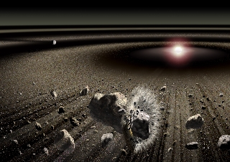
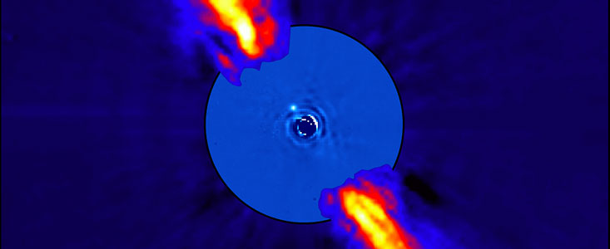
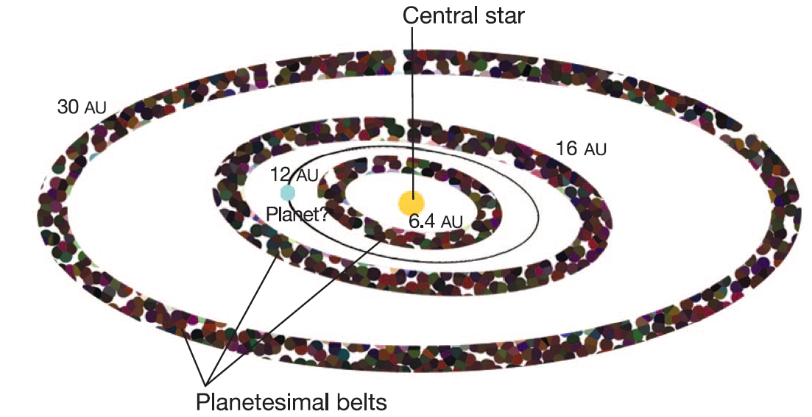
N-band low-R spectroscopy of planet forming disks
Artist’s view of β Pic planetesimal disk
Spatially resolved N-band spectra of β Pic debris disk (Okamoto+2004)
Spatial difference of dust feature
  Central condensation of crystalline silicate grains
  Several local peaks of small amorphous silicate
  → Multiple planetesimal belts
Planet imaged!
8-15AU
Lagrange et al, 2010
Notes:
Because these grains are quickly removed from the system, we suggested that these grains are formed in situ by the planetesimal belts. Here is the cartoon of the beta Pictoris planetesimal belts. We also suggested the possible planets which is actually found recently by Lagrange et al. recently. Above picutre is the artist’s view of beta Pic planetary system.

Slide 15
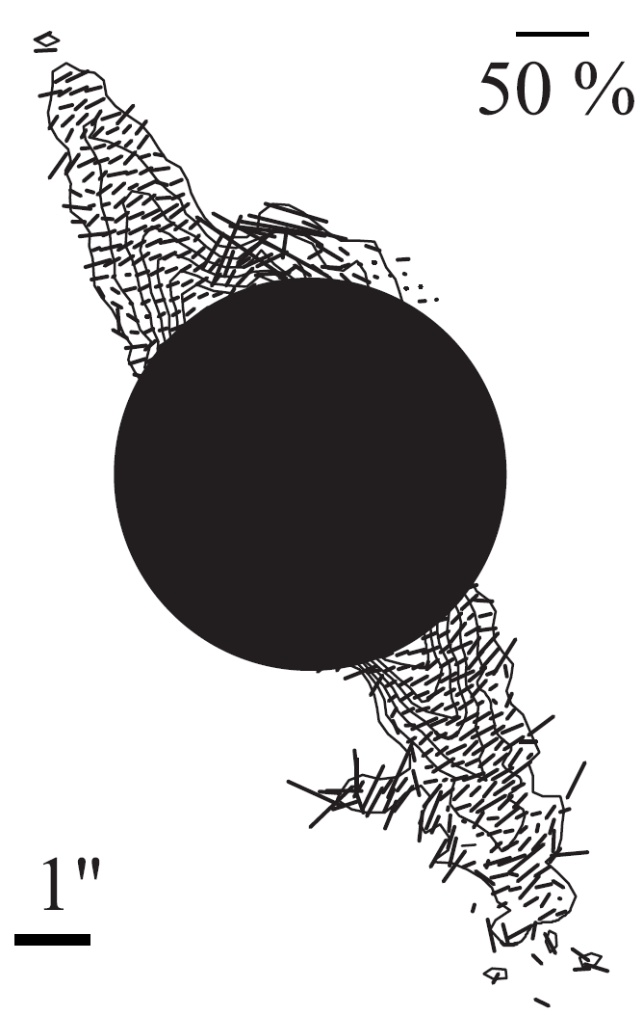
Debris Disks
Polarimetry effectively increases the contrast, making perturbations and protoplanets far easier to detect
Star formation process differentiates material for star
  Internal conditions regulate disc and planet formation
NIR polarimetry of individual sources typically dominated by scattered radiation
MIR polarimetry offers possibility to measure B field in debris discs
2.2μm corongraphic polarimetry β Pictoris (Tamura et al., 2006) showing scattered light

Slide 16
From Cloud Cores to Protostars
B fields play a crucial role in star formation
  Unclear how B field evolve from cloud cores to protostars
H band is dichroic transmission, 100 & 850μm is dichroic emission
  Good correlation in λ in outer regions
  Strong disagreement [especially] between H and other λ in central regions
Polarization of NGC2024 (Kandori et al. 2007): dichroic absorption at H (yellow) & emission at 850μm (blue) and 100μm (red)
Note: long wavelength vectors rotated by 90

Slide 17
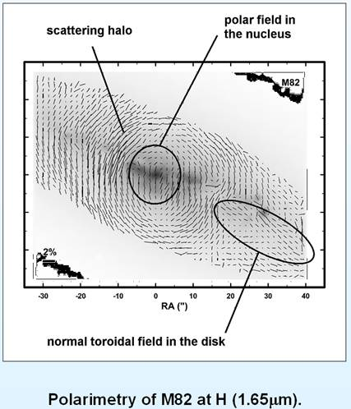
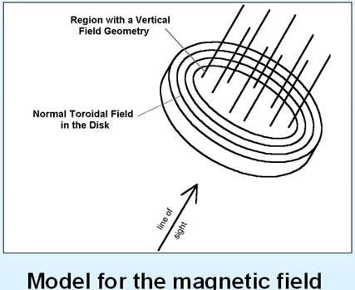
Galaxies
Galaxies typically show bimodal PA of polarization providing clear evidence of 2 polarizing mechanisms
  Extended regions in plane of galactic disc
    Toroidal field
  Nuclear regions is perpendicular to the disc
    Polar field

Slide 18
Models of Galactic Discs
Woods & Jones (1997) models assume dust grains completely aligned by toroidal magnetic field
  Magnetic field strength therefore irrelevant
Smooth distribution of stars and dust assumed
  Assumption will break down due to spiral arms and/or merger events
Polarization estimated using optical based polarization curve and/or standard scattering models

Slide 19
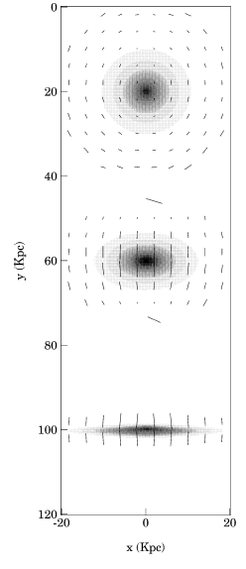
Models of Galaxies:
Scattering Only
Centrosymmetric at low inclinations
Perpendicular to galactic plane for high inclinations
Dust scattering α λ⁻⁴
  Scattering dominant at 0.3-2μm, minimal at MIR

Slide 20
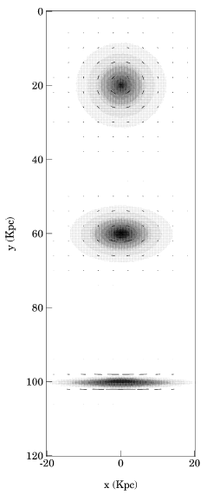
Models of Galaxies:
Dichroism Only
Simple toroidal magnetic field assumed
  Dissociated from spiral arms
Low inclinations are similar to a scattering only case
High inclinations show polarization is parallel to disc

Slide 21

Models of Galaxies:
Scattering & Dichroism
At low inclinations, centrosymmetric polarizing mechanisms reinforce each other
High inclinations at center dominated by dichroism, whereas areas distant from nucleus are dominated by scattering
At MIR, scattering efficiency is low, allowing us to see the undiluted dichroism
  Thus probing the toroidal B field at the centers of galaxies
  Of likely importance to formation of galaxies => cosmology

Slide 22
Models of Galaxies:
Scattering & Dichroism
At low inclinations, centrosymmetric polarizing mechanisms reinforce each other
High inclinations at center dominated by dichroism, whereas areas distant from nucleus are dominated by scattering
At MIR, scattering efficiency is low, allowing us to see the undiluted dichroism
  Thus probing the toroidal B field at the centers of galaxies
  Of likely importance to formation of galaxies => cosmology

Slide 23
Models of Galaxies:
Scattering & Dichroism
At low inclinations, centrosymmetric polarizing mechanisms reinforce each other
High inclinations at center dominated by dichroism, whereas areas distant from nucleus are dominated by scattering
At MIR, scattering efficiency is low, allowing us to see the undiluted dichroism
  Thus probing the toroidal B field at the centers of galaxies
  Of likely importance to formation of galaxies => cosmology

Slide 24
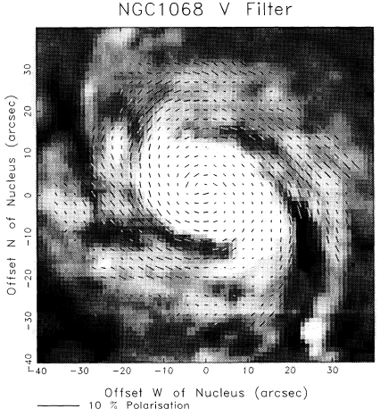
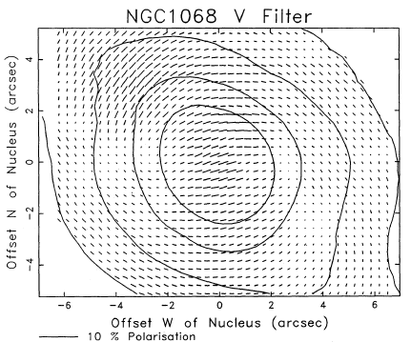
Face-on Galaxies
Away from any AGN influence, polarization vector pattern is spiral and follows the arms
Central regions show enhanced ionization cone scattering from nuclear source

Slide 25
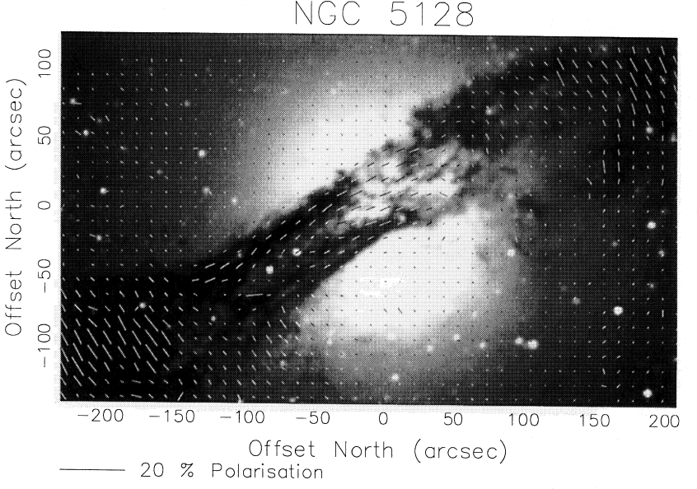
Edge-on Galaxies
Scatter
Dichroism
Scatter
Dusty spiral arms
can bisect galaxy
  Extinction and hence
  degree of dichroism more intense (Scarrott et al. 1996)
M104 shows P_{v}~4%, and λ_{max}~0.42µm
NGC5128 shows P_{v}~5%, and λ_{max}~0.46µm
  SN1985G also shows λ_{max}0.43-0.46µm
NGC2146 shows P_{v}~4-5%, and λ_{max}~0.45µm
λ_{max}~0.45µm, distinct from our Galaxy’s λ_{max}~0.55µm

Slide 26
Edge-on Galaxies
Scatter
Dichroism
Scatter
Dusty spiral arms
can bisect galaxy
  Extinction and hence
  degree of dichroism more intense (Scarrott et al. 1996)
M104 shows P_{v}~4%, and λ_{max}~0.42µm
NGC5128 shows P_{v}~5%, and λ_{max}~0.46µm
  SN1985G also shows λ_{max}0.43-0.46µm
NGC2146 shows P_{v}~4-5%, and λ_{max}~0.45µm
λ_{max}~0.45µm, distinct from our Galaxy’s λ_{max}~0.55µm

Slide 27
Dichroism in Our Own Galaxy
Need to be careful when looking at objects in the plane of the Galaxy

Slide 28
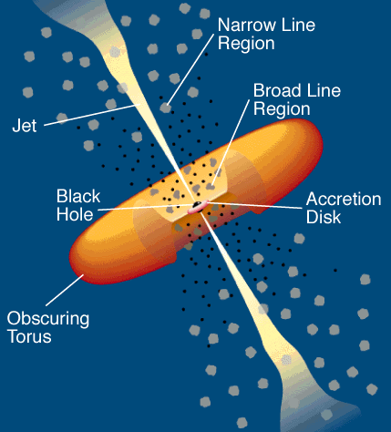
AGN
Perhaps the most famous use of polarimetry in the past ~30 years
Scattered broad emission lines led to a AGN revolution
  Antonucci & Miller, 1985
  1,243 citations and counting!

Slide 29
Active Galactic Nuclei
MIR observations hold the promise to probe the geometrically and optically thick dusty torus
  Fundamental to unified theories of AGN, but never directly imaged
Torus will re-emit absorbed radiation at MIR
  Contamination at optical/NIR λ frustrated previous observations
Dust in torus likely aligned (B field from central engine or radiation pressure)
  Polarimetry provides simple way to discriminate between galactic and torus related emission

Slide 30
ULIRGS & ISO
ULIRG observations of 4 objects made in polarimetry mode by ISO
  Siembenmorgen & Efstathiou 2001
Observations clearly show higher polarization where AGN thought to be most dominant
  Polarization most attributable to dichroic emission
Consistent with the idea that a torus requires a magnetic field for its creation/longevity
Polarized flux from the torus, not the surrounding diffuse emission
  More ‘pure’ torus SED

Slide 31
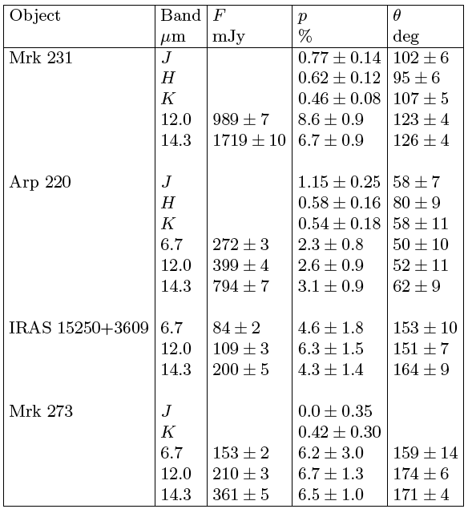

Slide 32
Polarimetry of NGC1068
Optical reveals nucleus completely obscured
  But scattered (polarized) broad emission lines detected
NIR consistent with dichroic absorption from ‘torus edge’
Silicate absorption from Mason et al. show dust extending 1” south of nucleus

Slide 33
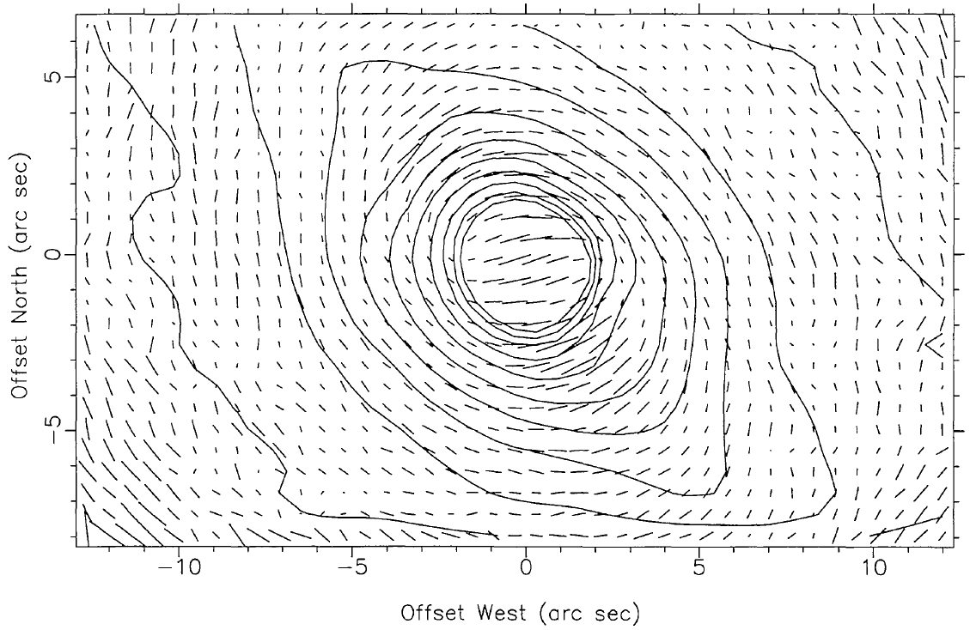
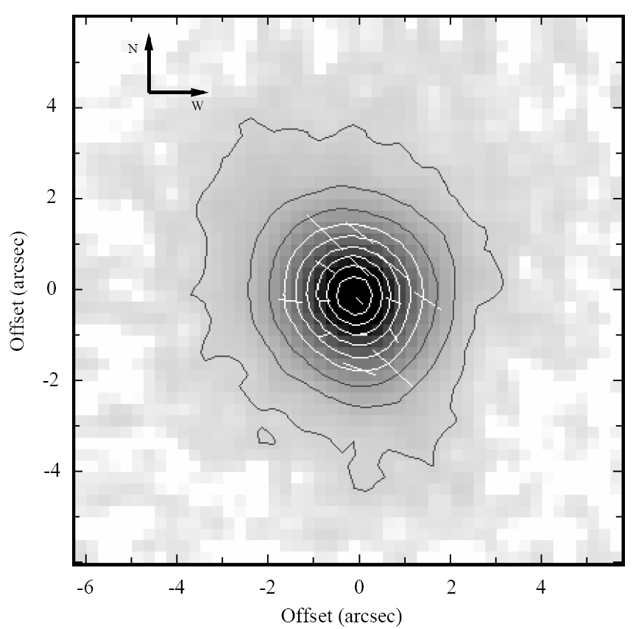
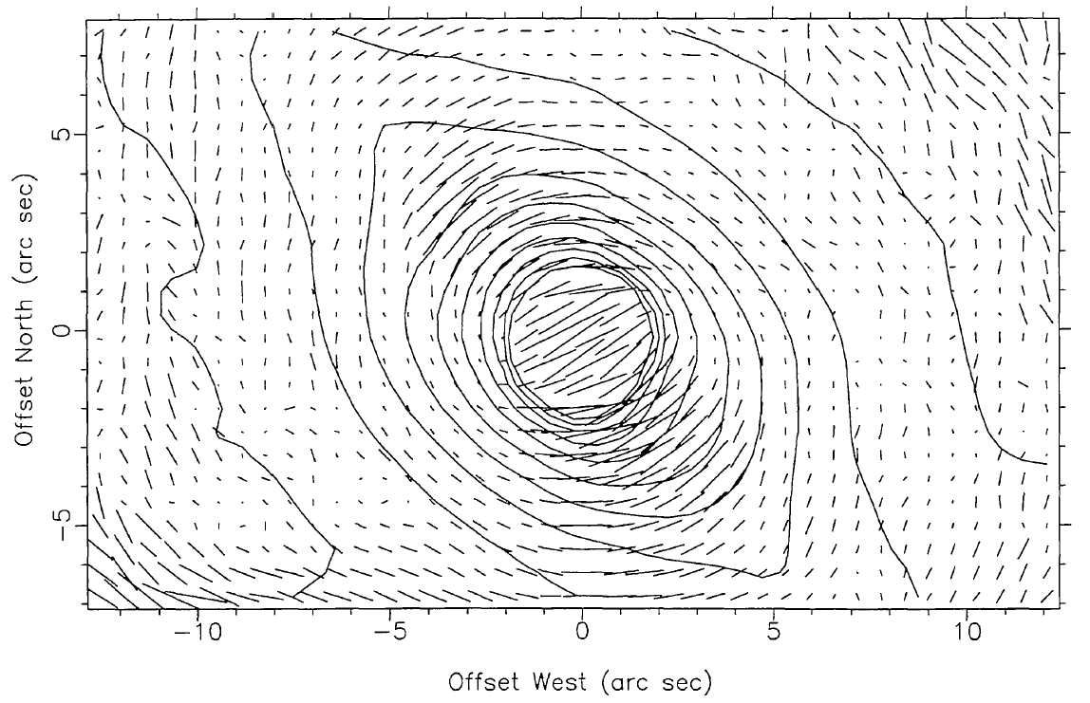
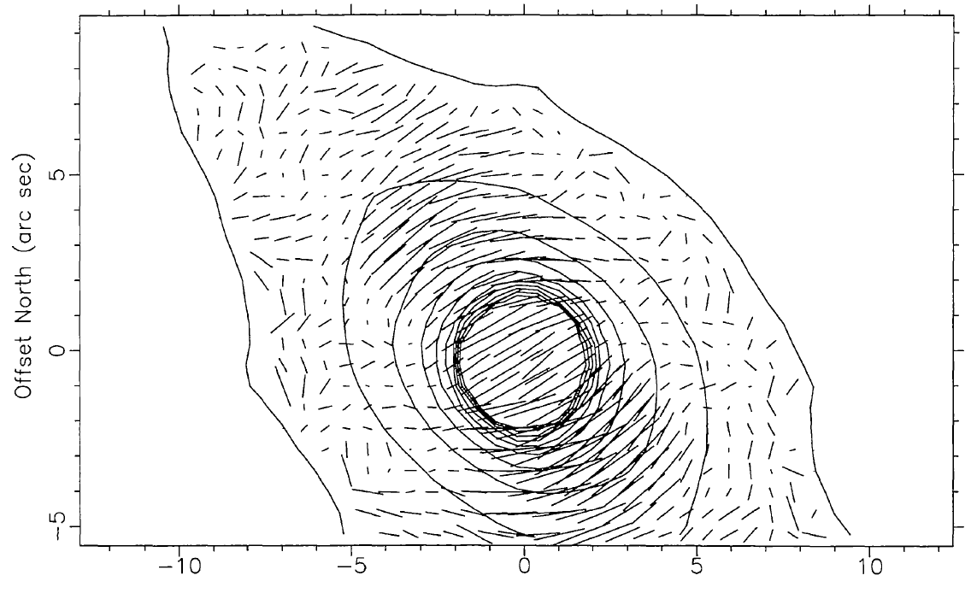
Previous IR Polarimetry
1.2μm
1.6μm
10μm
NIR: Packham et al. (1997)
MIR: Lumsden et al. (1999)
2.2μm

Slide 34
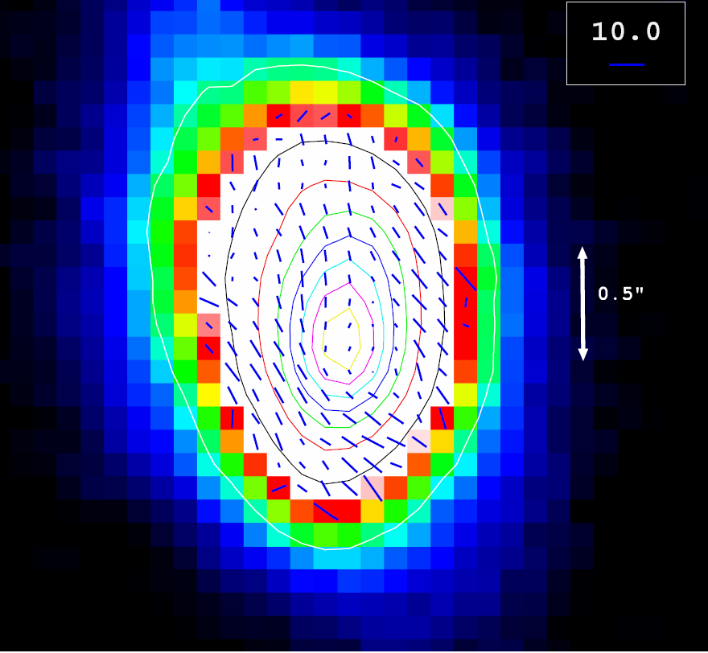
Lumsden et al. (1999)
7 hours on-source
Packham et al. (2007)
148 seconds on-source
9.7μm
10μm

Slide 35
Polarizing Components
Polarization PA
Polarization PA
2.2μm
9.7μm

Slide 36
Polarizing Components
2.2μm
9.7μm
Dichroic emission from galactic dust near torus
Dichroic emission in NLR through interaction with jet
Central un-polarized source or polarized source at PA ~orthogonal to surrounding emission
  Source is <22pc, consistent with MIR spectroscopic torus size

Slide 37
Interpretation
MIR polarization traces dust/gas in nuclear environments
  Best explained by warm aligned dust grains being channeled from the host galaxy toward the torus
To reconcile a compact torus with these and other observations we suggest the compact, geometrically and optically thick torus is surrounded by a large diffuse structure, associated with the dusty central regions of the host galaxy
  Where the torus ends and the host galaxy dust structure starts may be more of a question of semantics rather than a true physical boundary

Slide 38

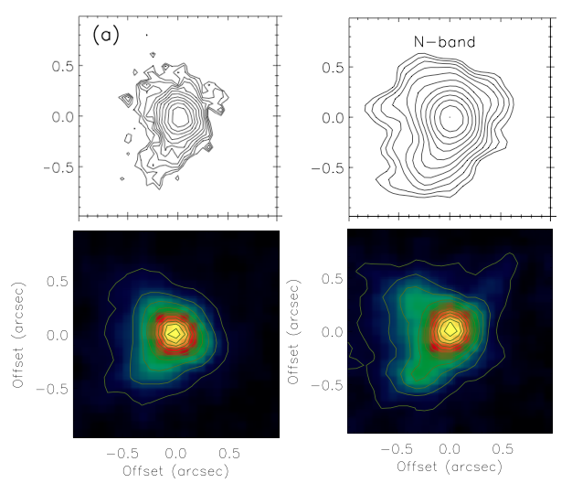
Cygnus A Morphology
OSCIR
at Keck
Raw image
Smoothed image
Radomski et al. (2002)
CanariCam
Lopez et al. (in prep.)
Si2[8.7 μm]
Si5[11.6 μm]

Slide 39
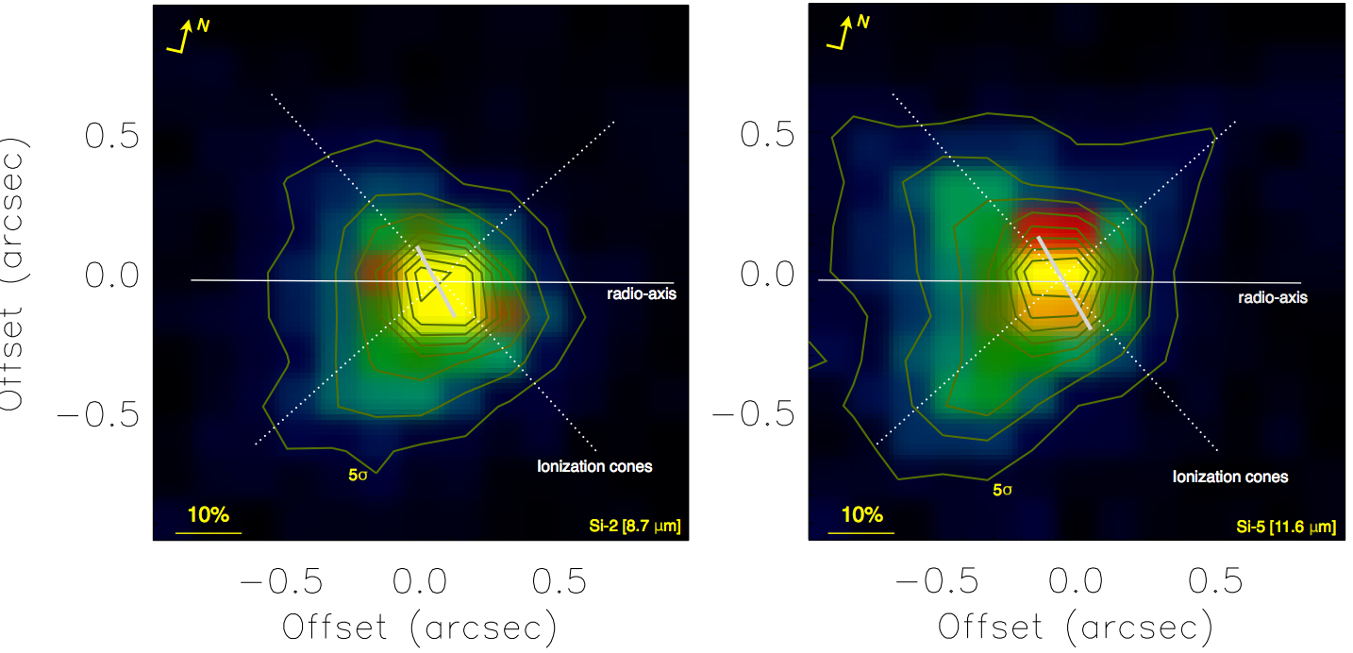
Cygnus A Polarimetry
P = 11 ± 3%
P = 12 ± 3%
Polarization measured in a 0.38” aperture

Slide 40
Cygnus A Polarimetry
P = 11 ± 3%
P = 12 ± 3%
Such a high degree of polarization implies:
Synchrotron radio at base of radio jet
Electron scattering
Very high efficiency alignment of dichroic emission (unlikely)

Slide 42
NIR Polarimetry and the
Homogenous Torus Model
Dichoric absorption in the torus leading to observed polarization, especially at K
Our LOS view
AGN
NIR emission
MIR emission
FIR emission

Slide 43
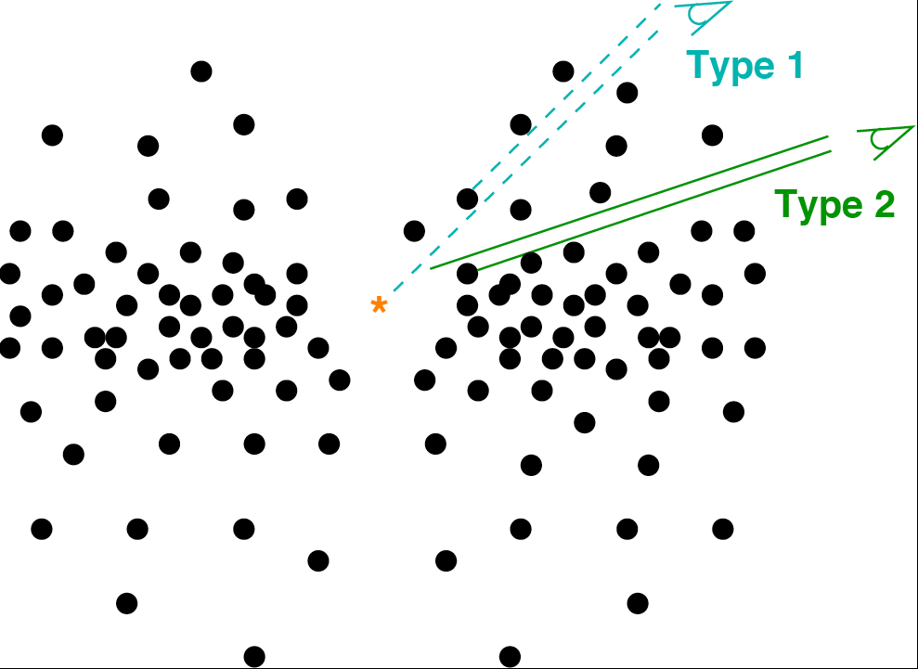
Clumpy Torus Model
Clumpy torus model of Nenkova et al. (2002)
  Clouds follow power law distribution
  Clouds concentrated in equatorial plane
  τ_{v} of each cloud = 40-150

Slide 44
NIR Polarimetry and the
Clumpy Model (Single Clump)
Dichoric absorption in the clump leads to observed polarization, especially at K
MIR emission
NIR emission
AGN
FIR emission
NIR emission
MIR emission
We observe NIR flux only from the front surface of the clump (or AGN central engine) at a glancing angle to our LOS
Other areas emit the NIR flux, but are absorbed within the dust clump
Measured polarization α B field & obscuration
Lopez et al. 2013

Slide 45
Importance of the B Field
B field will affect formation and motion of clumps in the torus
B field differences between AGN could break the radio-loud/quiet dichotomy
  Do radio-loud AGN concentrate their magnetic field to create jets?
B field will significantly affect the fueling, accretion, and outflows in and around AGN
This area is wide open, as it has been traditionally very difficult to observationally probe

Slide 46
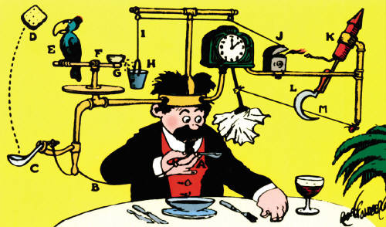
A Few Slides on Instrumentation

Slide 47
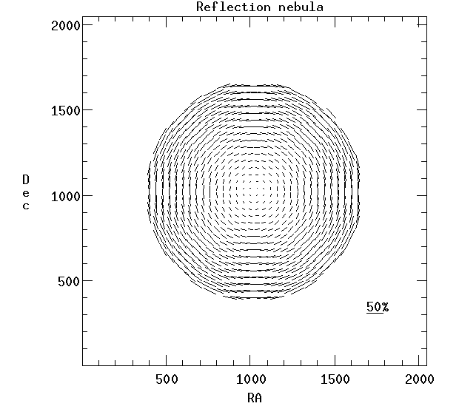
Resolution & Polarimetry
Model reflection nebula
  Individual polarization vectors up to 50%
  Integrated polarization = 0%
    Crossed (unresolved)
    polarization vectors
    add to null (zero)

Slide 48
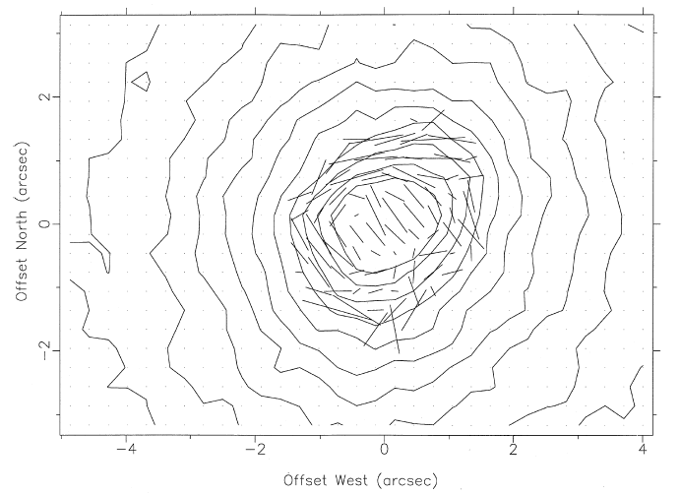
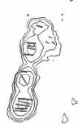
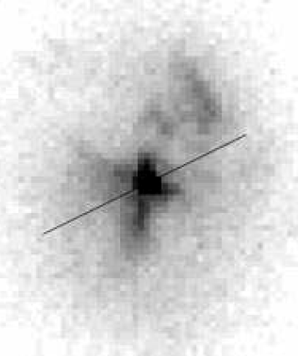
Quick Example: AGN
Natural seeing vs. HST observations find startlingly different polarizations
  UKIRT 1.0” ~ 4%
  HST 0.2” ~ 28%

Slide 49
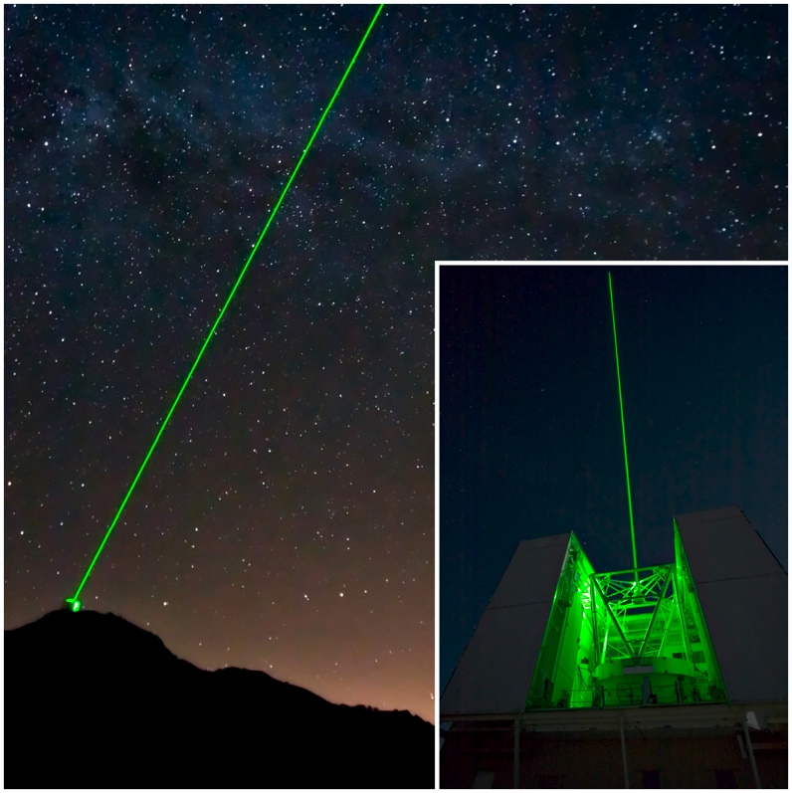
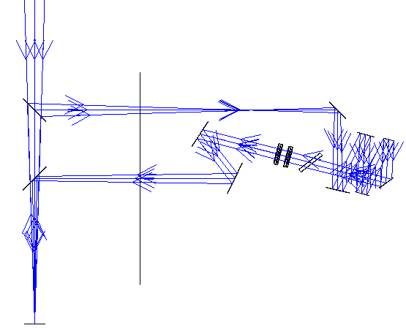
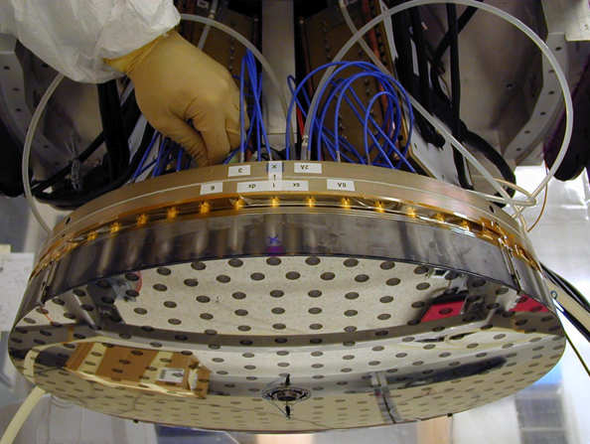
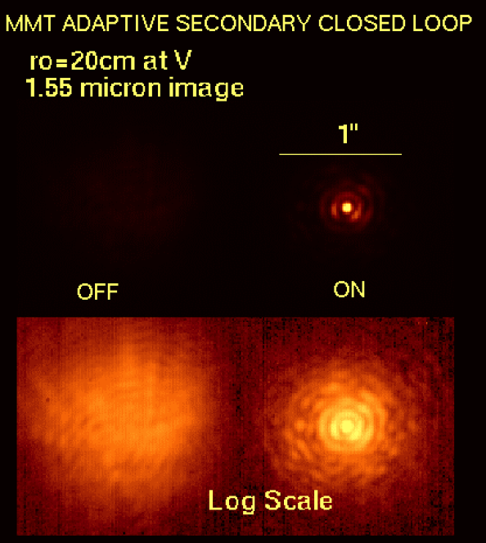
AO Polarimetry
Extremely difficult for high accuracy NIR polarimetry with standard AO systems
  Multiple reflections, dichroics, etc. scramble the polarization signature
6.5m MMT in Arizona with AO secondary
  Laser guide star deployed
  Implementation offers very low instrumental polarization & minimal IR background
ASMs to revolutionize 8m class telescopes

Slide 50
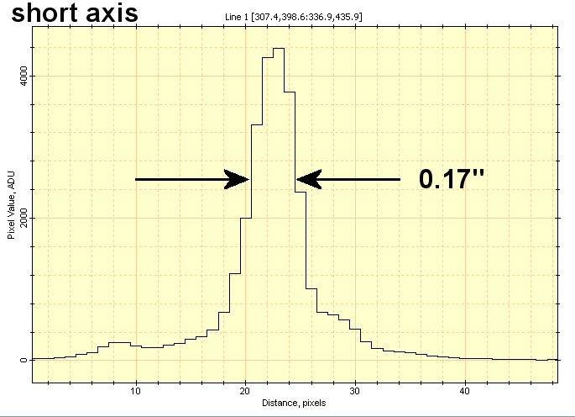
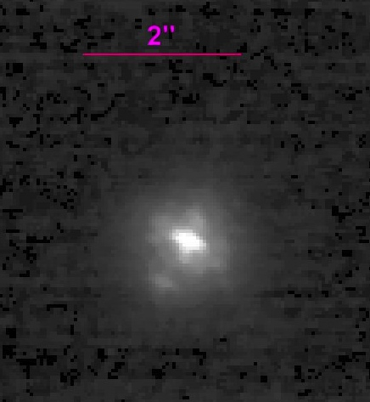
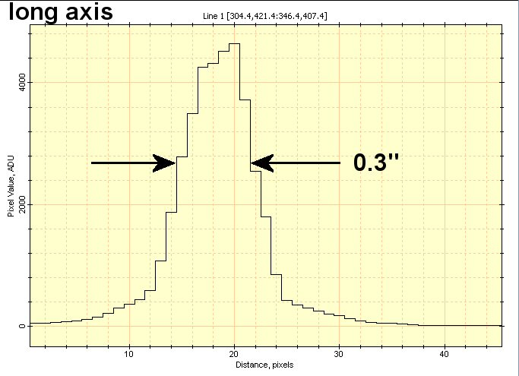
Initial Results MMT-POL
(Packham et al, 2008, 2010, 2012)
System working well
Zero polarized standard:
  P = 0.11% +/- 0.12%
Image quality is excellent
  Image shows some distortion in both o and e rays
Data taken in very poor conditions

Slide 51
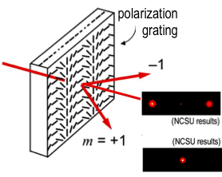
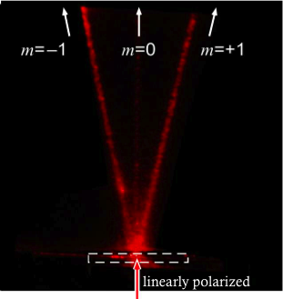
Polarization Gratings
Collaboration with communications research group to use novel polarimetric component in MMT-POL (Packham et al. 2010)
Spectropolarimetry in one ‘hit’, low cost, and easy to implement
  Plan to integrate to MMT-POL August-2013
  Cost reduced by ~80% compared to ‘standard’ approach

Slide 52
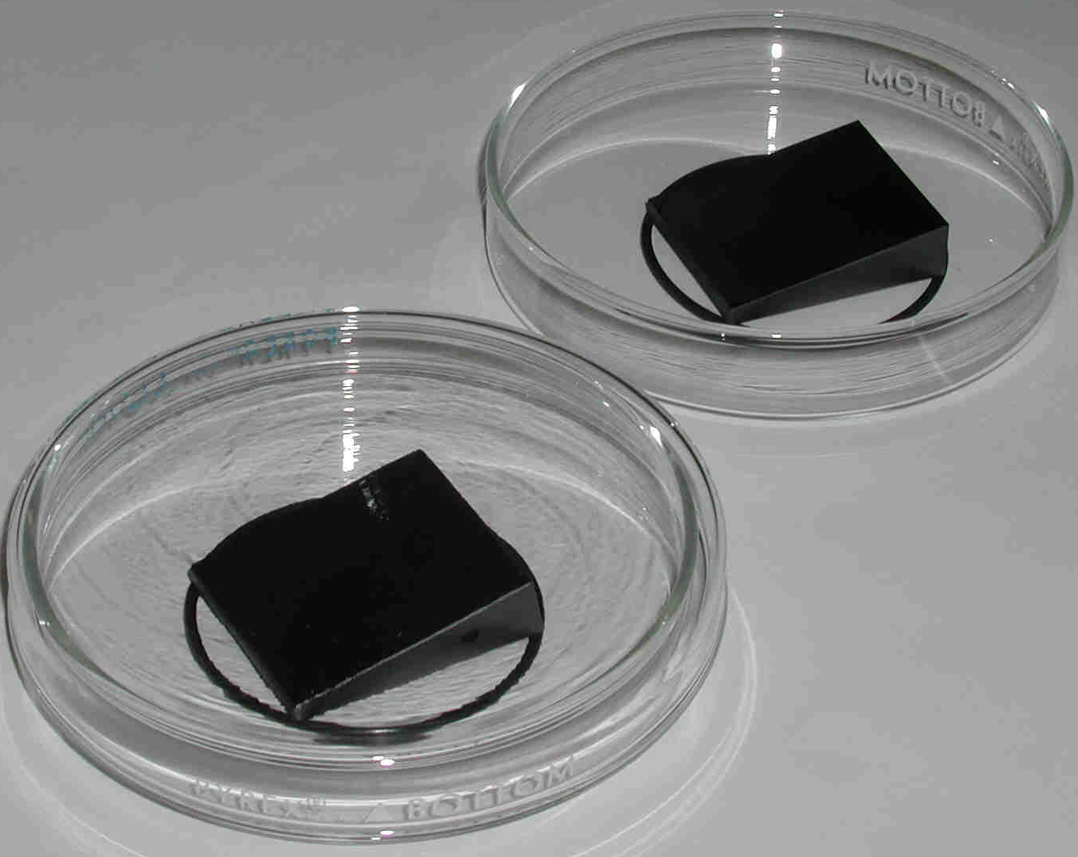
CanariCam-POL (Packham et al. 2006)
PI: Telesco, Florida
$3M multi-mode instrument the 10.4m GranTelescopio Canarias, commissioned in 2010-2012
1st dual-beam polarimetry module at 10μm
  Uses ‘standard’ half wave
  retarder and Wollaston
  Designed in Zemax

Slide 53
Polarization & λ Coverage
(Illustrative only)
MMT-POL
CanariCam
Dust Scattering
P ∝ λ⁻⁴ or λ⁻¹
Dichroic Emission
P ∝ ?
Efficiency
Dichroic Absorption
P ∝ exp(ln²(λ⁻¹))
Electron Scattering
Synchrotron Emission
P ∝ λ⁰
λ
0.5μm
5μm
15μm

Slide 54
My Personal Thoughts on Polarimetry 1/2
Can be hard to ‘sell’, need to ensure a good science ‘hook’ back to national plans
I’ve always felt polarimetry is most powerful when polarization models employed simultaneously with total flux models
How fast to modulate?
Instrumental polarization
Worries about coatings and how that affects things
  But often hard to get that information from vendors
    They don’t know it, or don’t want to provide it
    GIGO
Birefringent lens in MMT-POL
Stress birefringence in entrance window

Slide 55
My Personal Thoughts on Polarimetry 2/2
Polarization fringes can exist in spectro-polarimetry
Calibration sources
  Hard for 8m telescopes
  How to select them is standard, but little time available
DR is not hard, but can be ‘fiddly’
  POLPACK, very nice approach
Although quoting Q, U, and V is fine for us, IMHO it is not the best way to advertise our work
  Degree and PA of polarization is far easier for non-polarimetry people to understand
  In the last 10 years (+?) we gone from data poor to data rich, making our work as accessible as possible is crucial

Slide 56
Observatories & Polarimetry
Observatories often don’t like polarimetry as:
  Every one wants the Cass focus
  Lots of moving parts to get ‘stuck’ in the beam
  Small community
But is a great tool for planet searching
We need to ensure the polarimetry community is strong, vibrant and connected
  Hats off to the COST polarization people for providing us the venue to do this!
It is our job to produce and promote our results to the wider community, and urge for polarimetry on the 30m’s

Slide 57
Conclusions
Lots of great stuff to do at IR with polarimetry
  Perhaps most applicable to debris discs and connection into planets
  But formation/evolution of galaxies and AGN is also very attractive
Low IP, diffraction limited polarimetry in it’s infancy
  Can expect some really nice science soon

Slide 58
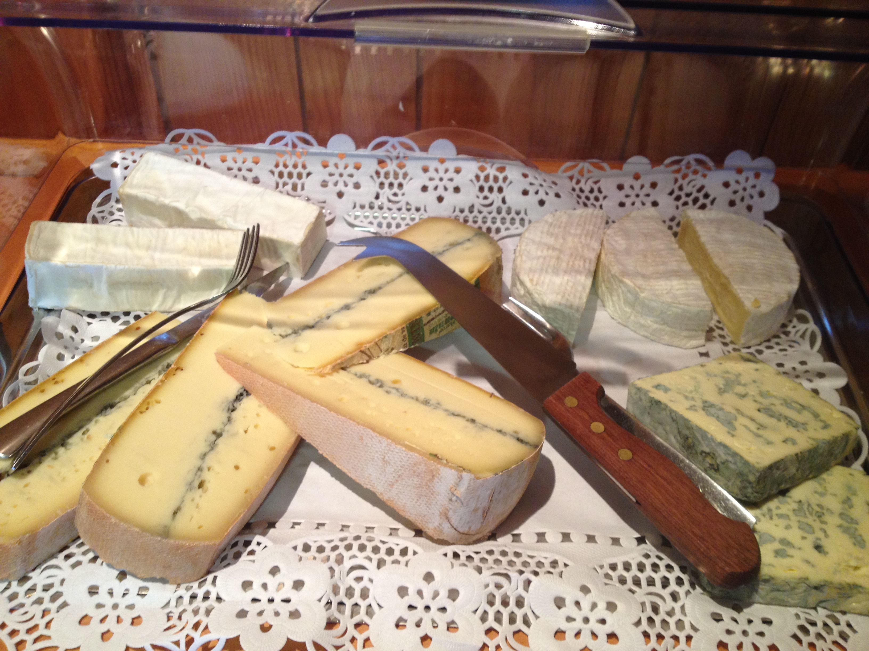
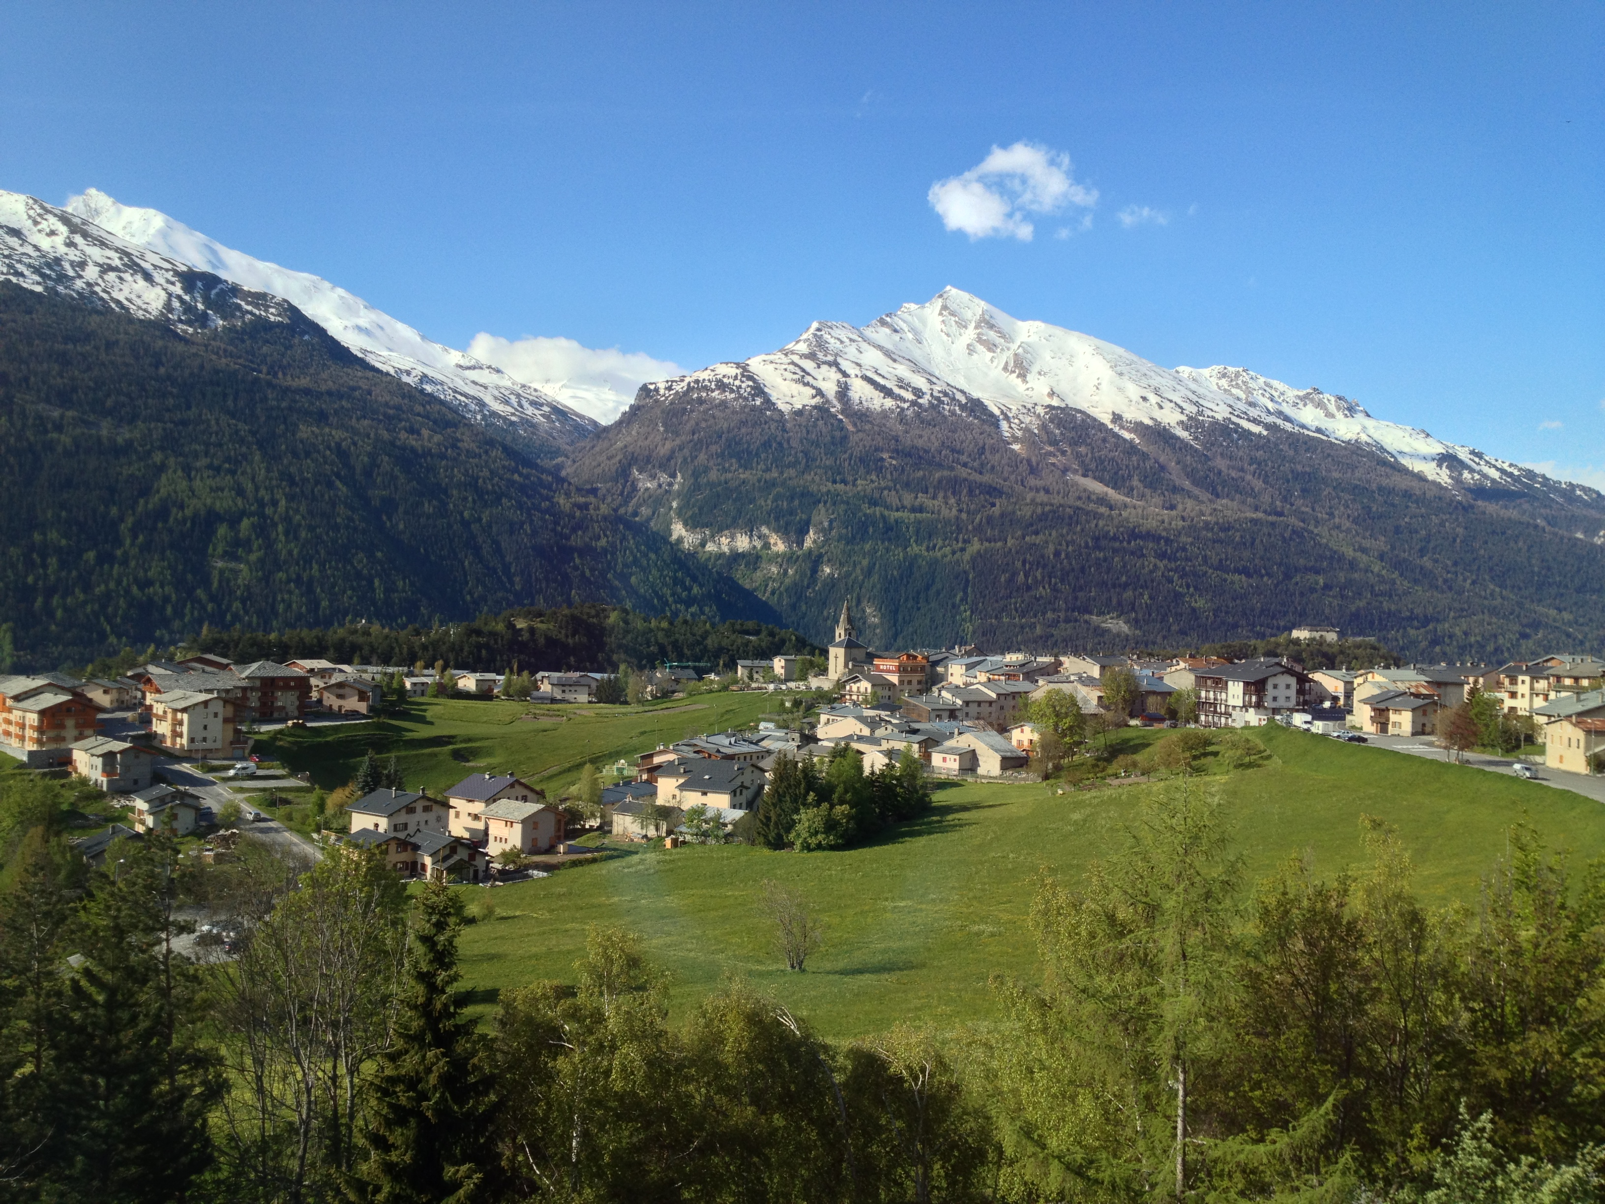
Merci beaucoup pour l'écoute

