Slide 1
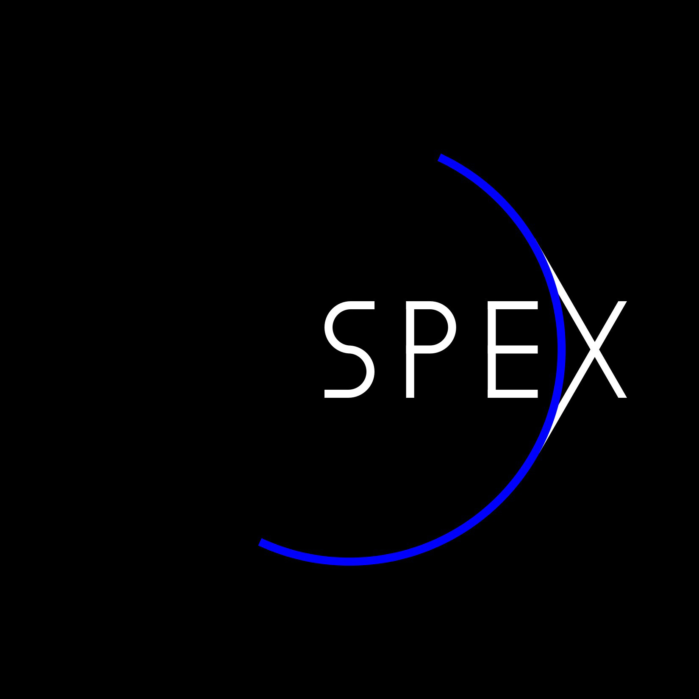
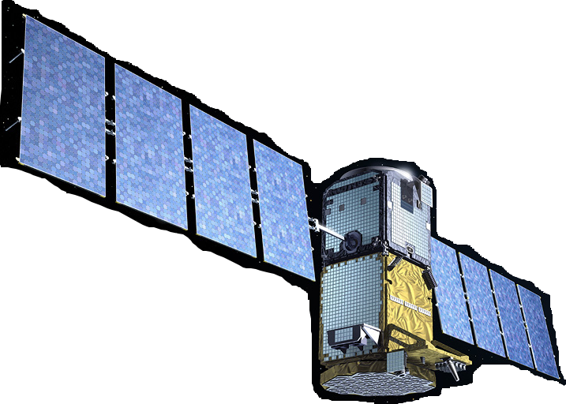







The SPEX instrument
measurement concept, polarimetric calibration,
ground-based measurements
Gerard van Harten, Leiden Observatory, The Netherlands
Polarimetric Techniques & Technology, March 24, 2014, Leiden
Frans Snik
Christoph Keller
Jeroen Rietjens
Martijn Smit
Antonio di Noia
Otto Hasekamp
Hester Volten

Slide 2
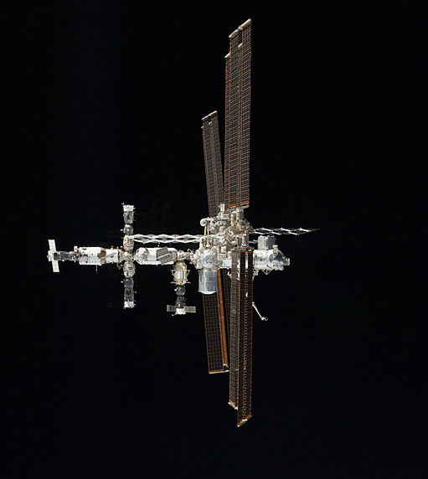
Atmospheric aerosols
Size
Shape
Chemical composition

Slide 3
Measurements
Intensity + polarization
Multiple wavelengths
Multiple scattering angles

Slide 4
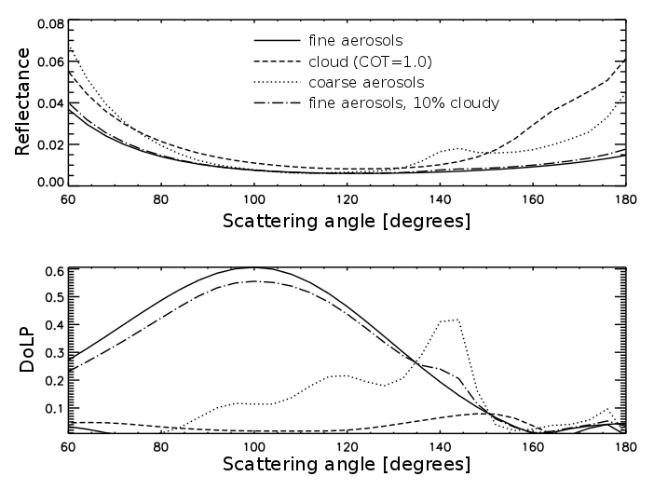
Measurements
Hasekamp+ (2011)

Slide 5
Instrument requirements
400-800 nm
30 viewing angles
ΔP=0.001+0.005.P
Snapshot
Low power
Small size
Low complexity
Modularity
Mishchenko+ (2004)
Hasekamp+ (2007)

Slide 6
Polarization modulation
Temporal modulation: rotating polarizer or waveplate, or liquid crystal.
Timing issues; Risk of failure; large power consumption.
2. Spatial modulation: split up beam according to four (three) linear polarization directions.
Differential transmission; Large.
Spectral modulation: a sinusoidal modulation on the measured intensity spectrum.
Degree of Linear Polarization (DoLP) ➔ Amplitude
Angle of Linear Polarization (AoLP) ➔ Phase

Slide 7
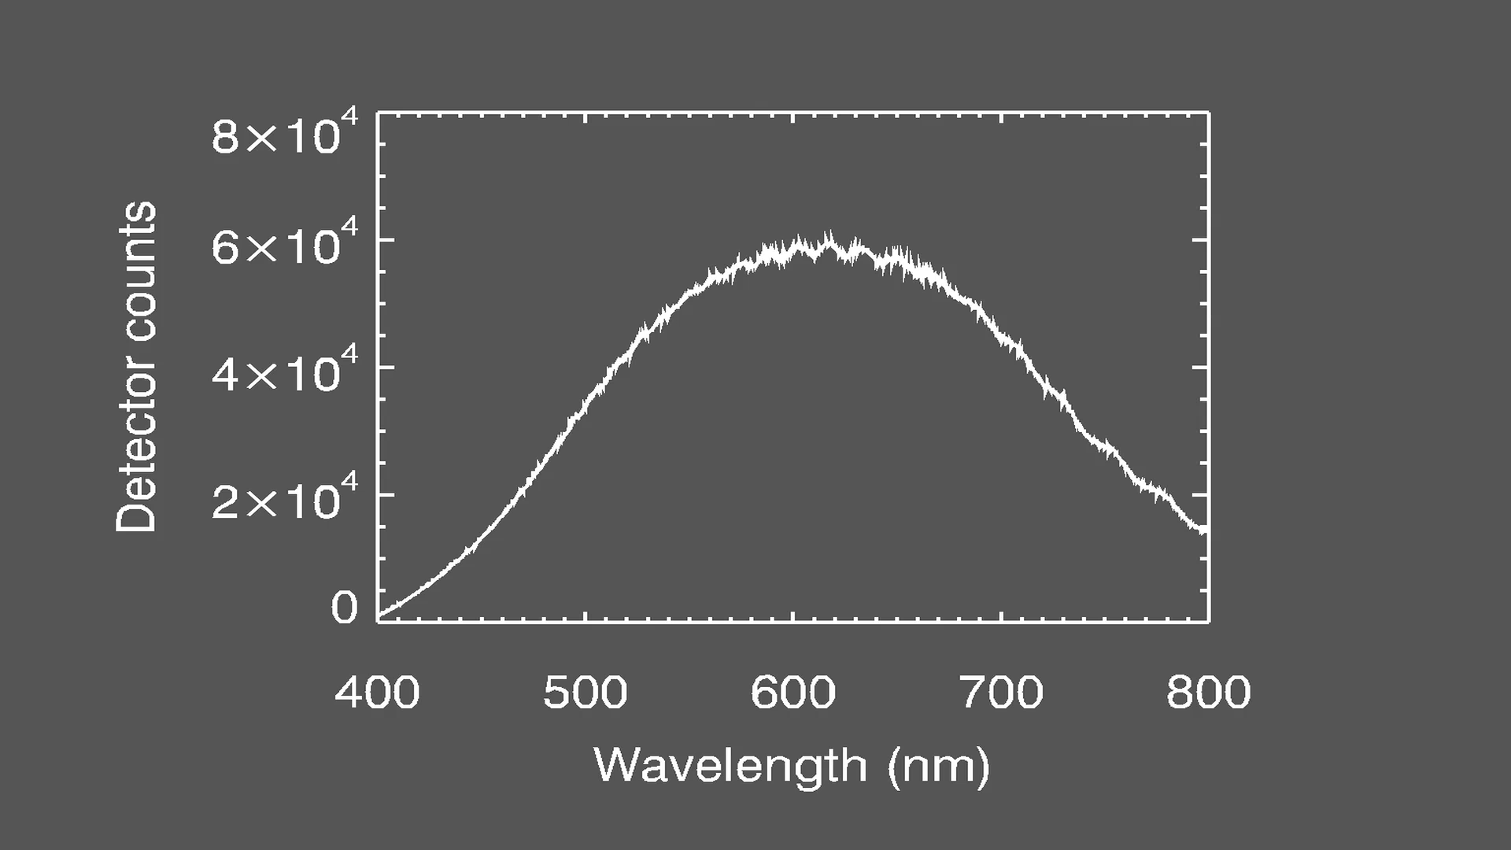
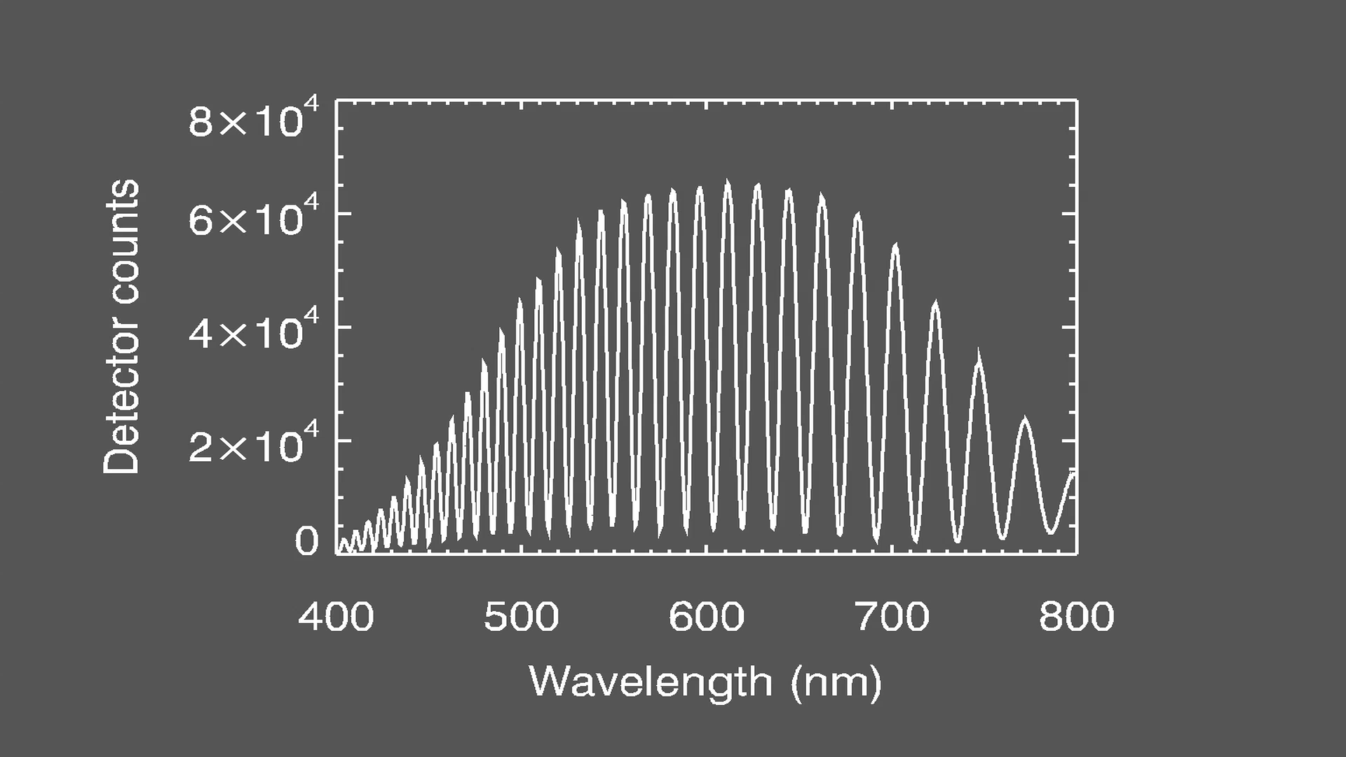
SPEX polarimetry
DoLP variation
AoLP variation
courtesy: Jeroen Rietjens (SRON)

Slide 8
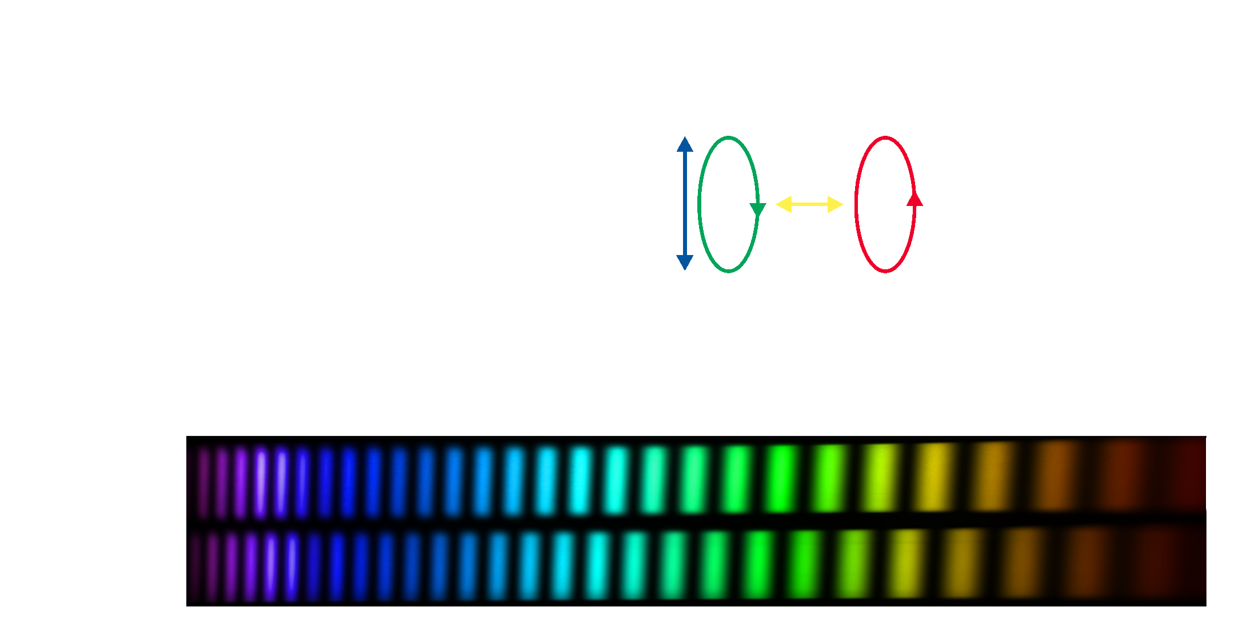
SPEX polarimetry
Snik+ (2009)

Slide 9
Polarimetric trade-off
Advantages of spectral modulation:
Fully passive
Scalable
One-shot measurement
No differential effects
Disadvantages:
Spectrograph
Spectral oversampling

Slide 10
Dual-beam spectral modulation
Intensity at full resolution
No aliasing ➔ accurate radiometry & DoLP
Redundancy ➔ differential transmission correction
Beam-exchange polarimetry ➔ averages out dark & differential transmission
Snik+ (2009)
Craven+ (2009)
Van Harten+ (2014a)

Slide 11
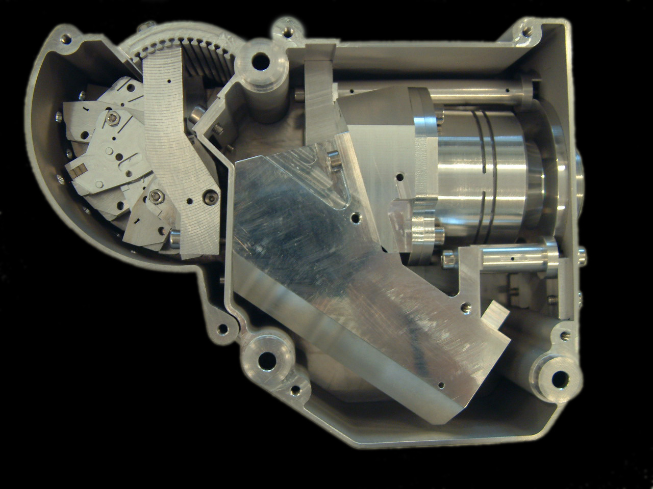
SPEX prototype
60 mm
190 mm
100 mm
spectral range: 400-750 nm
spectral resolution (flux): 2.5 nm
spectral resolution (polarization): 20 nm
volume: 2 dm³
mass: 2 kg

Slide 12
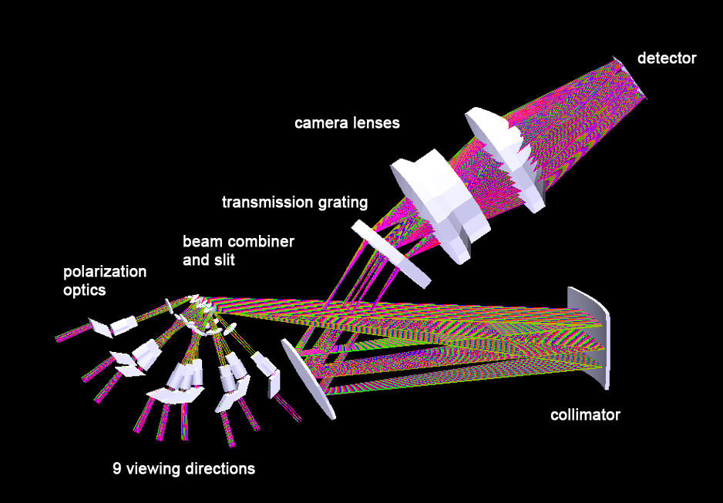
SPEX prototype
60 mm
190 mm
No instrumental
polarization
100 mm
spectral range: 400-750 nm
spectral resolution (flux): 2.5 nm
spectral resolution (polarization): 20 nm
volume: 2 dm³
mass: 2 kg

Slide 13
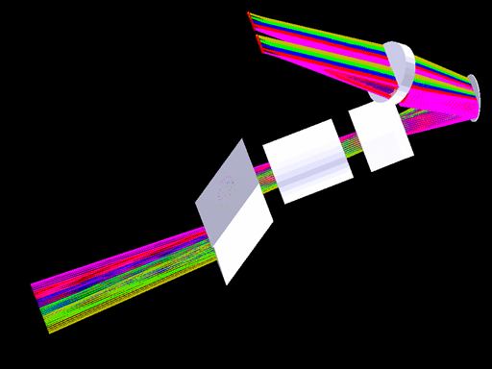
SPEX prototype
60 mm
190 mm
Athermal
Al2O3
MgF2
Fresnel
rhomb
100 mm
spectral range: 400-750 nm
spectral resolution (flux): 2.5 nm
spectral resolution (polarization): 20 nm
volume: 2 dm³
mass: 2 kg

Slide 14
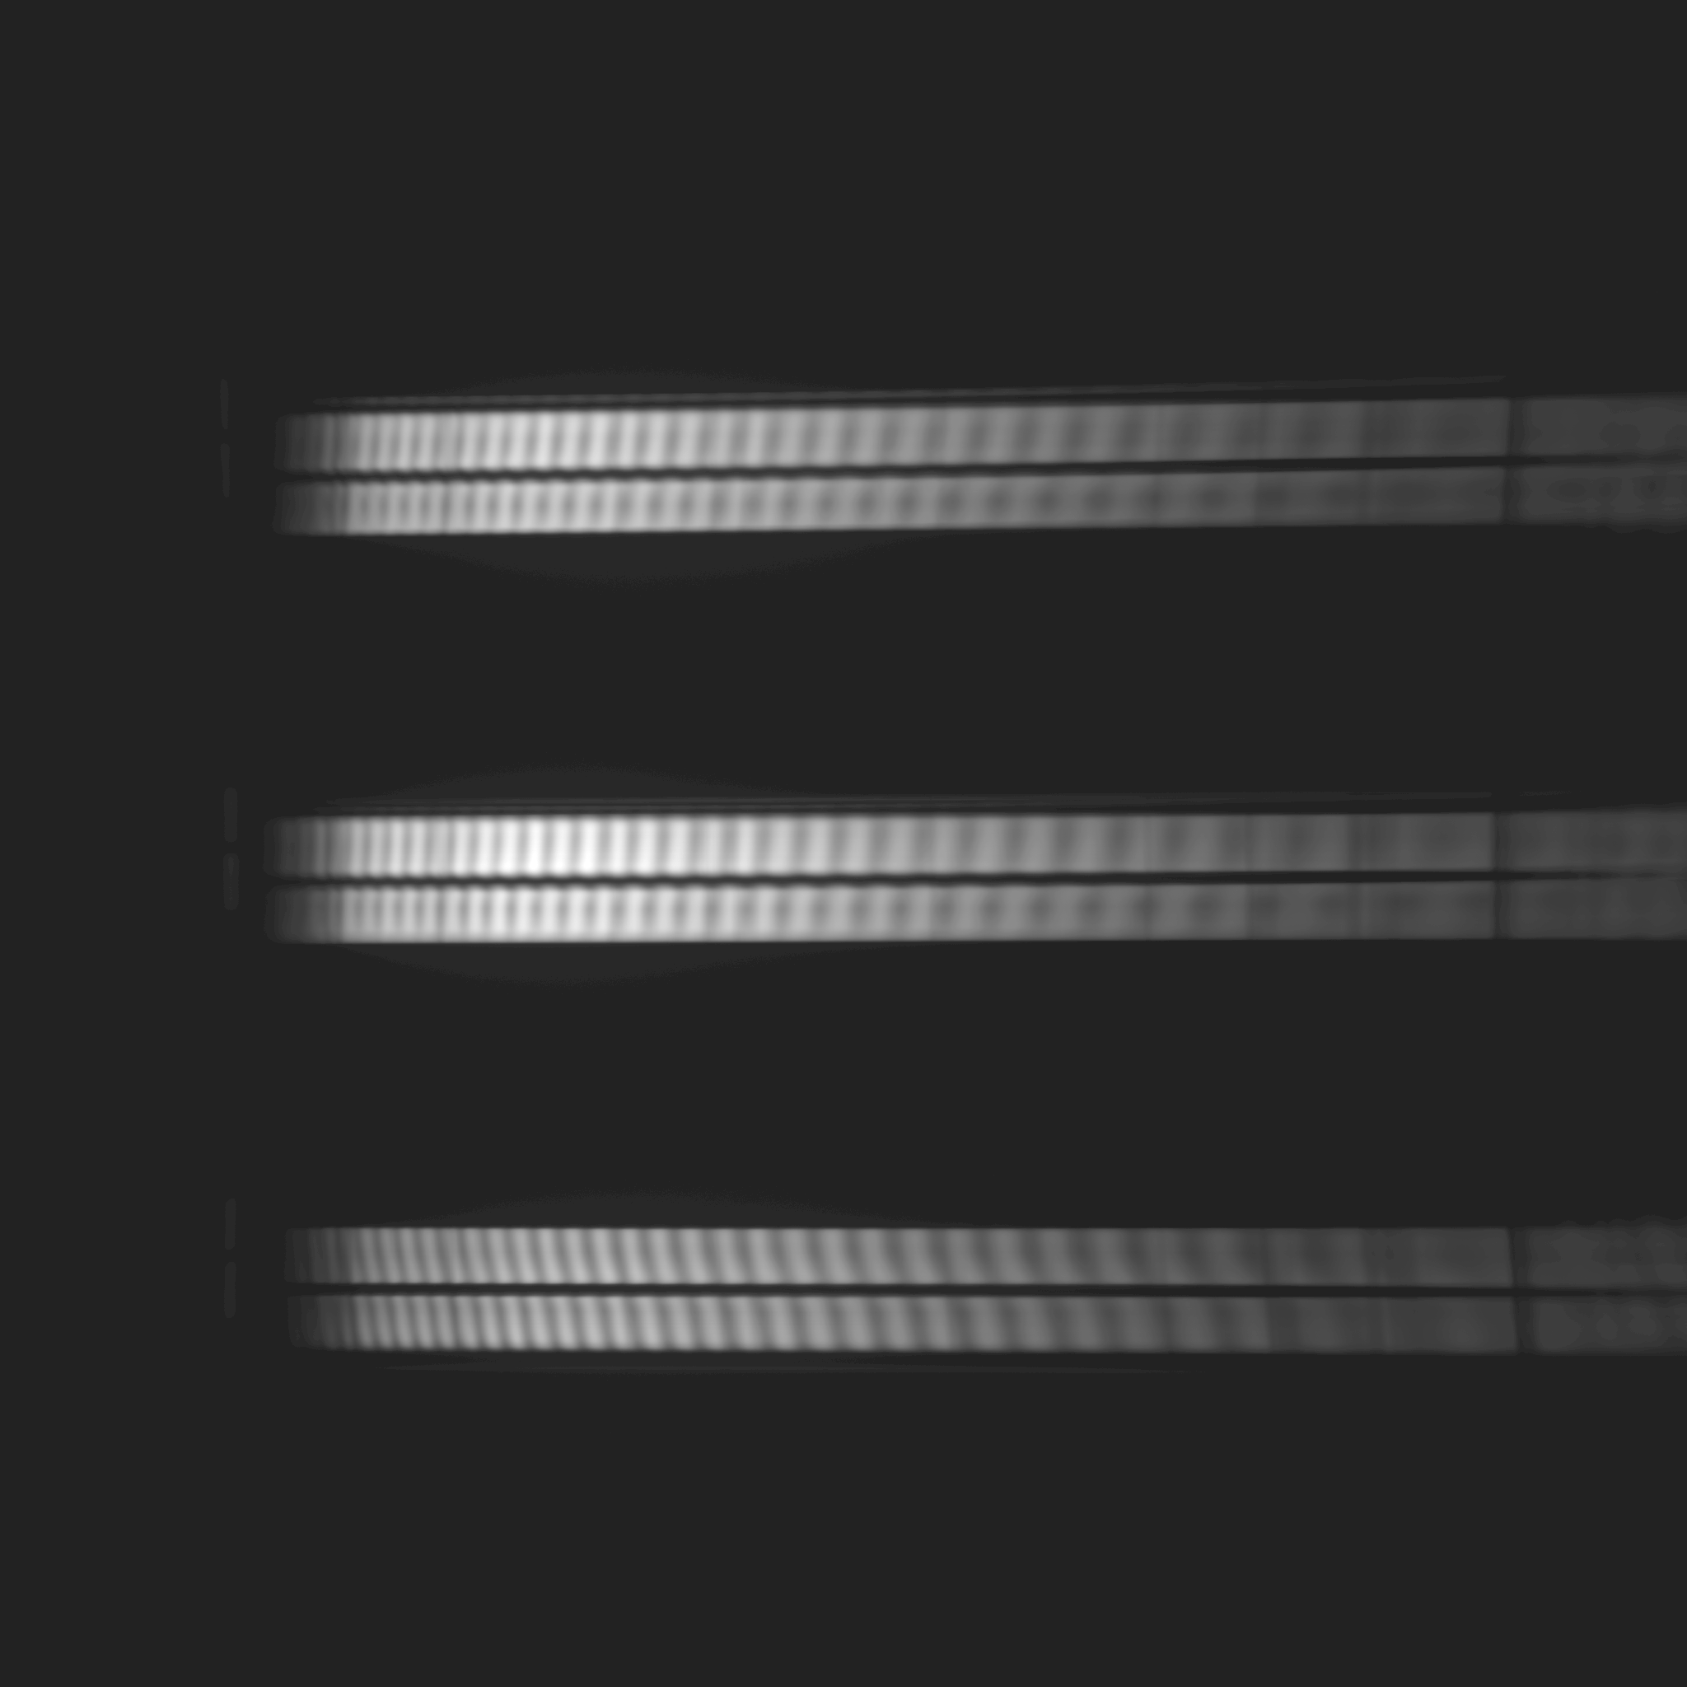
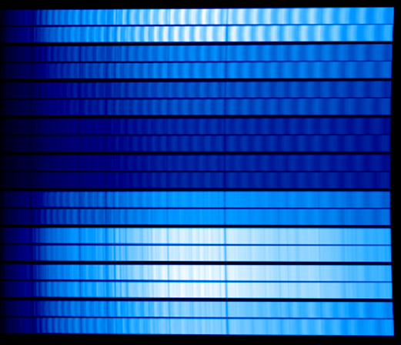
SPEX prototype
Simulation
Measurement
courtesy: Jeroen Rietjens (SRON)

Slide 15
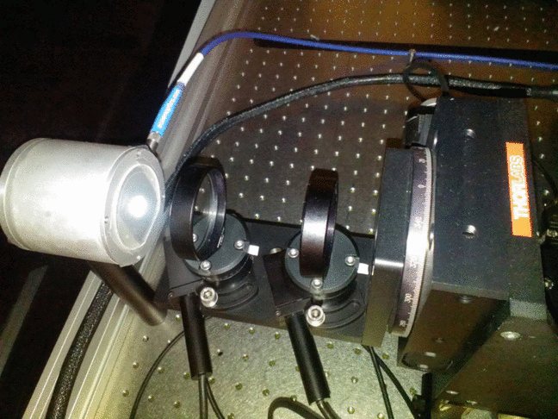

Polarization calibration
DoLP

Slide 16
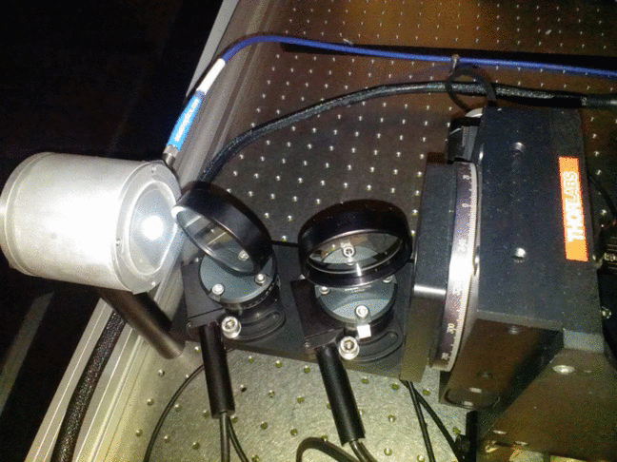

Polarization calibration
AoLP

Slide 17
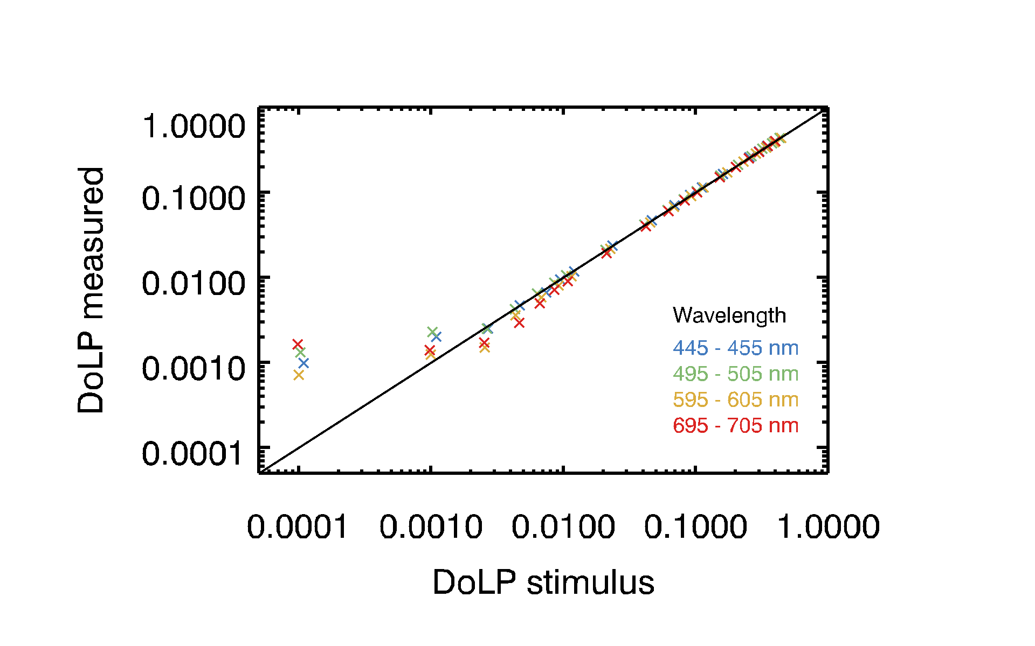
Polarization calibration
DoLP accuracy
courtesy: Jeroen Rietjens (SRON)

Slide 18
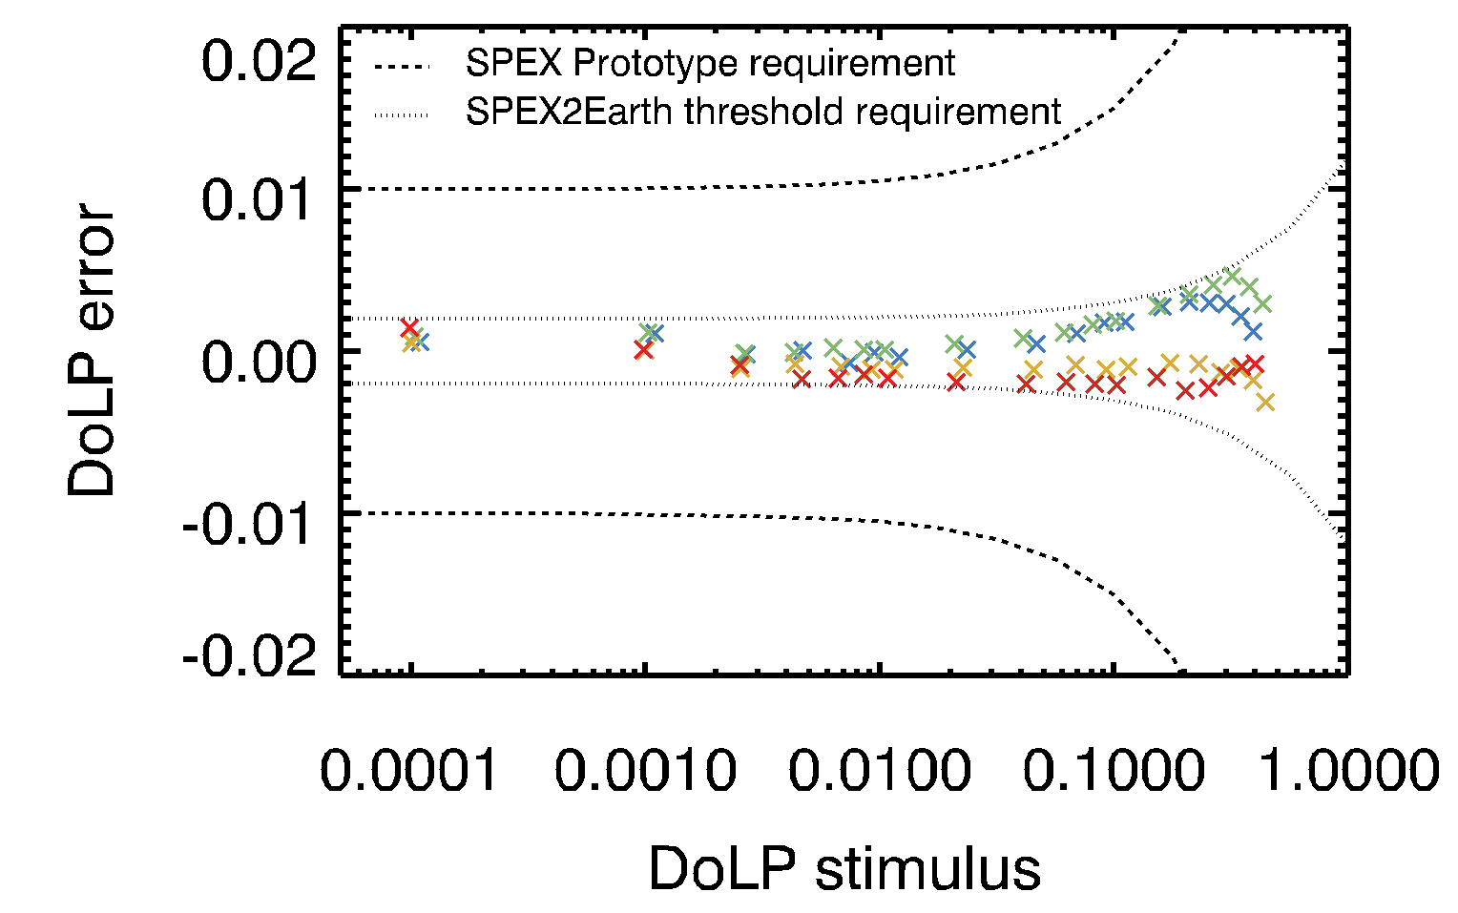
Polarization calibration
DoLP error
courtesy: Jeroen Rietjens (SRON)

Slide 19
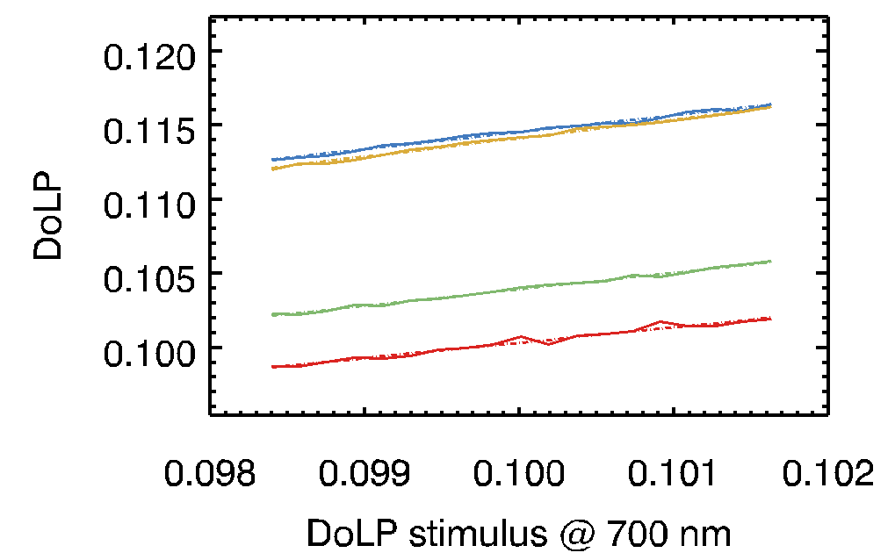
Polarization calibration
DoLP sensitivity
courtesy: Jeroen Rietjens (SRON)

Slide 20
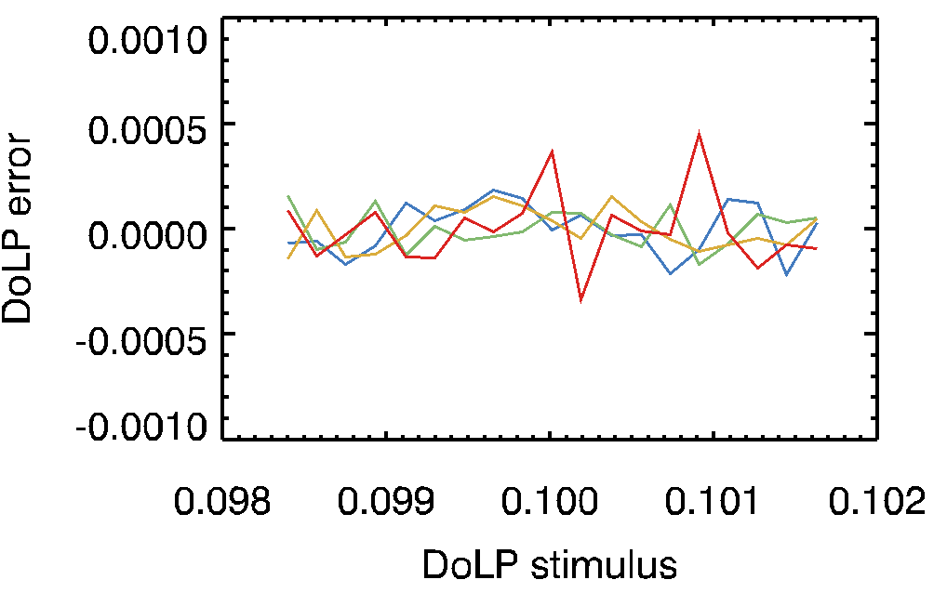
Polarization calibration
DoLP error
courtesy: Jeroen Rietjens (SRON)

Slide 21
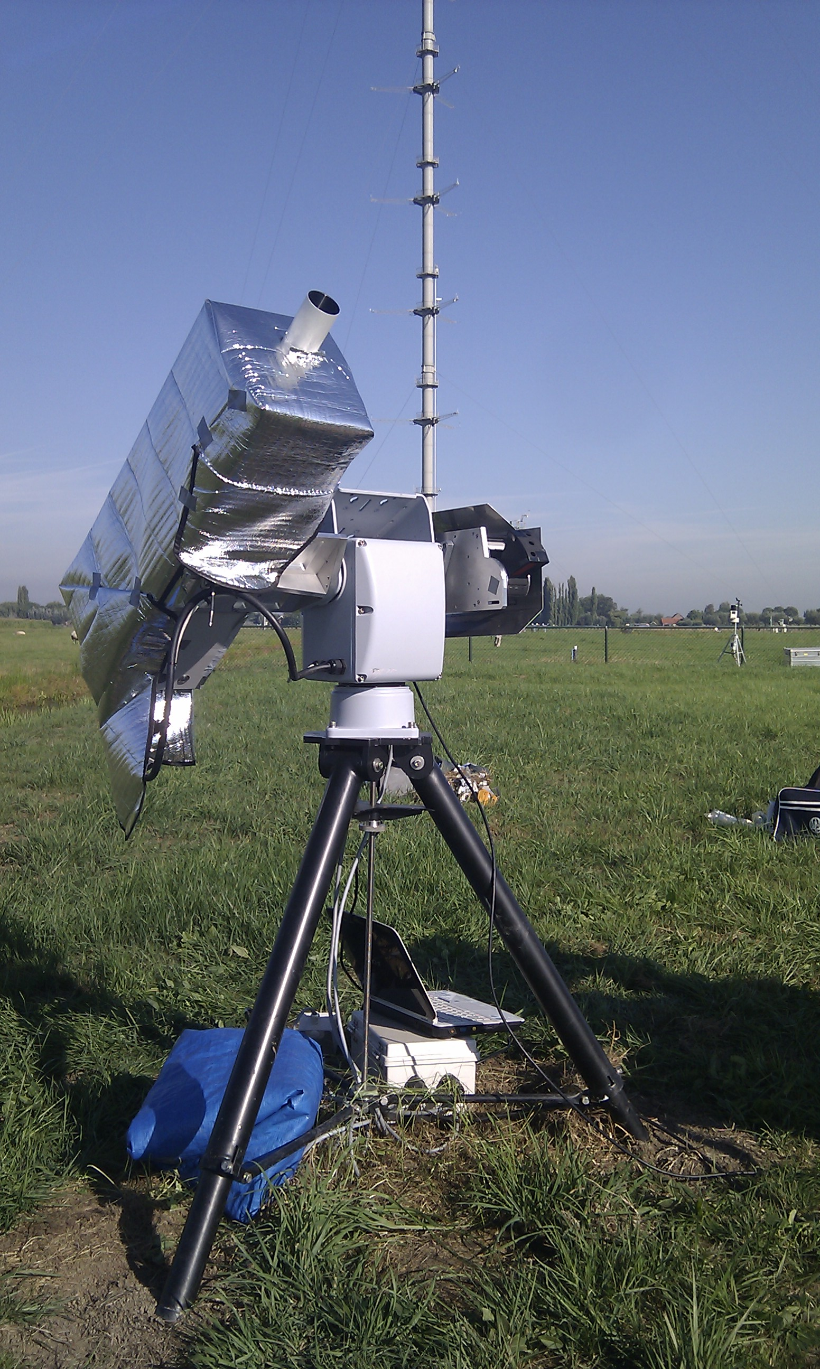
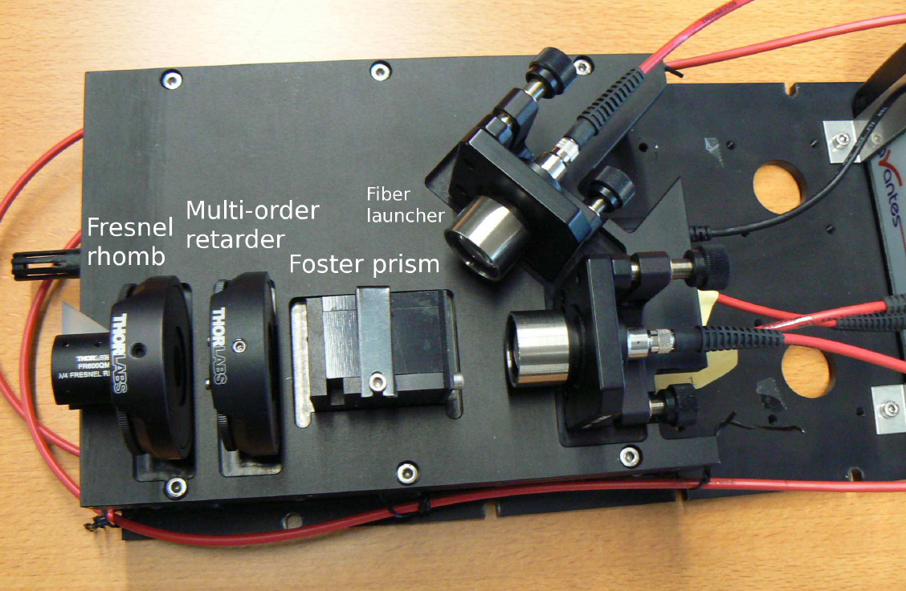
Sky measurements
Ground-based SPEX instrument
Off-the-shelf components
Low-cost
Space prototype
Meteorological site w/ AERONET
courtesy: Jos de Boer

Slide 22
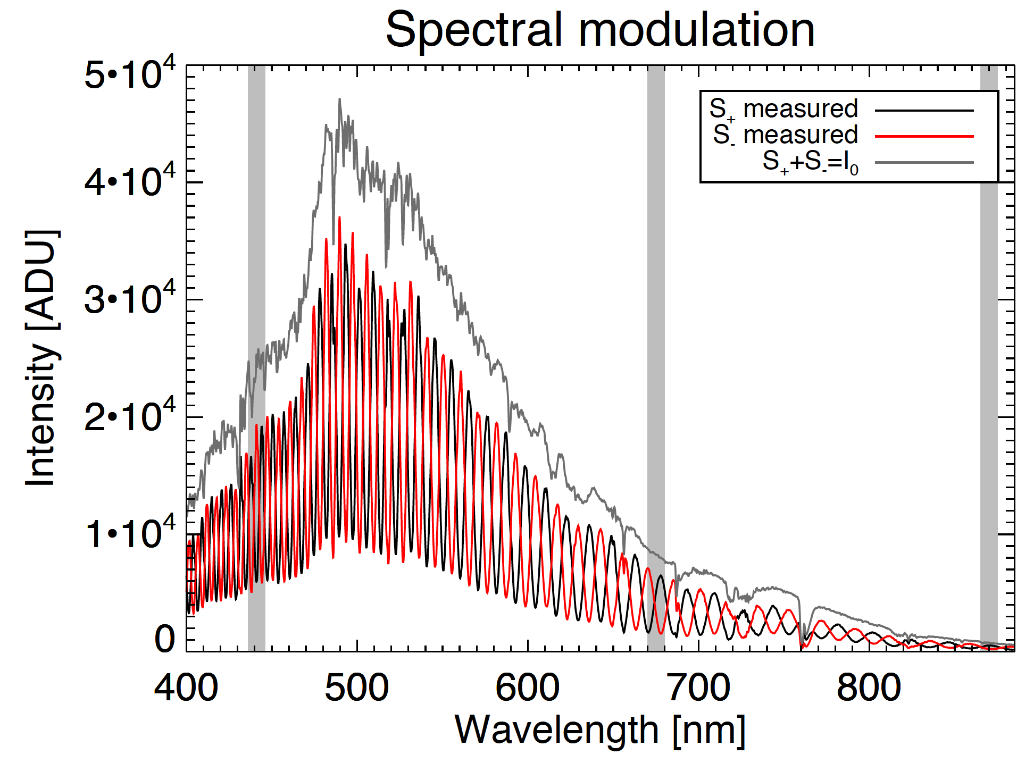
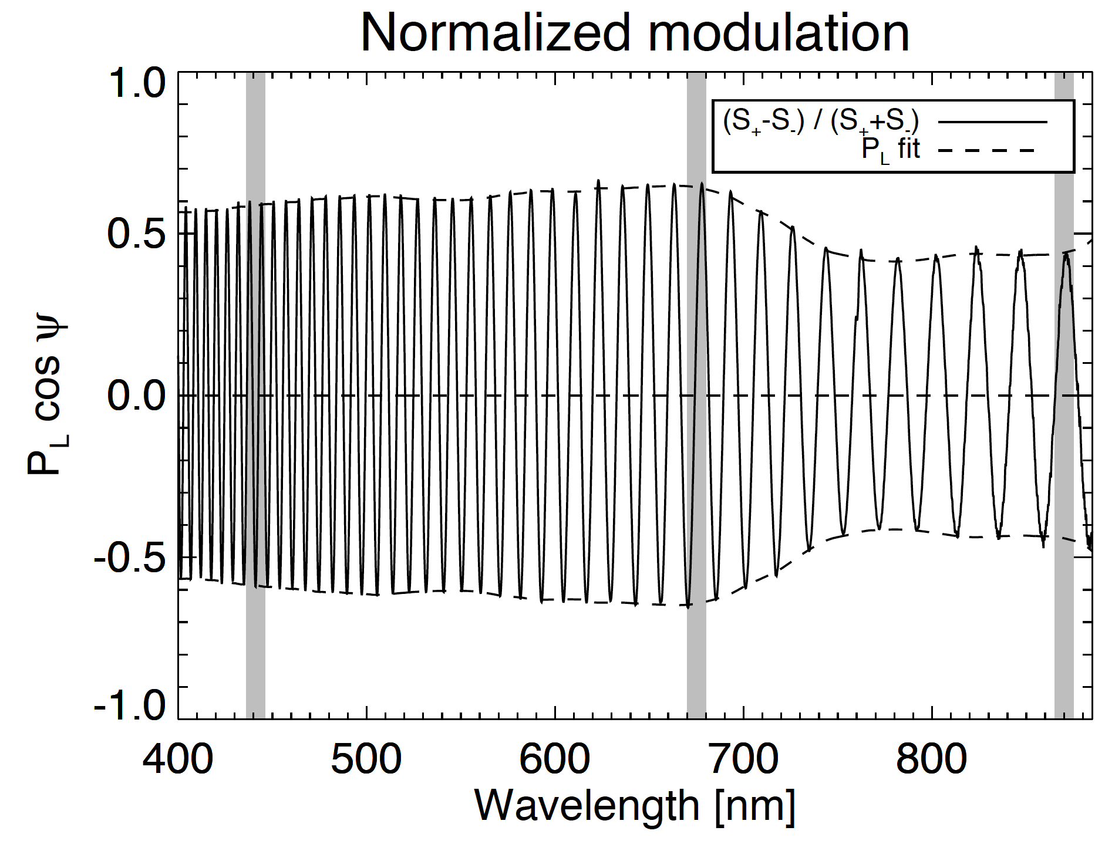
Sky measurements
Raw spectral data
Van Harten+ (2014b)

Slide 23
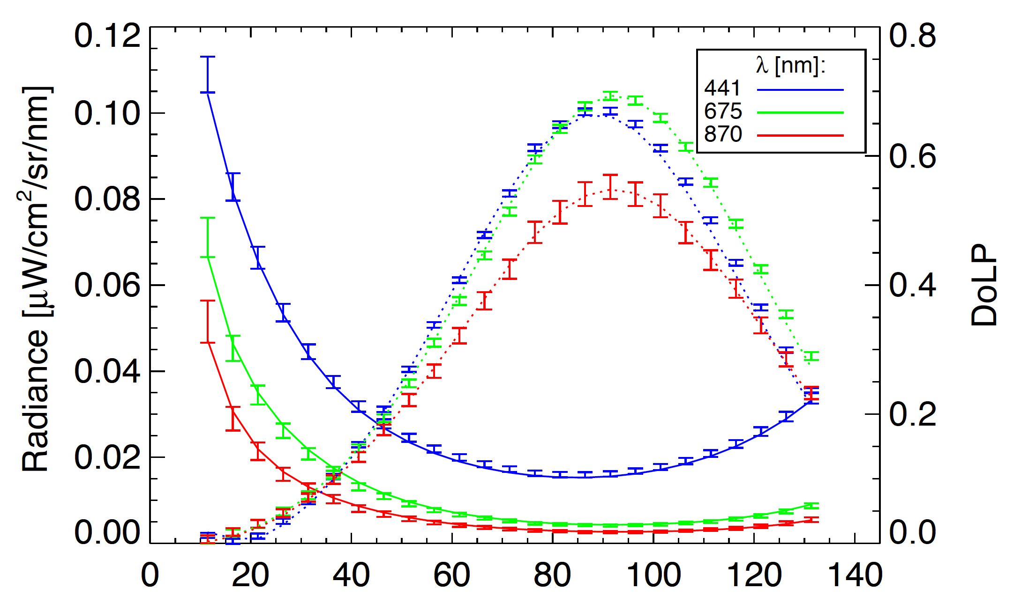
Sky measurements
Measurement & retrieval
.....
courtesy: Antonio di Noia (SRON)

Slide 24
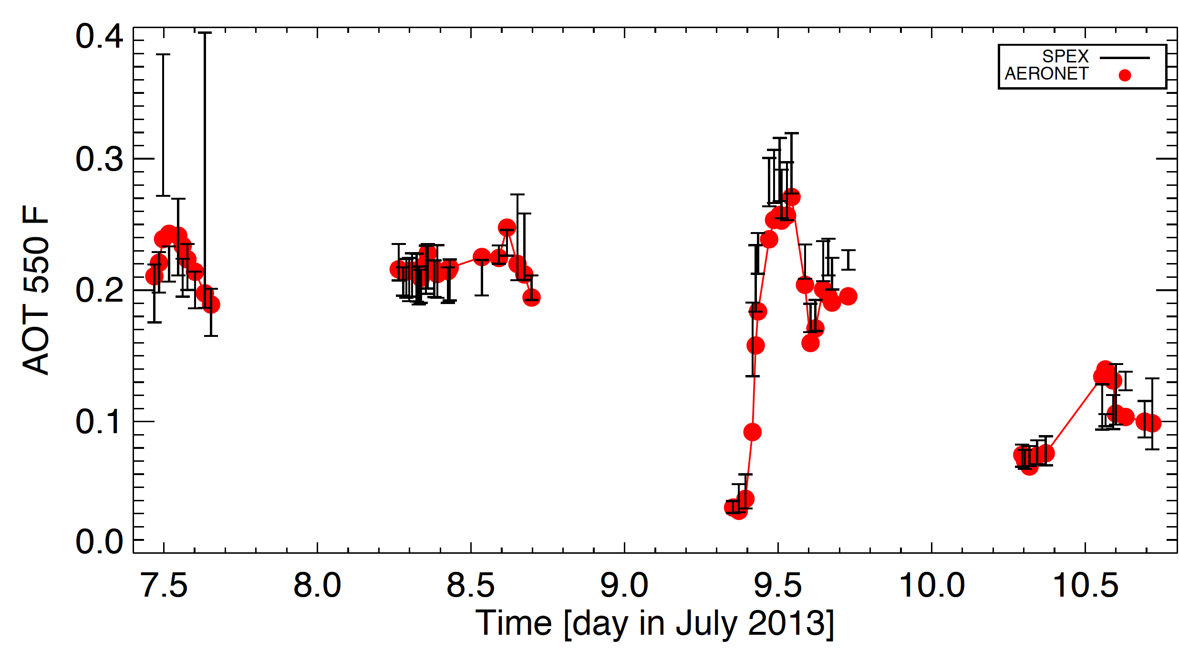
Sky measurements
Aerosol parameters
courtesy: Antonio di Noia (SRON)

Slide 25
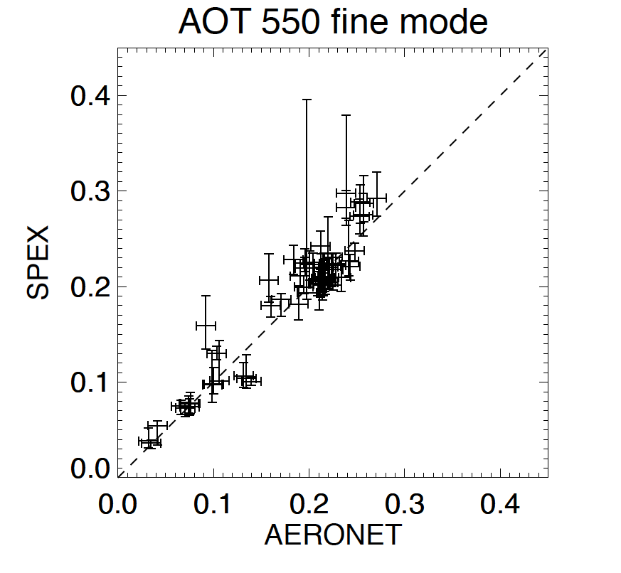
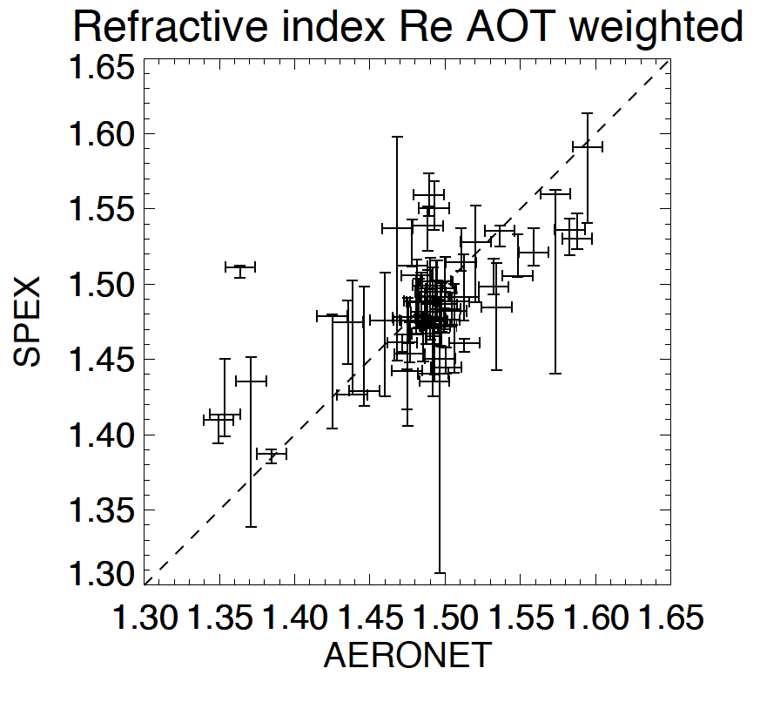
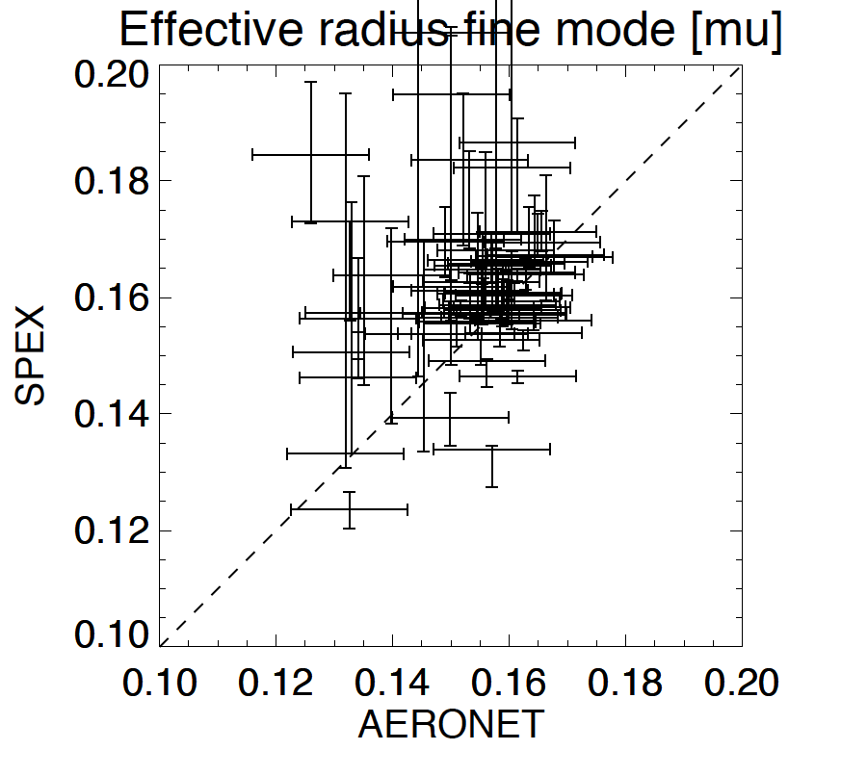
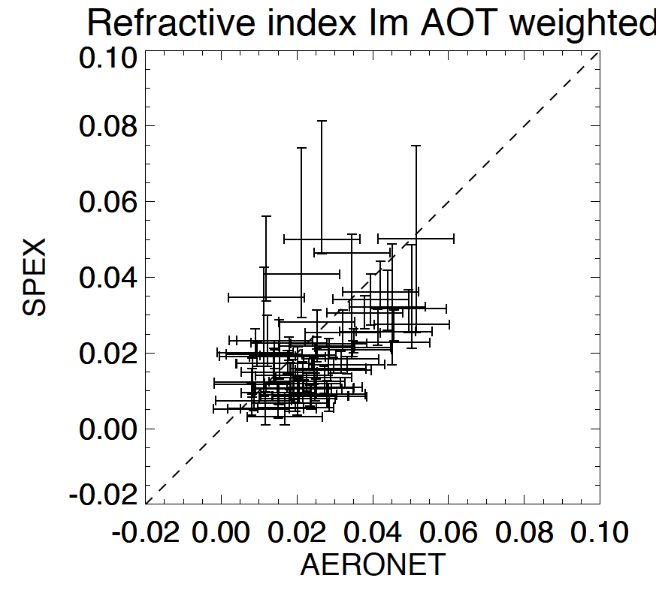
Sky measurements
courtesy: Antonio di Noia (SRON)

Slide 26
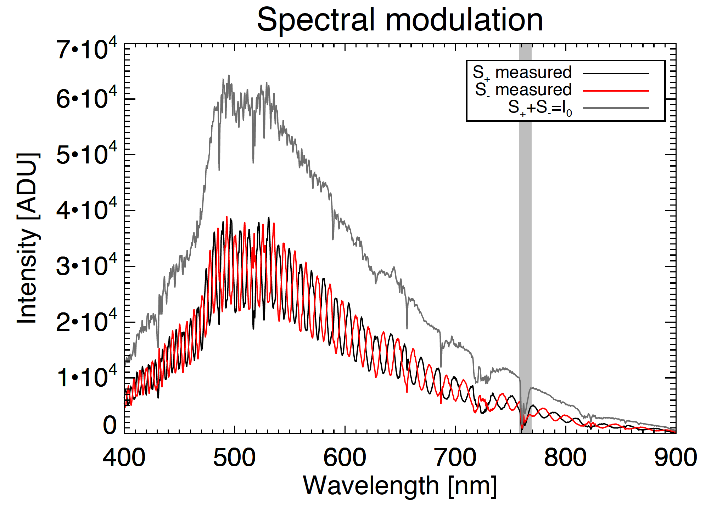
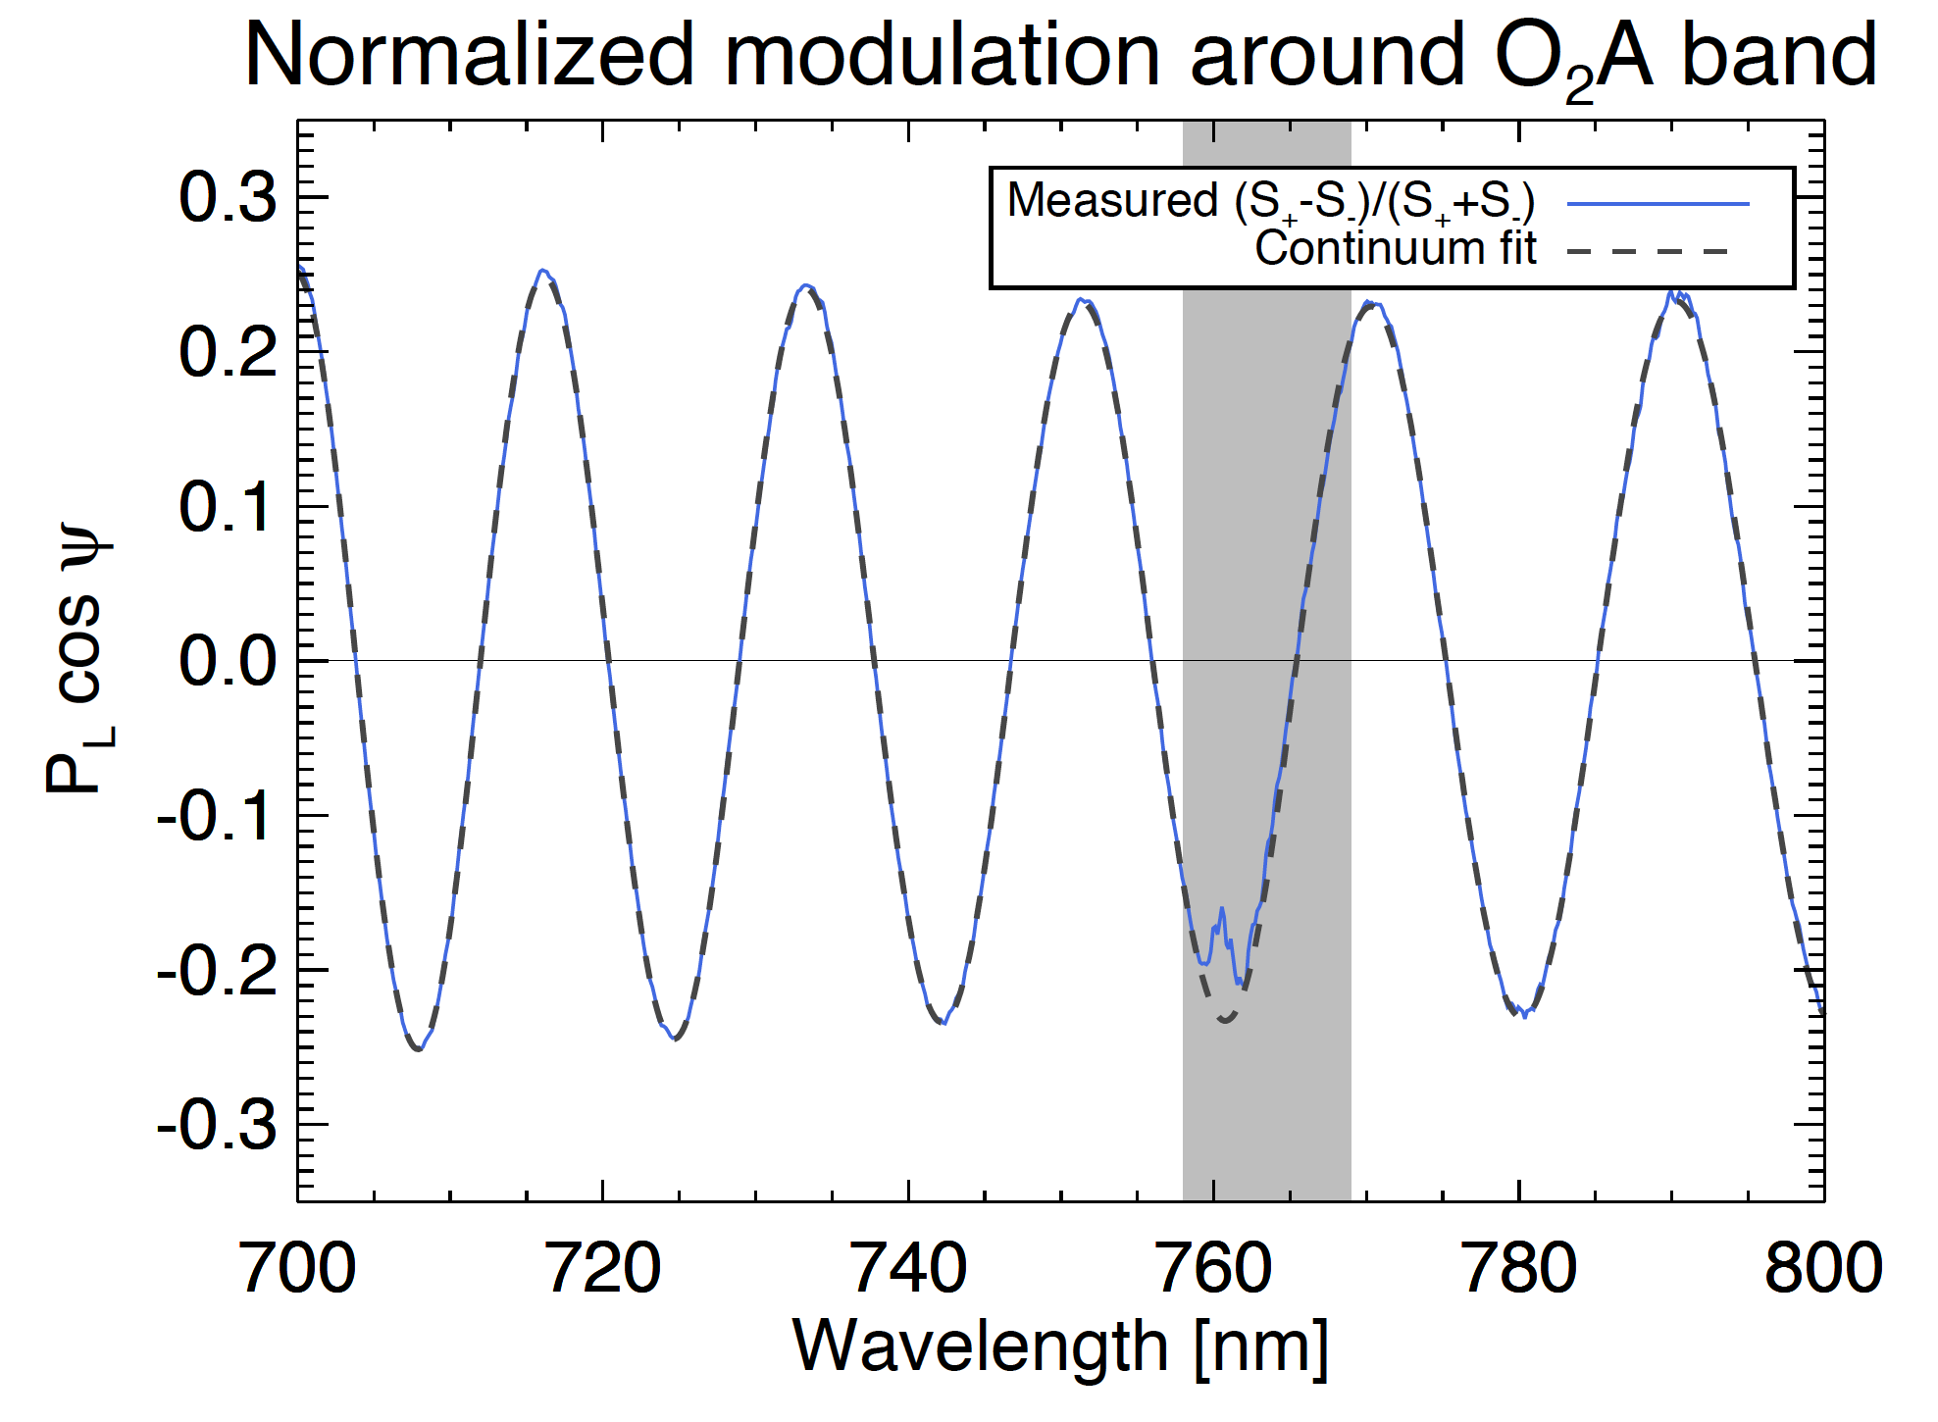
Spectral line polarimetry
Spectrograph
Aerosol vertical profiling
Line polarization?
Differential transmission correction
Van Harten+ (2014a)

Slide 27
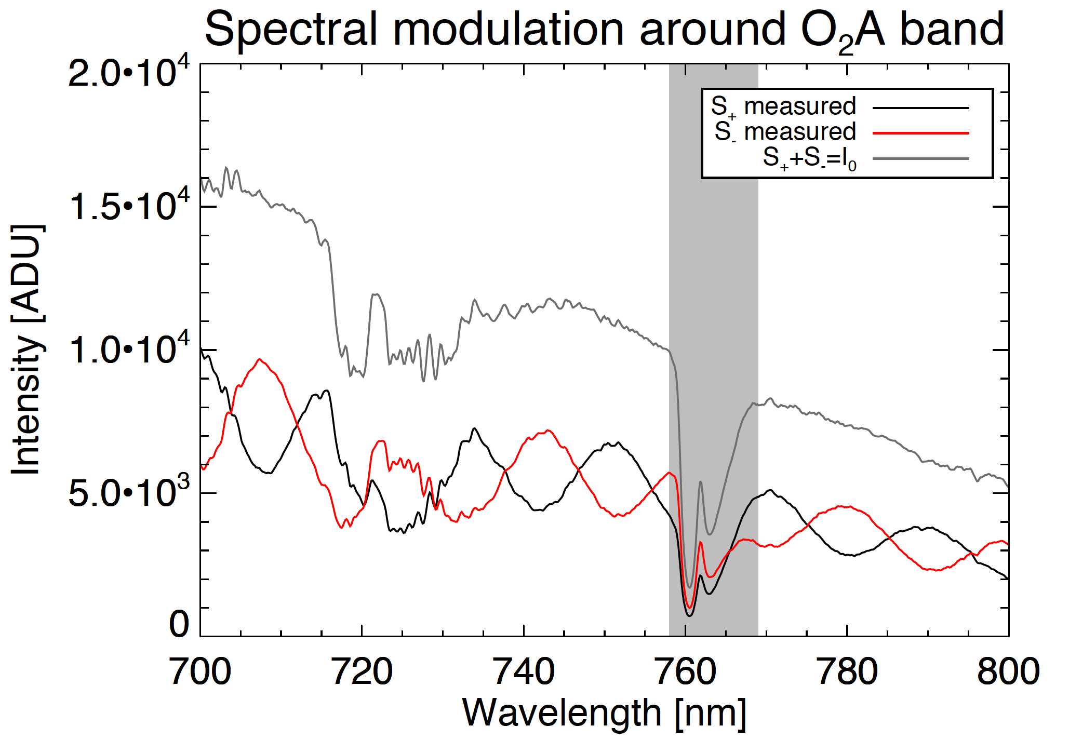
Spectral line polarimetry
Spectrograph
Aerosol vertical profiling
Line polarization?
Differential transmission correction
Van Harten+ (2014a)

Slide 28
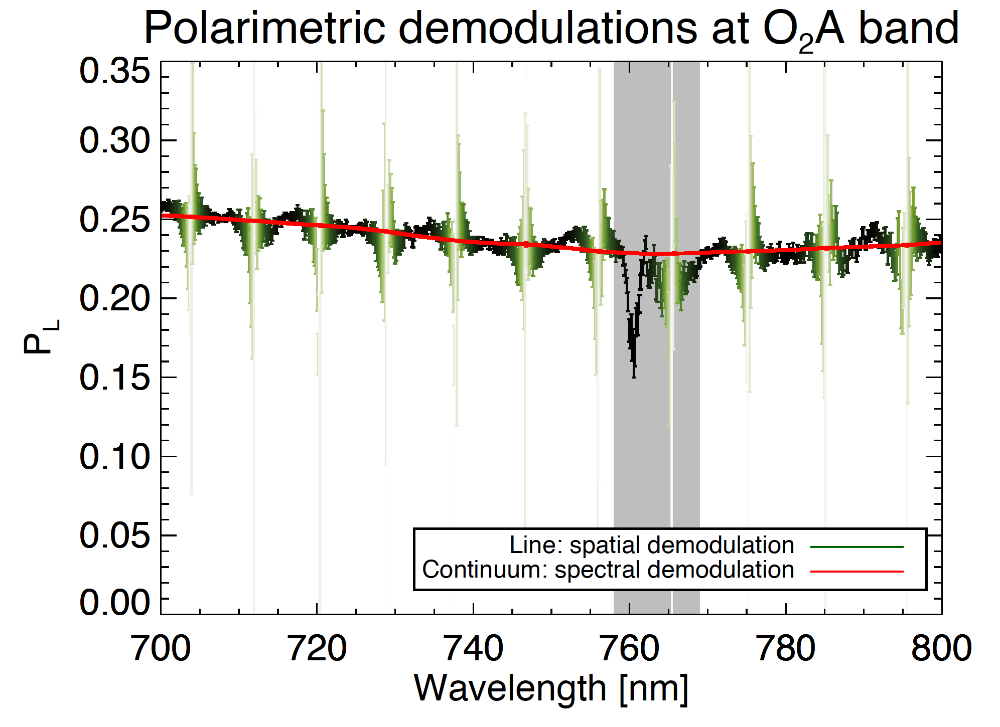
Spectral line polarimetry
O₂A band + continuum polarization
Van Harten+ (2014a)

Slide 29
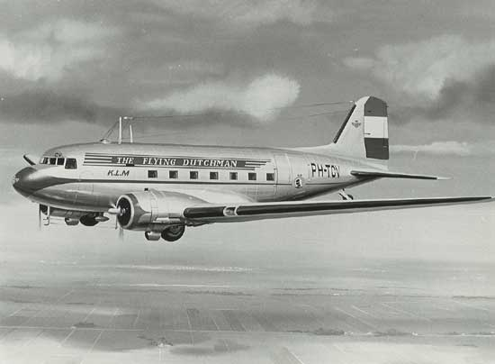
Outlook
Operational ground-based instrument
Flight campaign prototype

Slide 30
SPEX
Demonstration prototype
during lunch break!
Polarimetric Techniques & Technology, March 24, 2014, Leiden
Frans Snik
Christoph Keller
Jeroen Rietjens
Martijn Smit
Antonio di Noia
Otto Hasekamp
Hester Volten

