Slide 1
Workshop on “Calibration targets for Astronomical Polarimetry for the 0.3 to 30 μm wavelength range”
Polarized V-band Stars for In-flight Calibration
of Space-borne Solar Coronagraphs
Capobianco, Gerardo; Fineschi, Silvano
INAF- Osservatorio Astrofisico di Torino (I)
COST MP-1104 Action Workshop Zurich, January 23 and24, 2013

Slide 2
Polarized V-band Stars for In-flight Calibration of Space-borne
Solar Coronagraphs
OUTLINE
Solar Orbiter Mission and METIS instrument
Polarimetry with METIS
In-flight Polarimetric Calibrations
COST MP-1104 Action Workshop Zurich, January 23 and24, 2013

Slide 3
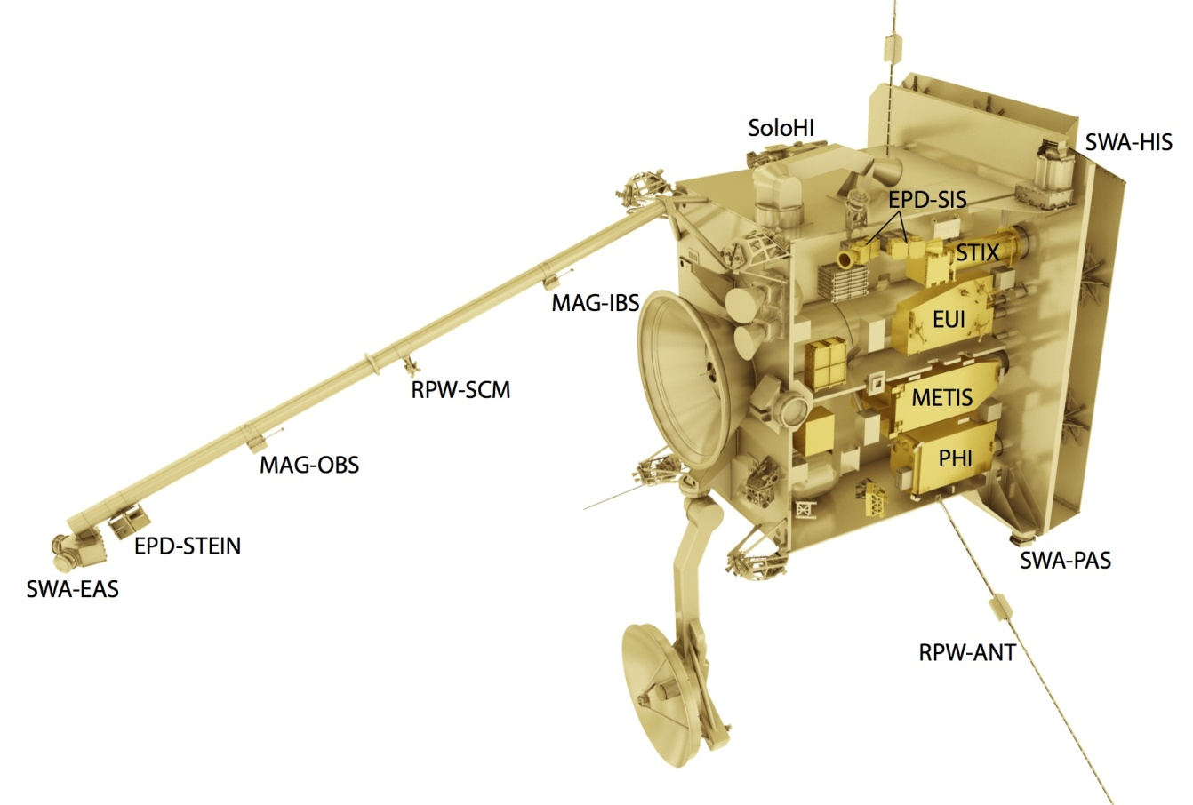
Polarized V-band Stars for In-flight Calibration of Space-borne
Solar Coronagraphs
ESA SOLAR ORBITER MISSION/Description
ESA Cosmic Vision 2015-2025 mission to be launched on January 2017
Main objective of the mission is to answer to the question: “How does the Sun create and control the heliosphere?”
(http://www.solarorbiter.org/spacecraft.php)
COST MP-1104 Action Workshop Zurich, January 23 and24, 2013

Slide 4
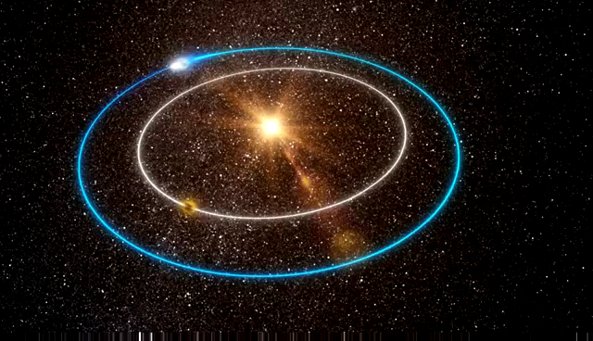
Polarized V-band Stars for In-flight Calibration of Space-borne
Solar Coronagraphs
SOLAR ORBITER MISSION/Orbits (1)
Closest approach to the Sun: 0.29 AU
Orbit inclination (≤32°) for the study of the polar regions of the Sun
Full Solar Orbiter presentation movie available at: http://www.youtube.com/watch?v=LLMfGeIkA7E
COST MP-1104 Action Workshop Zurich, January 23 and24, 2013

Slide 5
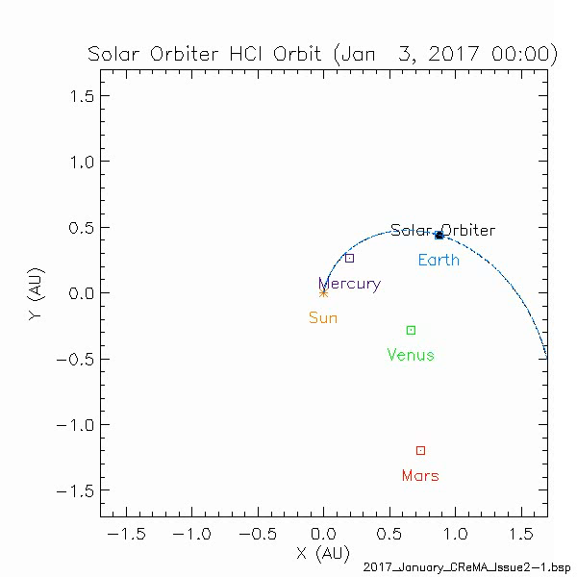
Polarized V-band Stars for In-flight Calibration of Space-borne
Solar Coronagraphs
SOLAR ORBITER MISSION/Orbits (2)
Solar ORBitEr TEam (SORBETE) of the University of Alcalá Space Research Group (SRG)
COST MP-1104 Action Workshop Zurich, January 23 and24, 2013

Slide 6
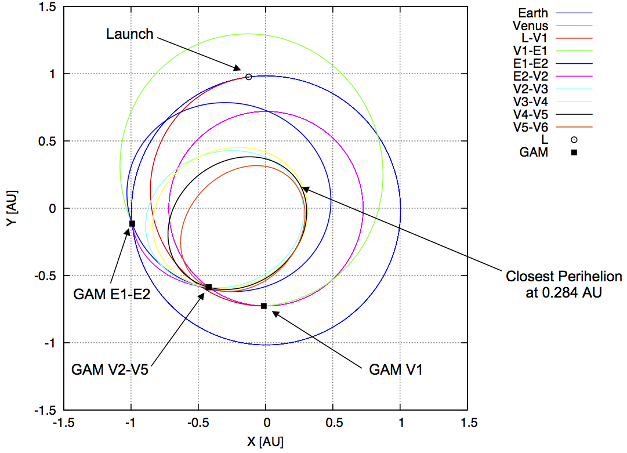
Polarized V-band Stars for In-flight Calibration of Space-borne
Solar Coronagraphs
SOLAR ORBITER MISSION/Orbits (3)
Solar Orbiter's trajectory viewed from above the ecliptic
http://www.solarorbiter.org
COST MP-1104 Action Workshop Zurich, January 23 and24, 2013

Slide 7
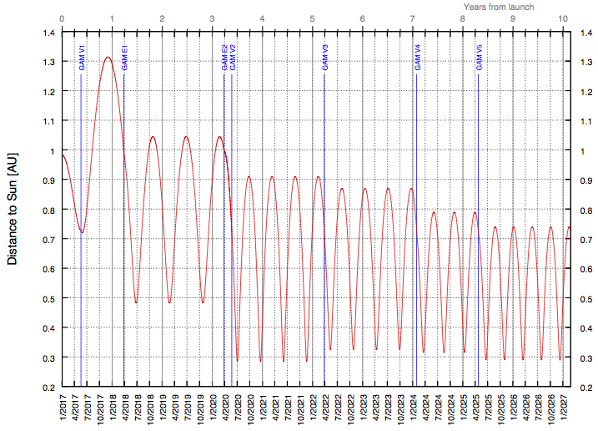
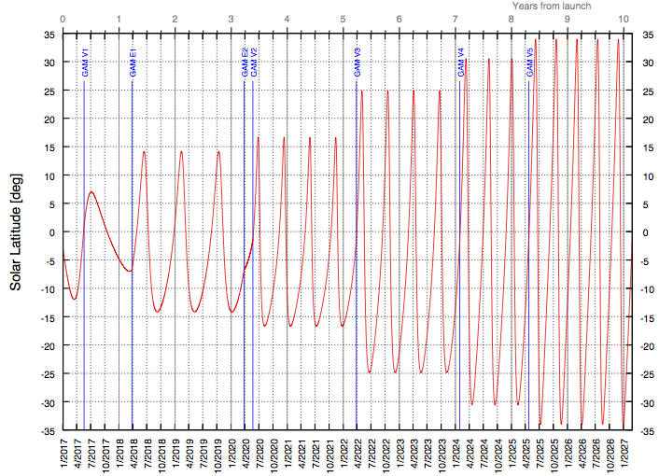
Polarized V-band Stars for In-flight Calibration of Space-borne
Solar Coronagraphs
SOLAR ORBITER MISSION/Orbits (4)
Heliocentric Distance vs. Time
Heliocentric Latitude vs. Time
http://www.solarorbiter.org
We use these information for the evaluation of the portion of sky visible during the mission
COST MP-1104 Action Workshop Zurich, January 23 and24, 2013

Slide 8
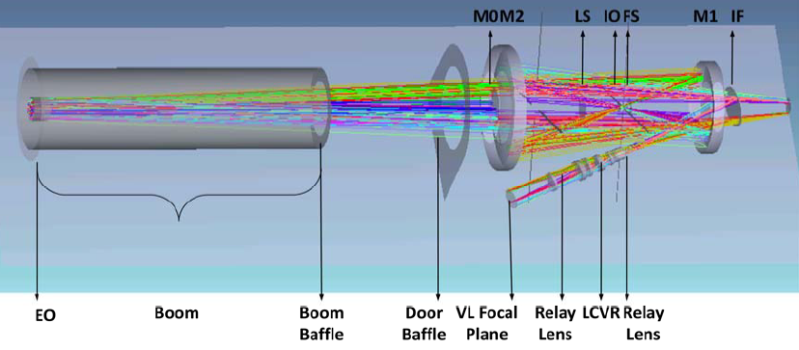
Polarized V-band Stars for In-flight Calibration of Space-borne
Solar Coronagraphs
METIS CORONAGRAPH (1)
METIS: Multi Element Telescope for Imaging and Spectroscopy
Fineschi et al., Proc. of SPIE Vol. 8443 84433H (2012)
COST MP-1104 Action Workshop Zurich, January 23 and24, 2013

Slide 9
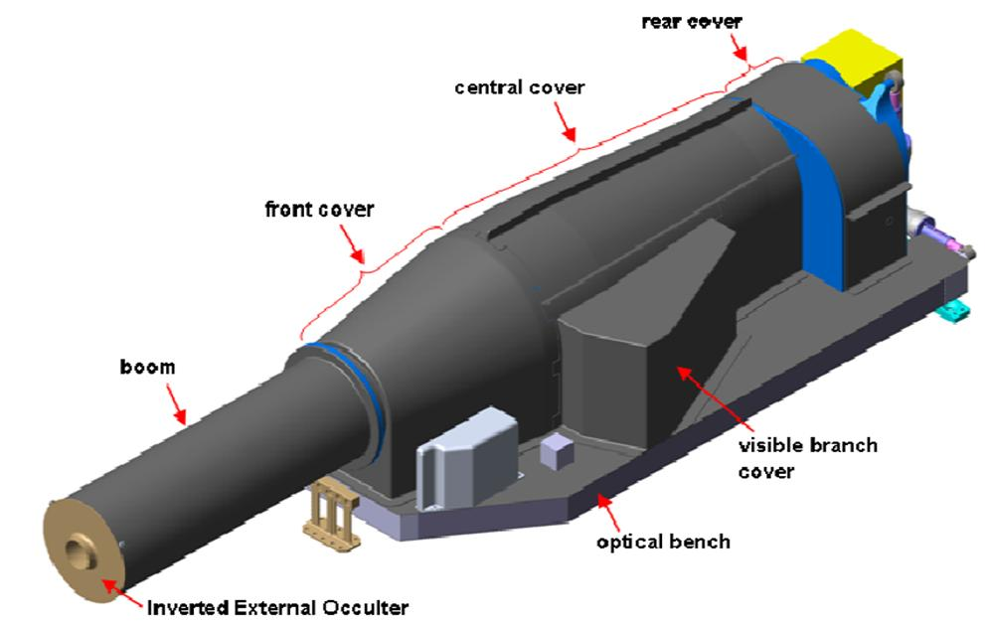
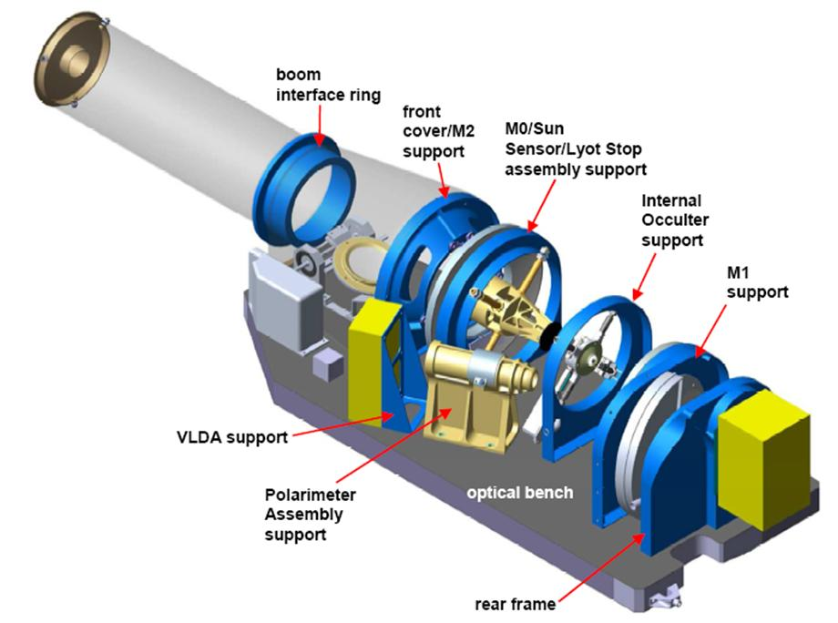
Polarized V-band Stars for In-flight Calibration of Space-borne
Solar Coronagraphs
METIS CORONAGRAPH (2)
Fineschi et al., Proc. of SPIE Vol. 8443 84433H (2012)
COST MP-1104 Action Workshop Zurich, January 23 and24, 2013

Slide 10
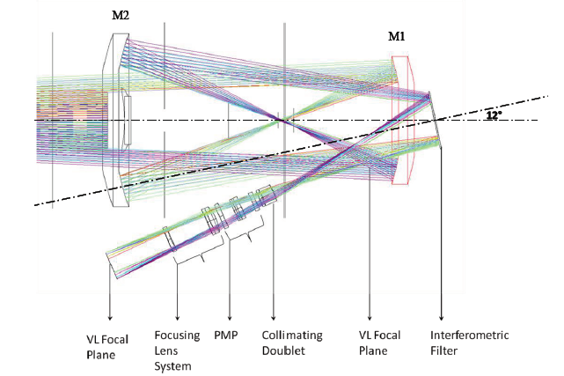
Polarized V-band Stars for In-flight Calibration of Space-borne
Solar Coronagraphs
METIS CORONAGRAPH/VL CHANNEL
Operative WL:
580-640 nm (limited by bandpass filter)
Astronomical standard V-band:
507-595 nm
Crescenzio et al., Proc. of SPIE Vol. 8443 84433J (2012)
COST MP-1104 Action Workshop Zurich, January 23 and24, 2013

Slide 11
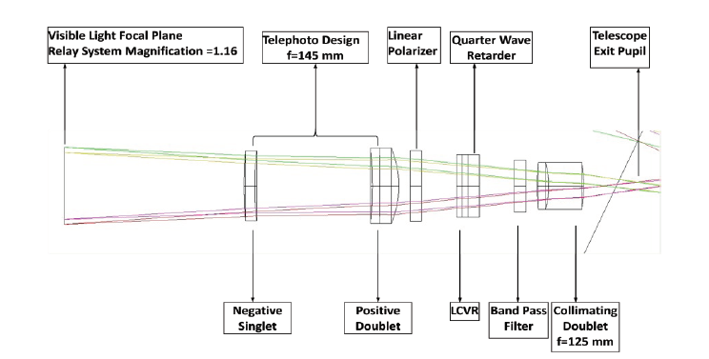
Polarized V-band Stars for In-flight Calibration of Space-borne
Solar Coronagraphs
METIS VL CHANNEL/POLARIMETER
Crescenzio et al., Proc. of SPIE Vol. 8443 84433J (2012)
COST MP-1104 Action Workshop Zurich, January 23 and24, 2013

Slide 12
Polarized V-band Stars for In-flight Calibration of Space-borne
Solar Coronagraphs
EXPECTED PERFORMANCES OF THE VL CHANNEL
The main objective of the METRIS VL channel is the detection of the linearly polarized brightness (pB) of the solar K-corona in order to evaluate the electronic density and the other physical parameters (i.e. effective coronal temperature, upper limit of the He abundance,.. )
In order to estimate the electron density with an accuracy better than 2-3%, the accuracy in the measurements of pB must be better than 1%.
(Fineschi et al., 2005; Capobianco et al., 2012)
The polarimeter and the whole channel has been designed in order to satisfy these requirements (instrumental pB ≤ 1%) .
(Capobianco et al., 2012)
COST MP-1104 Action Workshop Zurich, January 23 and24, 2013

Slide 13
Polarized V-band Stars for In-flight Calibration of Space-borne
Solar Coronagraphs
IN-FLIGHT CALIBRATIONS
The LC-based achromatic polarimeter assure good performances for space applications but the response should have variations with time and we expect to measure the pB with high accuracy.
IN-FLIGHT calibration is REQUIRED!!!
One of the suggested ways in order to calibrate the METIS VL channel is to use well knows linearly polarized stars.
Requirements on the polarization of the stars are:
- Degree of linear polarization higher than at list 5% (10% suggested)
Degree of linear polarization fixed or predictable during the time
Minimum Detectable Magnitude : 7 – 8 (V < 8)
COST MP-1104 Action Workshop Zurich, January 23 and24, 2013

Slide 14
Polarized V-band Stars for In-flight Calibration of Space-borne
Solar Coronagraphs
NOTES on the USED FORMALISM
Using the Stokes formalism, the light is, from the polarization point of view, fully described by the vector:
Where I is the intensity, Q and U the two parameters of the linear polarization and V the parameter of the circular polarization. The polarized brightness (pB) is defined as:
COST MP-1104 Action Workshop Zurich, January 23 and24, 2013

Slide 15
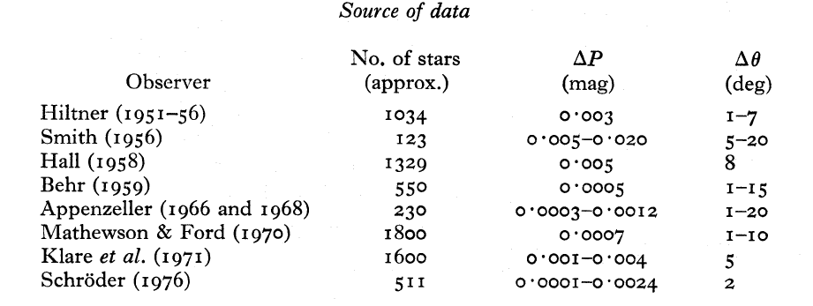
Polarized V-band Stars for In-flight Calibration of Space-borne
Solar Coronagraphs
POLARIZED STARS CATALOGUE (1)
The used catalogue is:
A catalogue of linear polarization measurements for 5070 stars
Author(s): D.J. Axon
Year: 1976
Ref: Mon. Not. R. Astr. Soc. , 177, 499-511 (1976)
Available on: http://vizier.u-strasbg.fr/viz-bin/VizieR-3
For all the stars Q and U parameters are given
D. J.Axon and R.S. Ellis Mon. Not. R. Astr. Soc. (1976) 177, 499-511
COST MP-1104 Action Workshop Zurich, January 23 and24, 2013

Slide 16
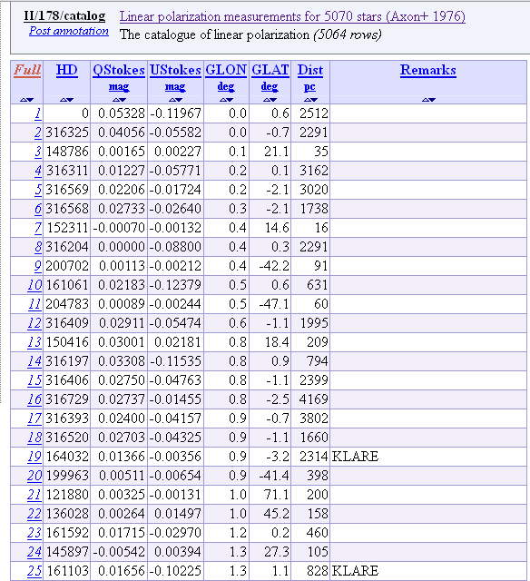
Polarized V-band Stars for In-flight Calibration of Space-borne
Solar Coronagraphs
POLARIZED STARS CATALOGUE (2)
COST MP-1104 Action Workshop Zurich, January 23 and24, 2013

Slide 17
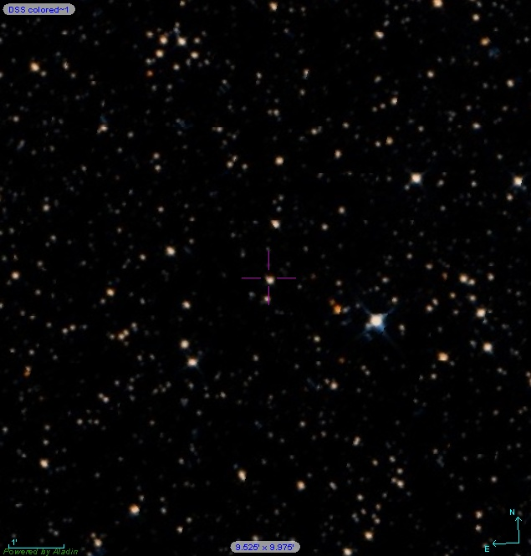
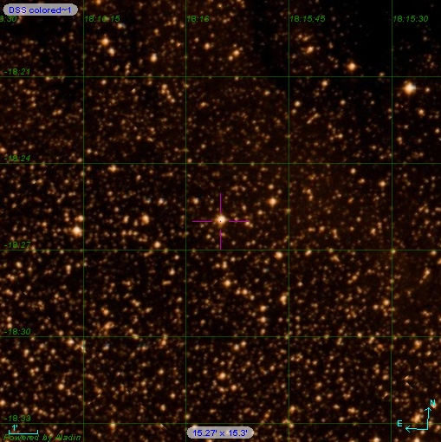
Polarized V-band Stars for In-flight Calibration of Space-borne
Solar Coronagraphs
POLARIZED STARS CATALOGUE/STATISTICS
HD 44537 pB: 18.9%
HD 167412 pB: 21%
Total Number of Stars: 5064
Stars with pB ≤ 1%: 2752
Stars with pB ≥ 5%: 709
Stars with pB ≥ 10%: 162
Stars with pB ≥ 13%: 35
Stars with pB ≥ 15%: 13
Stars with pB ≥ 17%: 2
COST MP-1104 Action Workshop Zurich, January 23 and24, 2013

Slide 18
Polarized V-band Stars for In-flight Calibration of Space-borne
Solar Coronagraphs
VARIATIONS of METIS FIELD of VIEW DURING THE MISSION/EXAMPLE
Movie created by A. Bemporad (INAF-Osservatorio Astrofisico di Torino)
COST MP-1104 Action Workshop Zurich, January 23 and24, 2013

Slide 19
Polarized V-band Stars for In-flight Calibration of Space-borne
Solar Coronagraphs
POLARIZED STARS in the FIELD of VIEW of METIS DURING the MISSION
The number of stars of the used catalogue matching the minimum and the maximum METIS FoV are:
Max number of Stars: 2353
Stars with pB ≤ 1%: 1469
Stars with pB ≥ 5%: 154
Stars with pB ≥ 10%: 21
Stars with pB ≥ 13%: 6
Stars with pB ≥ 15%: 4
Stars with pB ≥ 17%: 2
Min number of Stars: 301
Stars with pB ≤ 1%: 171
Stars with pB ≥ 5%: 31
Stars with pB ≥ 10%: 3
Stars with pB ≥ 13%: 0
COST MP-1104 Action Workshop Zurich, January 23 and24, 2013

Slide 20
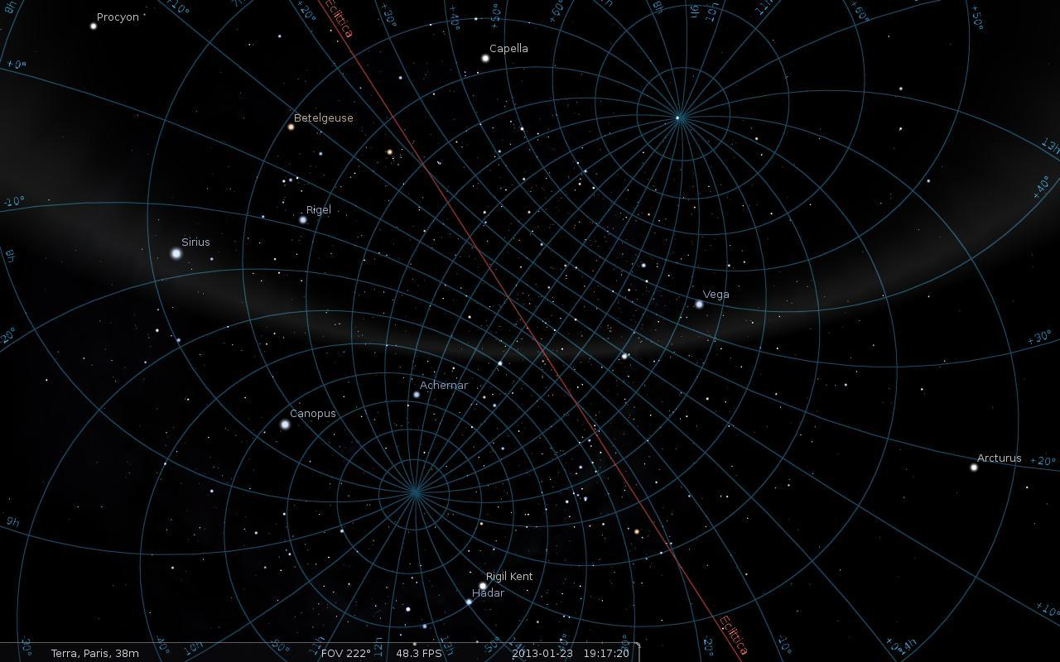
Polarized V-band Stars for In-flight Calibration of Space-borne
Solar Coronagraphs
POLARIZED STARS in the FIELD of VIEW of METIS DURING the MISSION(2)
COST MP-1104 Action Workshop Zurich, January 23 and24, 2013

Slide 21
Polarized V-band Stars for In-flight Calibration of Space-borne
Solar Coronagraphs
NOTES on the REFERENCES SYSTEMS
Standard Heliocentric Coordinate Systems
HAE: Heliocentric Aries Ecliptic
•X=First point in Aries
•Z=Ecliptic North Pole
(Can use either J2000 ecliptic, or mean ecliptic of date (D))
HEE: Heliocentric Earth Ecliptic
•X=Sun-Earth line
•Z=Ecliptic North Pole
(Based on mean ecliptic of date (D))
HEEQ: Heliocentric Earth Equatorial
•Z=Solar rotation axis
•X=intersection of solar equator and central meridian as seen from Earth
(Related to heliographic coordinates, as seen from Earth)
•HCI: Heliocentric Inertial
•Z=Solar rotational axis
•X=Solar ascending node on ecliptic of J2000
(Used by Ulysses mission)
COST MP-1104 Action Workshop Zurich, January 23 and24, 2013

Slide 22
Polarized V-band Stars for In-flight Calibration of Space-borne
Solar Coronagraphs
WORK in PROGRESS and OPEN POINTS
Check for time variability of the polarized stars in the FoV;
Selection for magnitude of stars in the FoV;
Choose the “best” star for the in-flight calibrations;
Others strongly linearly polarized targets (planets, comets,…)?
COST MP-1104 Action Workshop Zurich, January 23 and24, 2013

Slide 23
Polarized V-band Stars for In-flight Calibration of Space-borne
Solar Coronagraphs
REFERENCES and BIBLIOGRAPHY
Solar Orbiter web page on ESA website: http://sci.esa.int/science-e/www/area/index.cfm?fareaid=45
Solar Obiter Science web page: http://www.solarorbiter.org
METIS instrument
Antonucci, E., et al.; “Multi element telescope for imaging and spectroscopy (METIS)”, SPIE 8443-08 (2012)
Capobianco, G., et al.; “Electro-optical polarimeters for ground-based and space-based observations of the solar K-corona”, SPIE 8450-146 (2012)
Crescenzio, G., et al.; “Imaging Polarimetry with the METIS coronagraph of the Solar Orbiter”. SPIE 8443-129 (2012)
Fineschi, S. et al.; “METIS: a novel coronagraph design for the Solar Orbiter mission” SPIE
8443-127 (2012)
Polarized Stars Catalogue: http://vizier.u-strasbg.fr/viz-bin/VizieR-3
D. J. Axon and R.S. Ellis, Mon. Not. R. Astr. Soc. (1976) 177, 499-511
COST MP-1104 Action Workshop Zurich, January 23 and24, 2013

Slide 24
Polarized V-band Stars for In-flight Calibration of Space-borne
Solar Coronagraphs
CONTACTS
Gerardo Capobianco: capobianco@oato.inaf.it
Silvano Fineschi: fineschi@oato.inaf.it
COST MP-1104 Action Workshop Zurich, January 23 and24, 2013

Slide 25
Polarized V-band Stars for In-flight Calibration of Space-borne
Solar Coronagraphs
THANKS FOR YOUR ATTENTION
COST MP-1104 Action Workshop Zurich, January 23 and24, 2013

