Slide 1
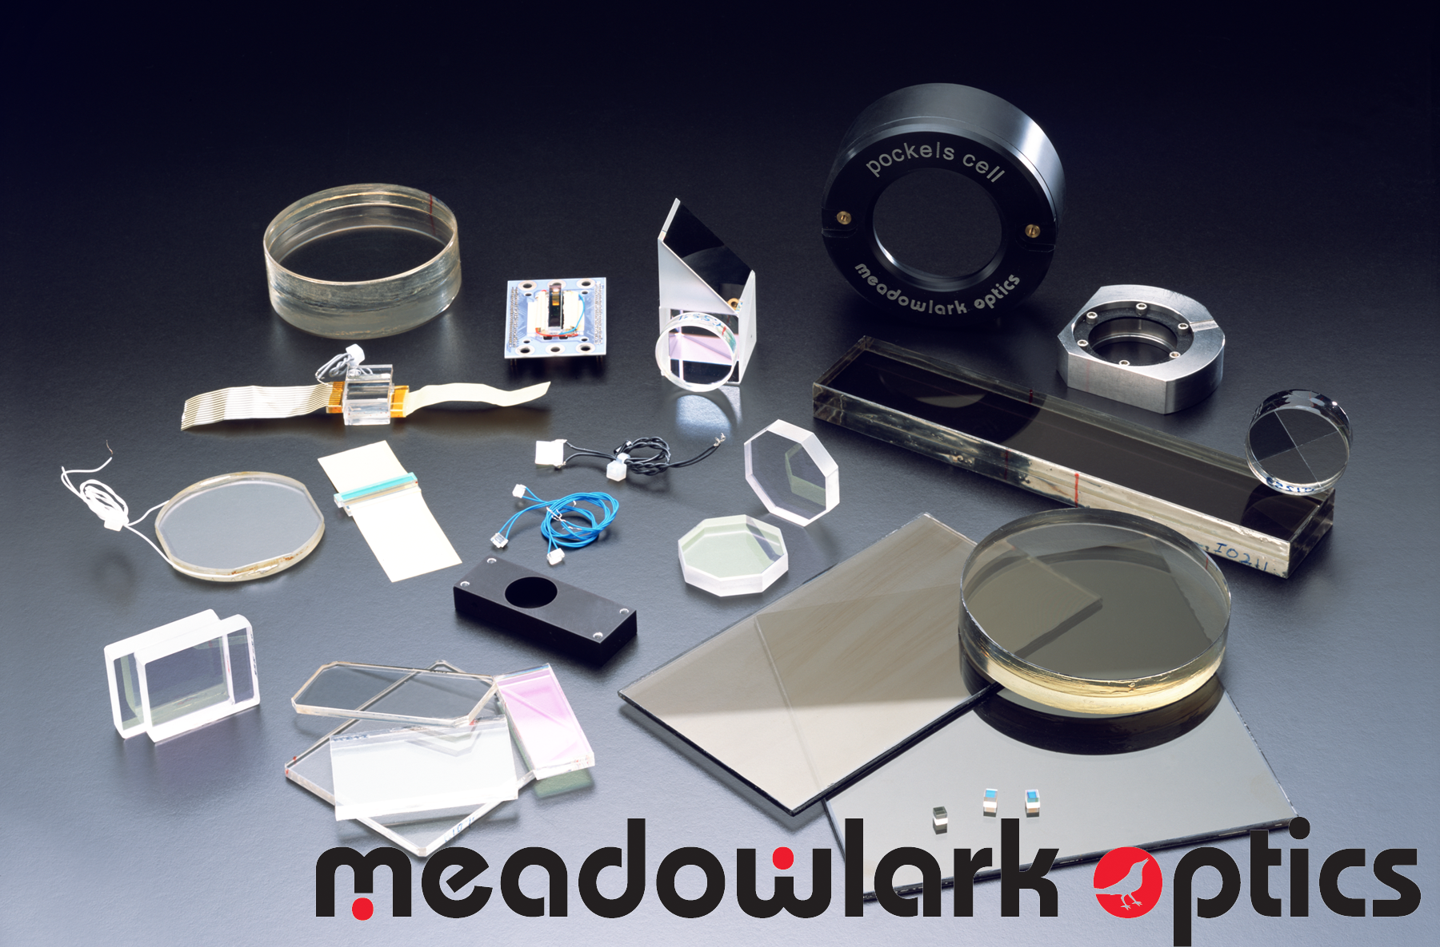
New Product Developments and Metrology for Polarization Control

Slide 2
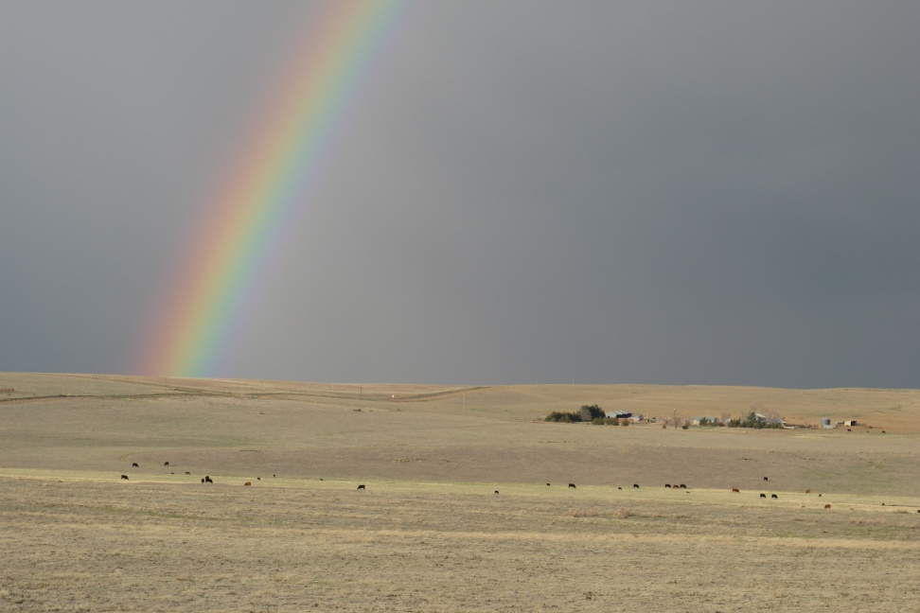
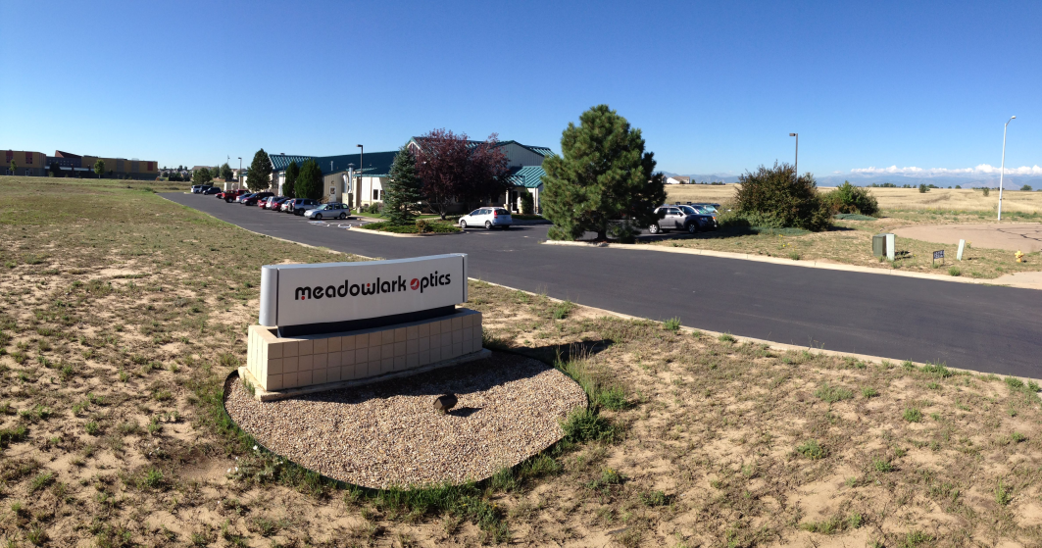
Located in Colorado USA
Home
Other Home

Slide 3
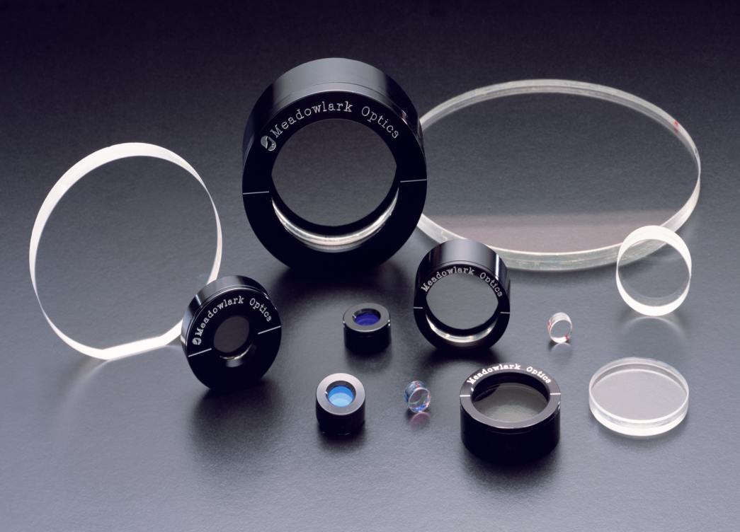
Topics
Components for polarization
Organic materials
  Liquid crystals
  Birefringent polymers
Microstructures
Applications
Metrology

Slide 4
Polymer Retarder Quality
Transmitted wavefront error less than 1/8 wave at 633 nm PP
Damage threshold above CW in visible
Beam deviation below 10 seconds
Space qualified
High transmission from 300 nm to 2700 nm
As thin as 10 microns unlaminated
Retardance accuracy to ±0.003 waves

Slide 5
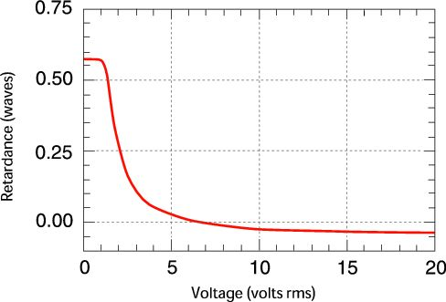
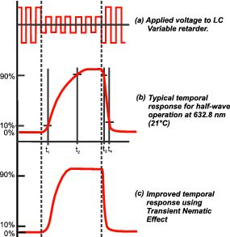
Nematic Liquid Crystal Quality
Transmitted wavefront error less than 1/8 wave at 633 nm PP
Space qualified
Tolerant to fusion class laser power levels
Some AC voltage ripple
Variable retardance selectable to 0.001 waves or less
Retardance switching times of a few milliseconds (100 microseconds for ferroelectric liquid crystals)
Some in plane axis rotation with voltage
Useful as variable retarders, shutters and polarization rotators.
Asymetric field of view.

Slide 6
Nematic LC Variable Retarder Construction
Cross Section
With Voltage Applied

Slide 7
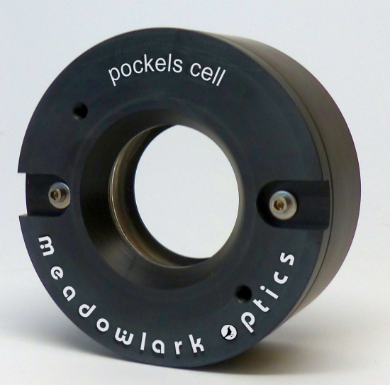
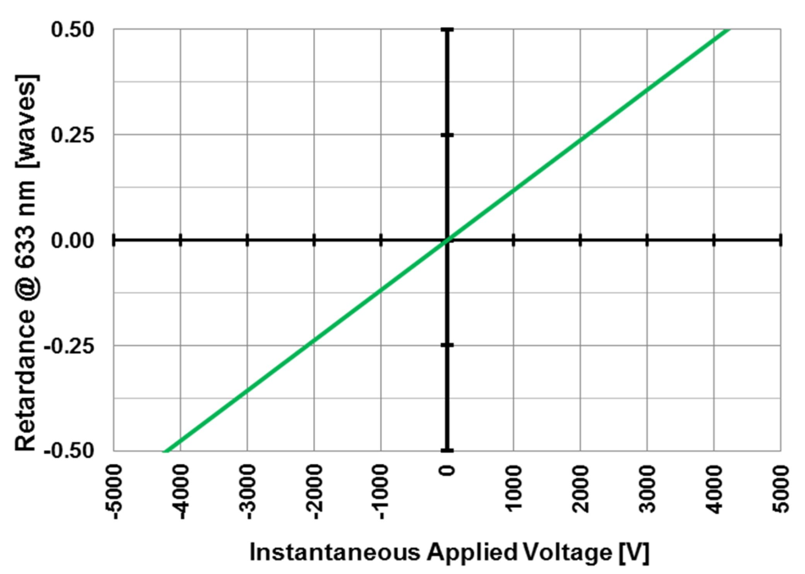
Pockels Cells
Response times of picoseconds
High voltage, DC balanced
Limited angular field (f/20)
Apertures to 40 mm at Meadowlark, 1 meter at NIF.
Piezoelectric problems

Slide 8
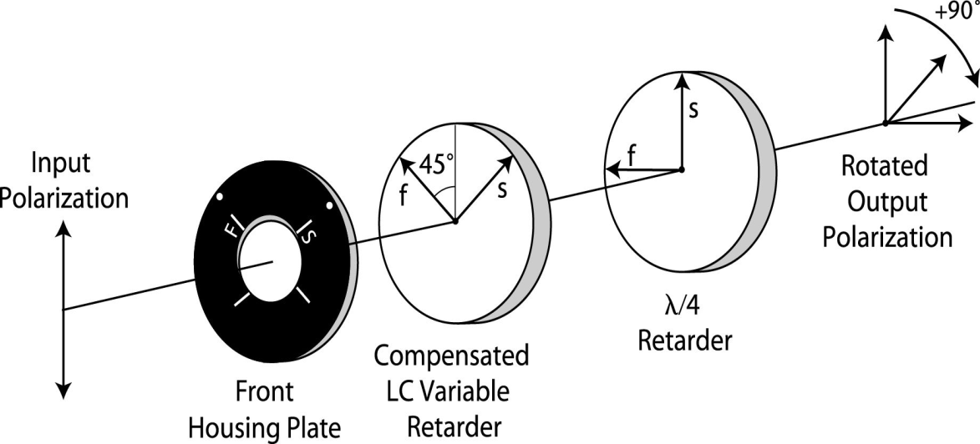
Liquid Crystal Polarization Rotators
Continuous
Binary
Monochromatic unless made with an achromatic quarter wave retarder.
Typically ~100:1 contrast ratio
Twisted nematic for angles of 0⁰ to about 270⁰
Twisted nematic are high contrast and achromatic.
Contrast exceeds 1,000:1.
Ferroelectric LC’s are fast (~100 µsec) and typically rotate through 90⁰.
Ferroelectrics are monochromatic. (Boulder Nonlinear Systems product.)

Slide 9
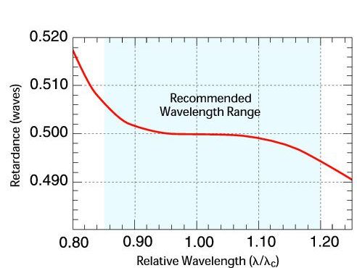
Achromatic Retarders
Pancharatnam
Bicrystalline
Generally 3 retarder stack with inner retarder rotated.
Usually 0.25 to 0.5 waves
±0.01 wave from 0.85 to 1.2x center wavelength.
Similar achromaticity to Pancharatnam
Quartz, magnesium fluoride and sapphire are common materials.
Does not have the weak dependence of fast axis direction with wavelength that Pancharatnam has.

Slide 10
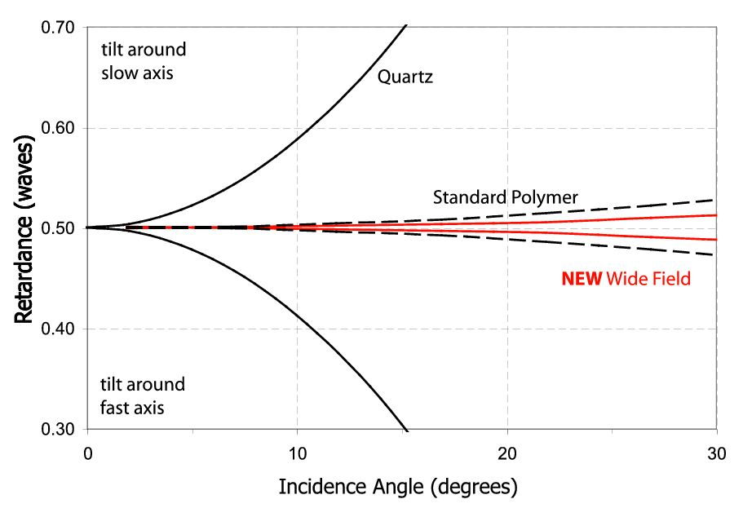
Other Retarder Types
Athermal
Dual wavelength
Wide angular field
Microstructured
Spin coated

Slide 11
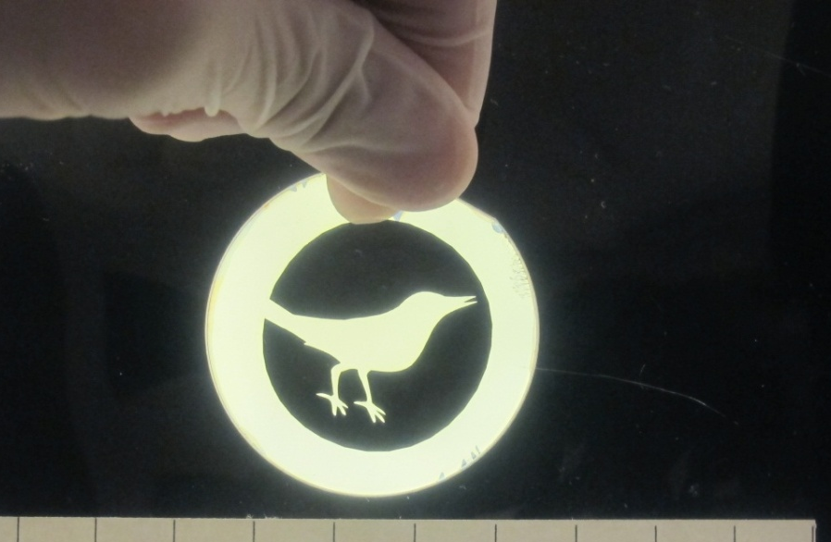
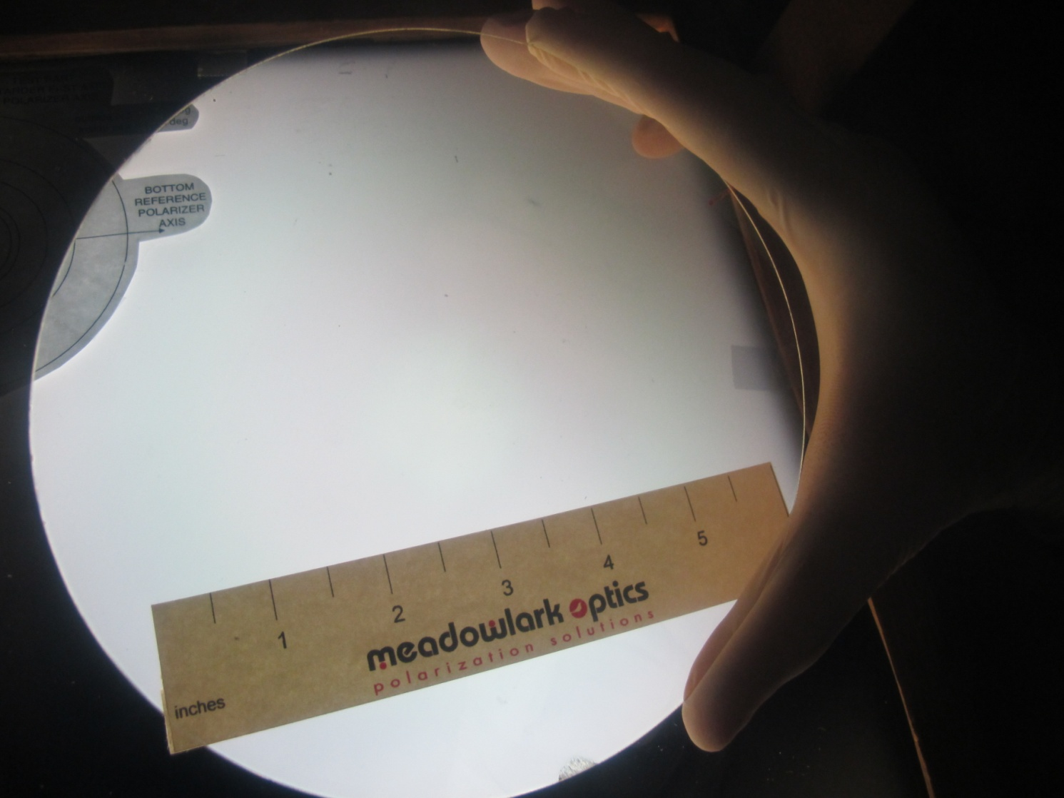
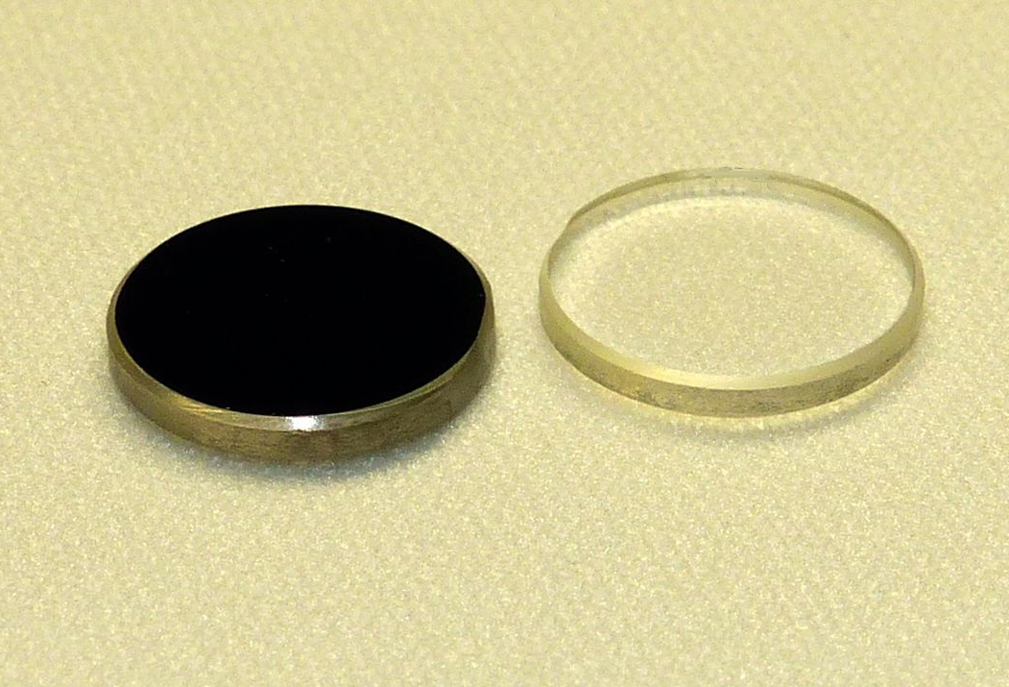
Spin Coated Retarders
Large aperture
Coated over a photoalignment layer or a buffed alignment layer.
Alignment direction set by exposure to UV polarized light which allows patterning.
May also be patterned by laser removal.
May be applied to mirrors and lenses.
Thickness less than 10 microns.

Slide 12
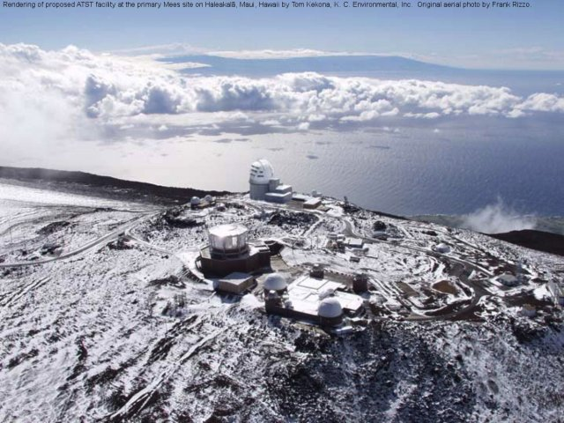
DKIST Retarders
Advanced Technology Solar Telescope
Polarization calibration and modulation achromatic retarders
Largest crystals ever used
Measures solar magnetic fields
Wavelengths 380 nm to 4 microns.

Slide 13
Polarizer Types
Dichroic sheet
Calcite -e.g. Glan Thompson
Wire grid or metal whisker
Beamsplitting
Radial and azimuthal
Micropatterned
Circular

Slide 14
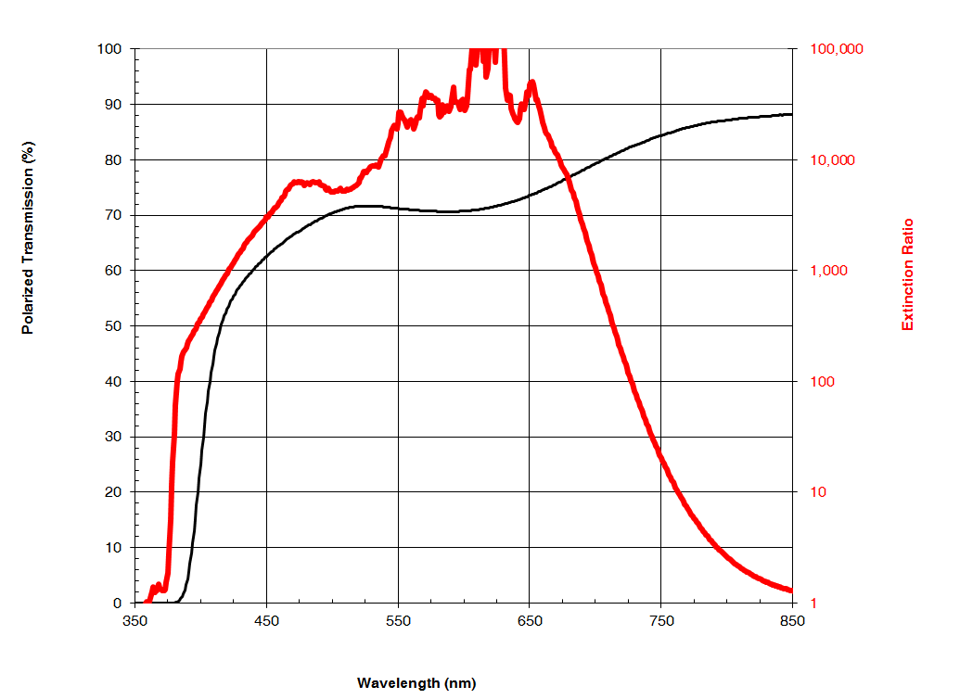
Dichroic Sheet Polarizers
High contrast in visible wavelengths
Can be high optical quality when glass laminated.
Low power only
Limited UV and IR offerings.

Slide 15
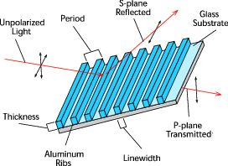
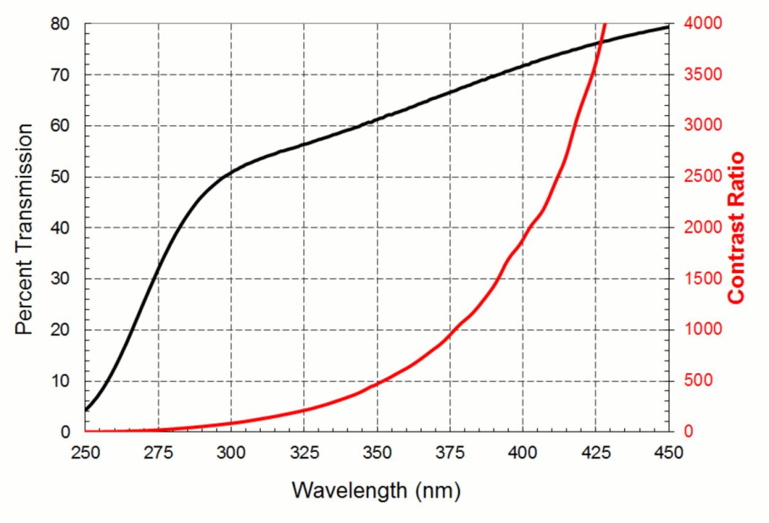
Wire Grid Polarizers
70 nm period
Moxtek product
1.15 mm maximum substrate thickness limits flatness.
Fused silica version works well to 2.7 microns.
Available on silicon for use to 15 microns.
Delicate wires unless overcoated.
Power tolerant plate polarizer- used in LCD projectors.
Infrared versions on silicon wafers work well to 15 microns.

Slide 16
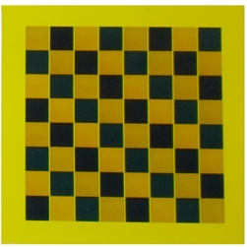
Patterned Polarizers and Retarders
Polarizers from Moxtek and Codixx
Retarders from Michael Escuti ( Imagine Optics) and from Beam Engineering. Some also from Meadowlark.
Photo courtesy of Codixx

Slide 17
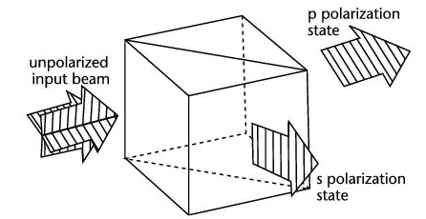
Beamsplitting Polarizers
Wire grid
  Pol. Direction set by wire direction (arbitrary)
  Wide field of view
  Very broad band
  10% + of light absorbed
MacNeille
  Thin film stack
  Narrow field of view
  Pol. direction rotates with angle of incidence

Slide 18

Azimuthal and Radial Polarizers
Continously variable polarization direction.
Available from ArcOptix in Switzerland and nanophoton in Japan.
Custom products from Meadowlark as well.
Radial sometimes called z polarizers.
Photo courtesy of ArcOptix.

Slide 19
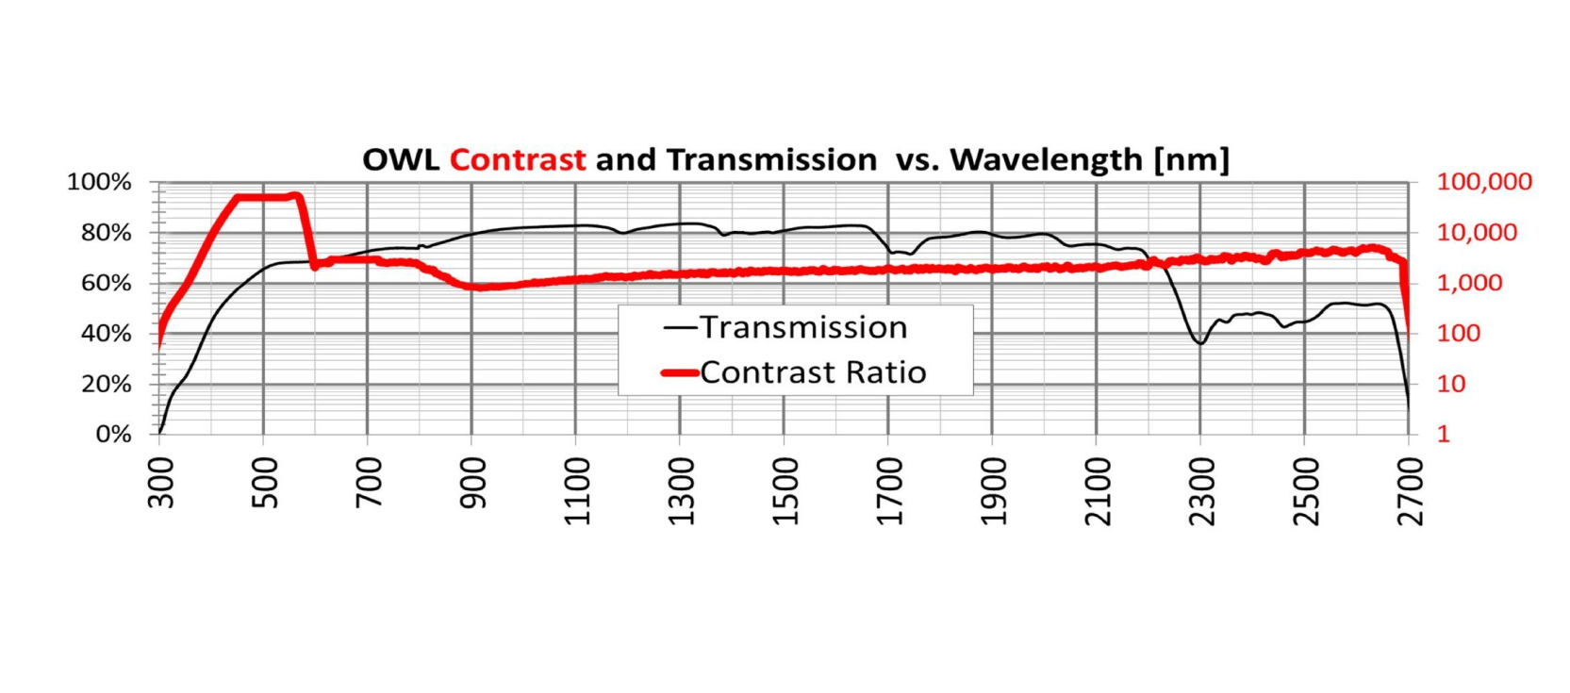
OWL Polarizer
Wide wavelength range.
Apertures to 12 cm.
Competes with calcite polarizers.

Slide 20
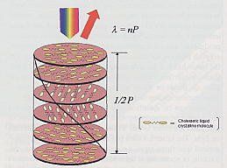
LC Circular Polarizers
Made by adding a chiral dopant to a nematic LC
Reflected and transmitted beams are circularly polarized over a λ range proportional to the birefringence.
Used as optical isolators in fusion class lasers at LLE at U. of Rochester.
Figures courtesy of S. Jacobs, K Marshall and K. Wozniak at above org.

Slide 21
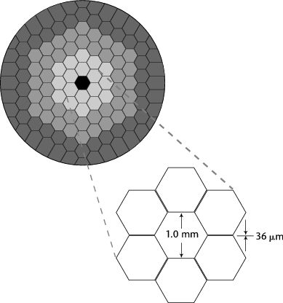
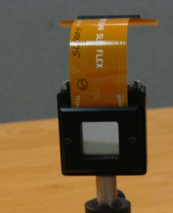
Spatial Light Modulators
(Electrically Patterned Variable Retarders)
Reflective
Transmissive
Large pixel count – more than 1Kx1K.
Liquid crystal on a silicon backplane 1cm-2 cm dimensions.
Available from Holoeye, Boulder Nonlinear Systems and Hamamatsu.
Low pixel count (128 – 256).
Larger sizes possible.
Custom configurations less expensive.

Slide 22
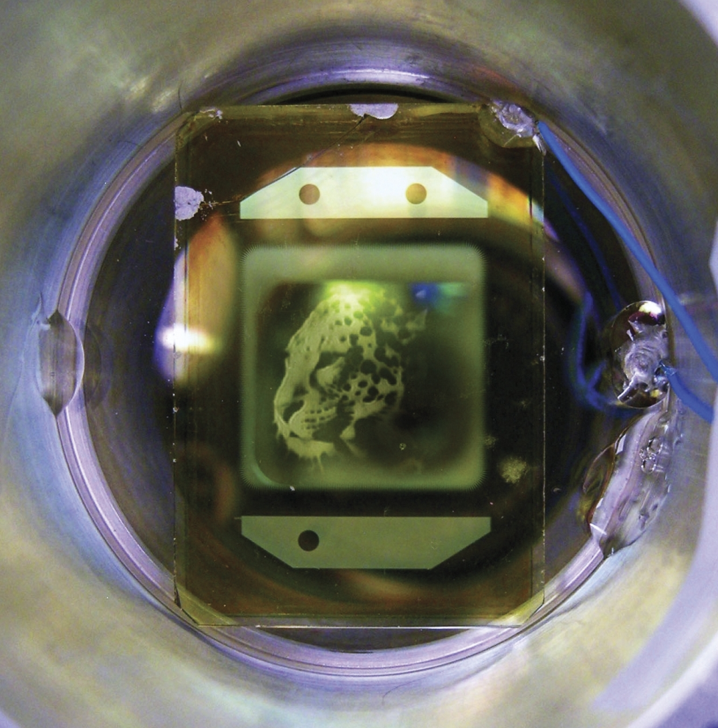
Optically Addressed SLM
Winner of R&D 100 Award
Blue write beam controls infrared beam.
For National Ignition Facility
Increases power tolerance of optics 10x+.

Slide 23
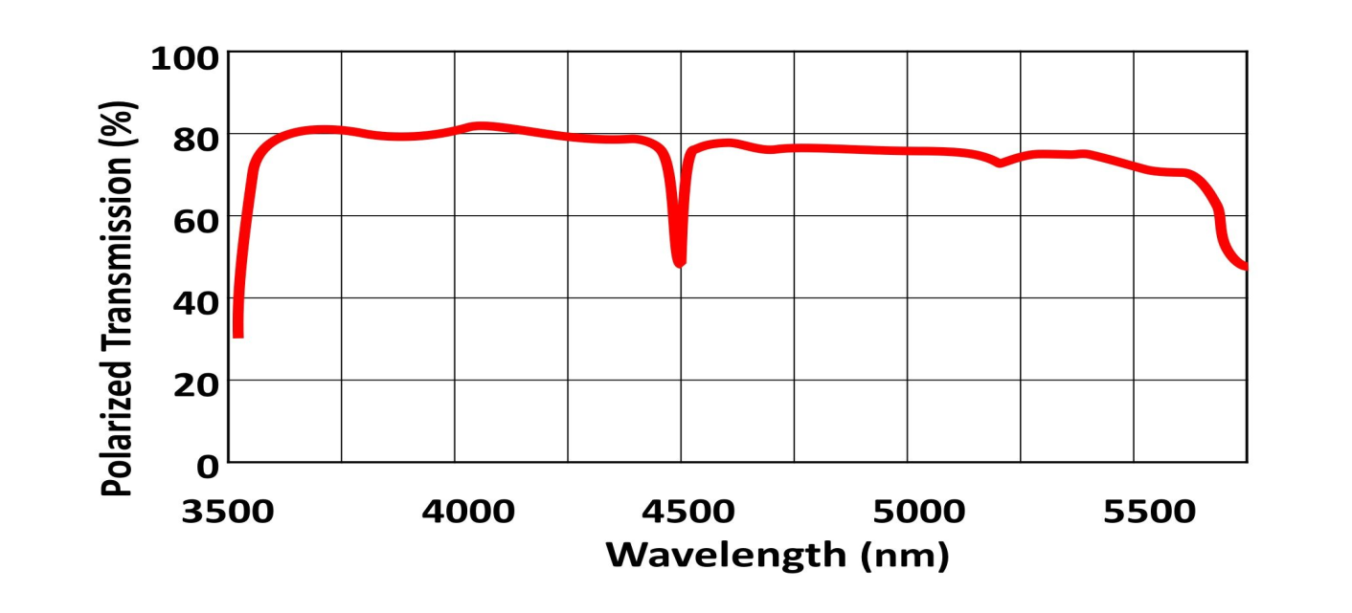
MWIR LC Variable Retarder
New product from Meadowlark Optics
Can be used with Moxtek IR polarizers for polarimetry or attenuator applications.
Maximum retardance exceeds half wave at a wavelength of 4 microns.

Slide 24
MWIR LC Transmission

Slide 25
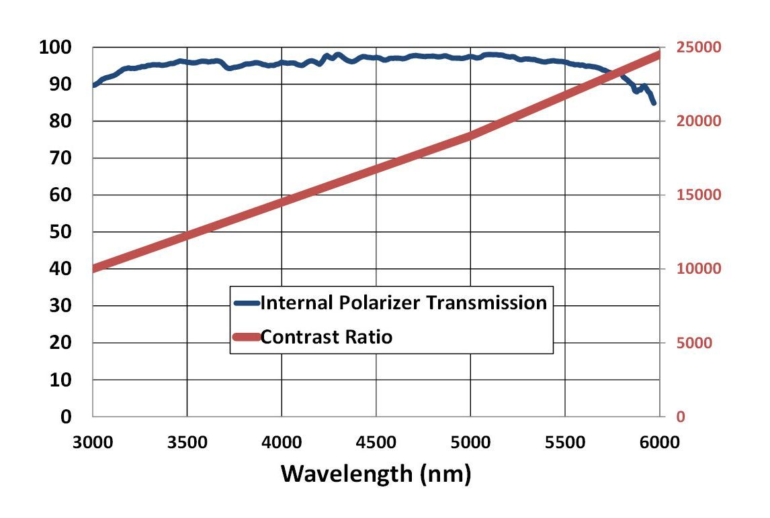
IR Wire Grid Polarizer
Moxtek wire grid on silicon wafer.

Slide 26
Infrared Bicrystalline Achromatic Retarders

Slide 27
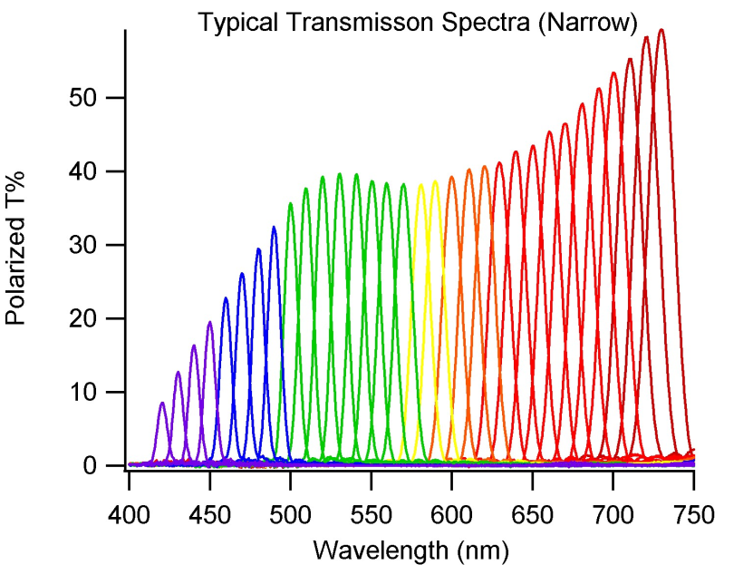
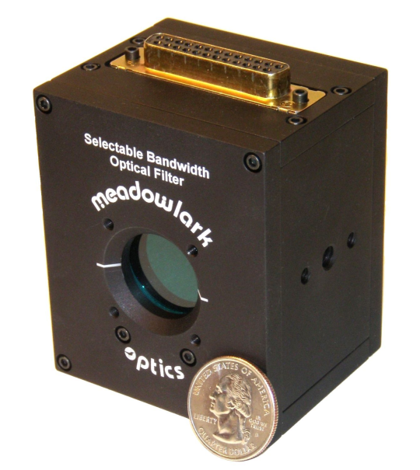
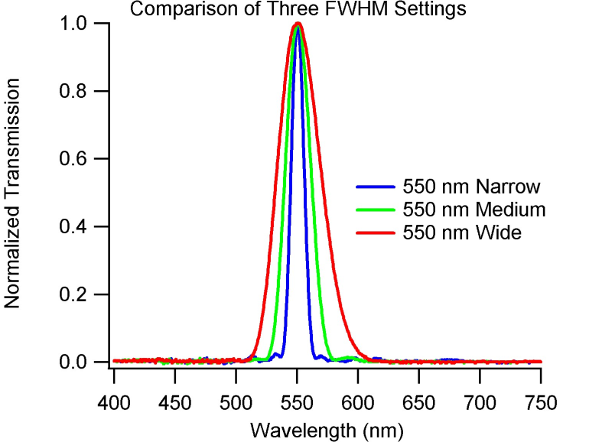
Applications – Tunable Filters
Wavelengths from 280 nm to 2.0 microns.
Bandpass FWHM from 0.02 nm to 200 nm.
Clear apertures from 2 mm to 30 cm.
Selectable FWHM.

Slide 28
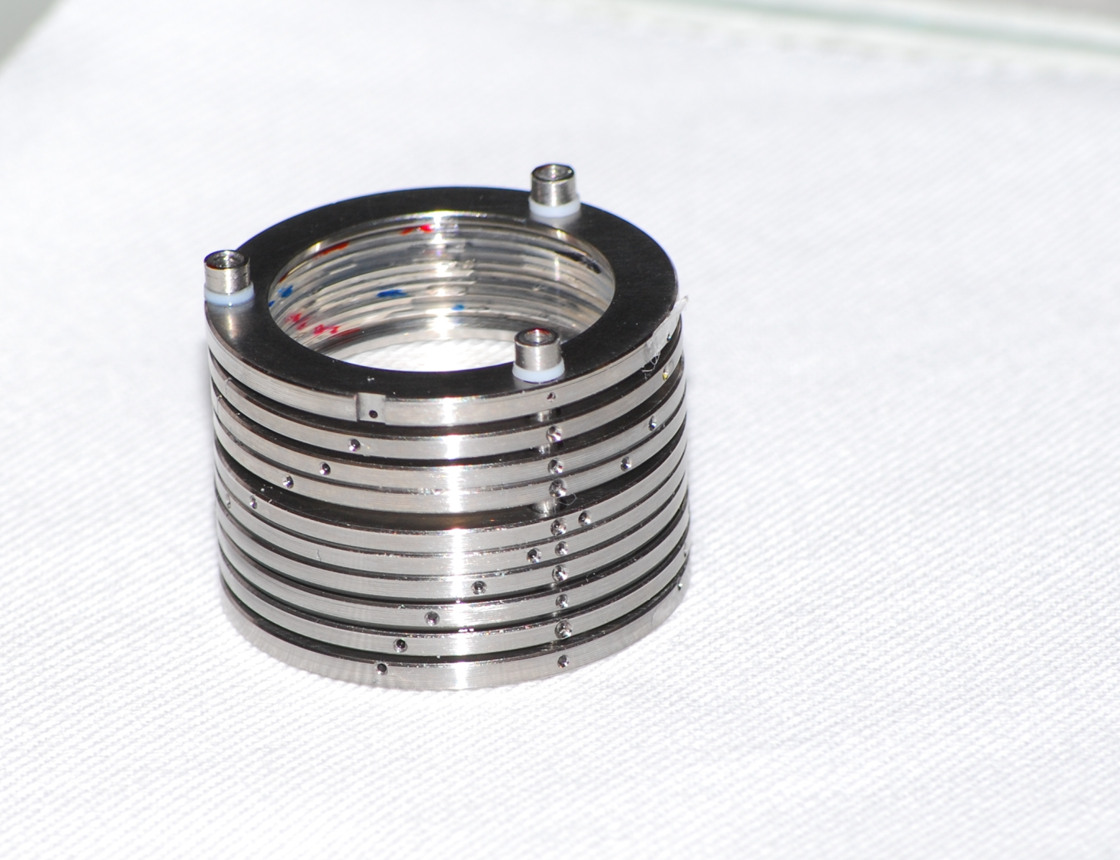
Iris Filter
In orbit June 2013
279.63±0.05 nm CWL
0.37 nm FWHM
8 element Solc
Fixed wavelength

Slide 29
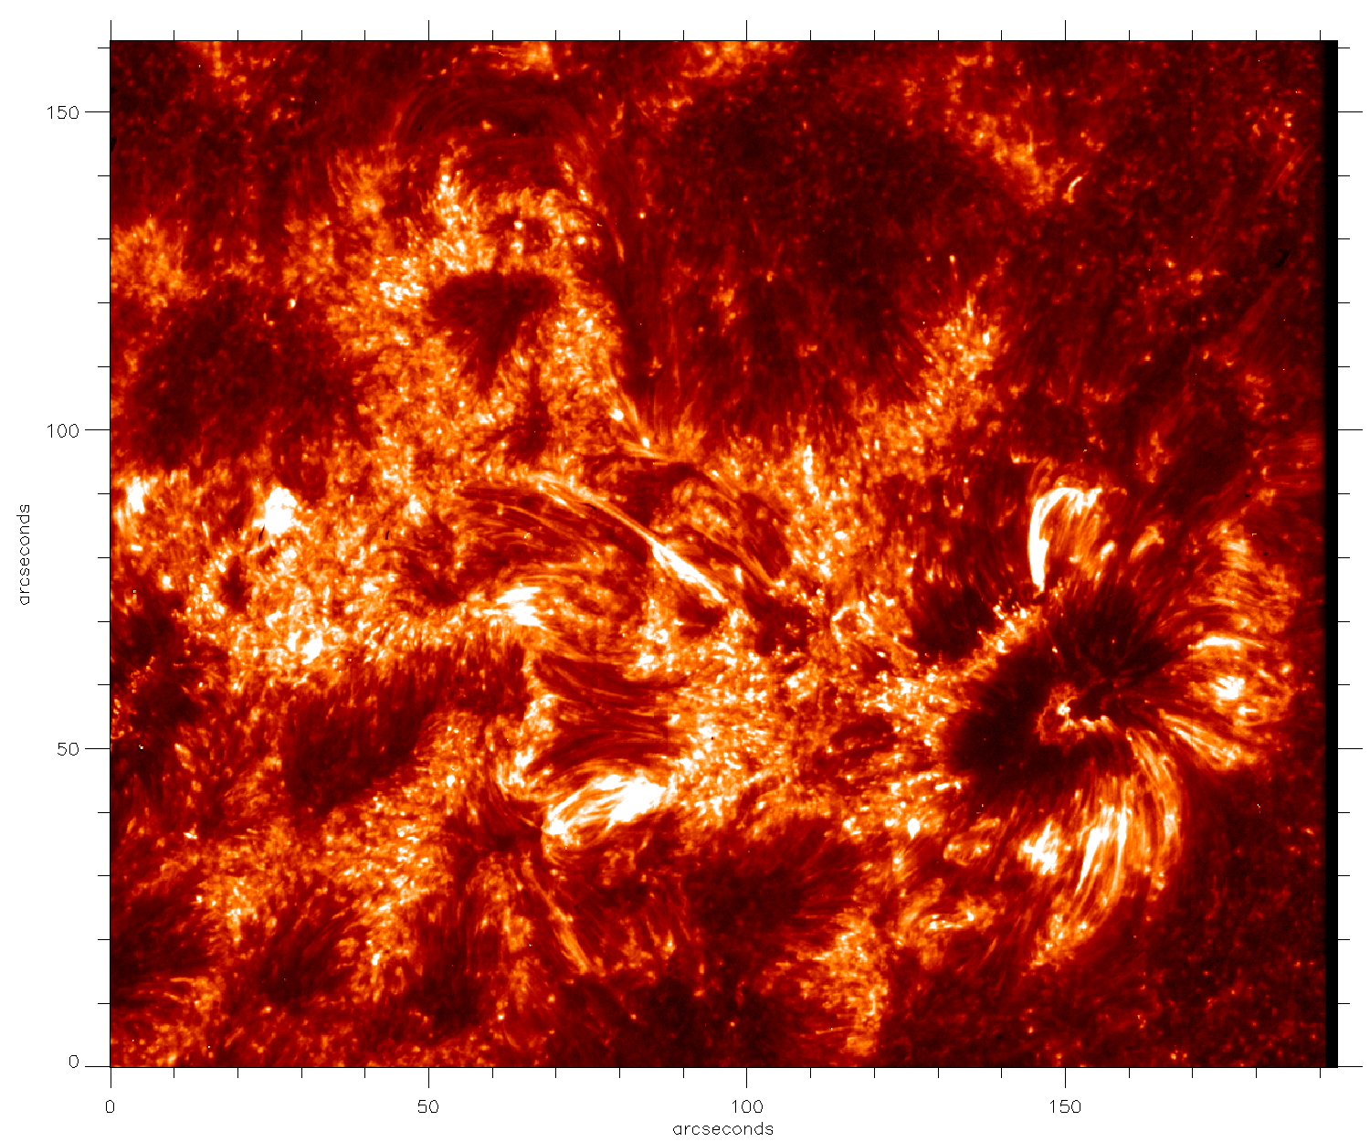
Iris Filter Solar Image

Slide 30
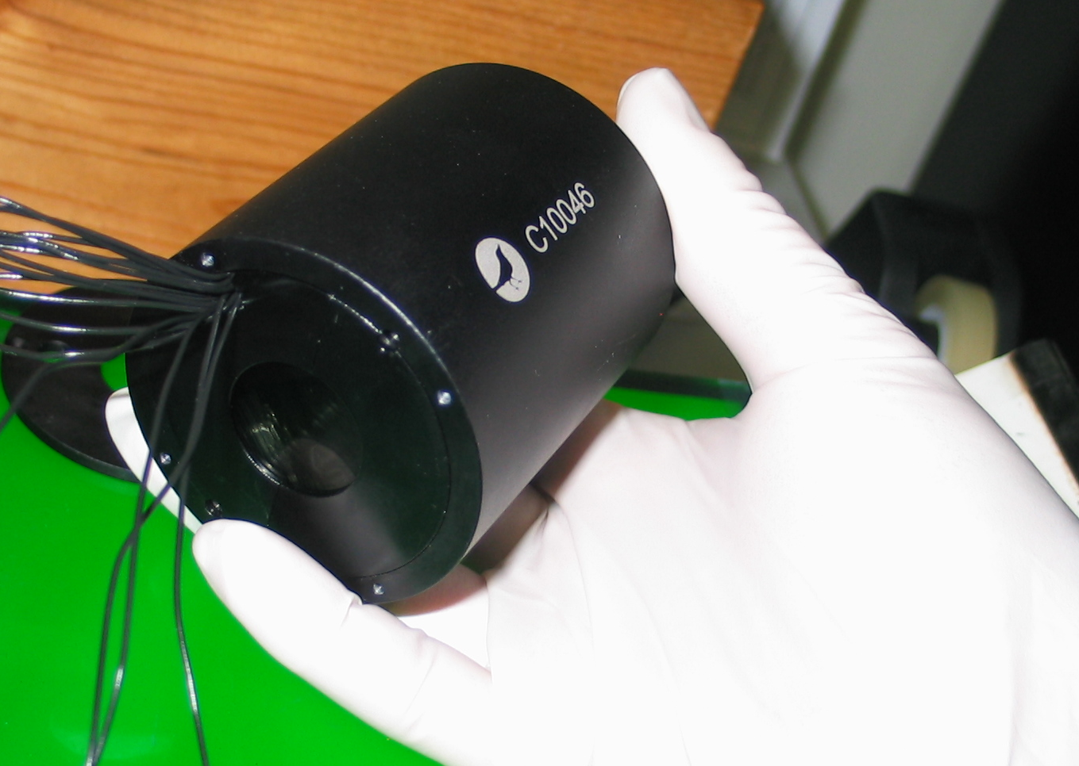
Athermal Filter and Polarimeter

Slide 31
Performance

Slide 32
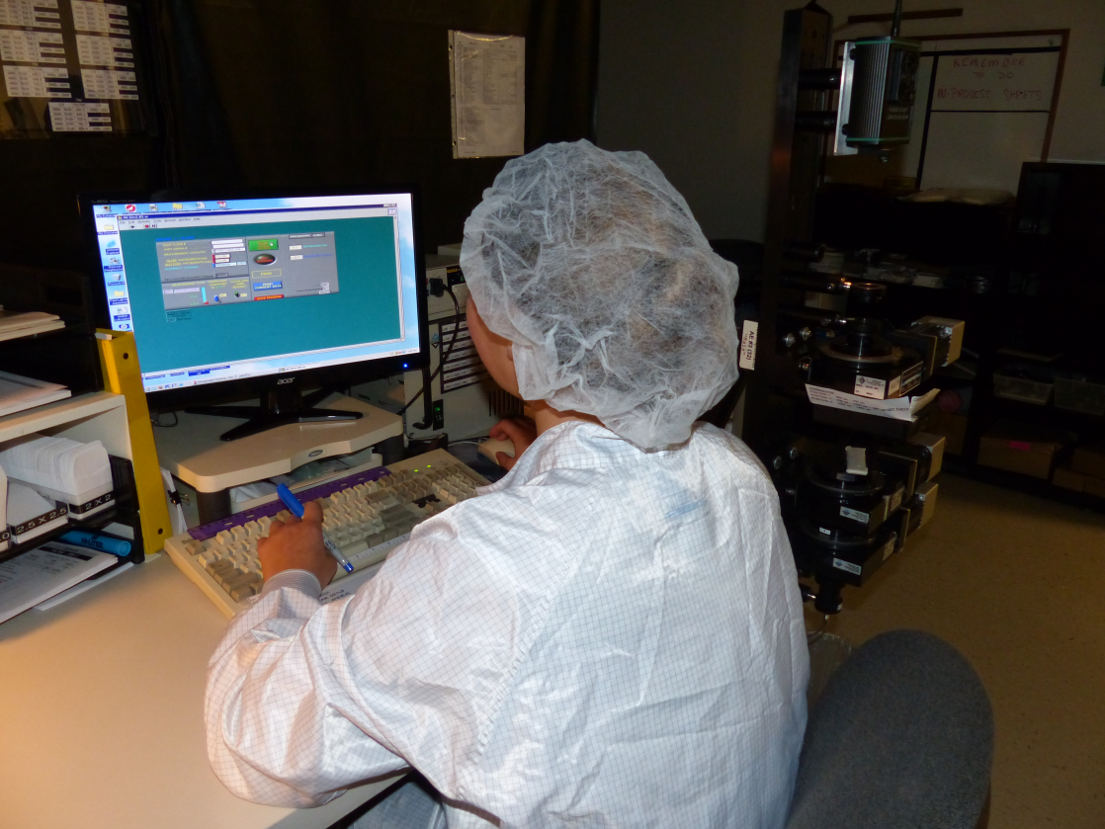
Retardance Metrology
400 nm to 1600 nm: ±0.0005 waves
250 nm to 400 nm: ±0.002 waves
1.6 to 5.8 microns: ±0.002 waves

Slide 33
Parting Thoughts
There are more “tools” in the polarization component toolbox than most know.
Tell your manufacturer what you are trying to do. Often we will have a better or cheaper solution than what you provide.
Realize that product development and maturity is driven by larger money buckets than the research bucket.
Call or email any request! Visit our plant!

Slide 36
Reference Standards- Eigenstate Generator

